Slide 1
You Are 85: Now What?
Rosanne M Leipzig MD PhD
Gerald and May Ellen Ritter Professor
Vice Chair, Education
Brookdale Department of Geriatrics and Palliative Medicine
Icahn School of Medicine at Mount Sinai

Slide 2
Reality Checks

Slide 3
Median Life Expectancy (US- all races)
At age 65
At age 85
At age 100
84.1
91.6
102.3
United States Life Tables, 2009.
Notes:
3

Slide 4
Percent of people over 85 who report good or excellent health
10
30
50
70
90

Slide 5
Percent of people over 85 who have significant limitations in vision, hearing, mobility, communication, cognition, or self-care.
10
20
30
40
50

Slide 6
Percent of people over 85 who live in nursing homes.
10
20
30
40
50

Slide 7
Reality Checks
Percent of people over 85 who report good or excellent health.
70%
Percent of people over 85 who have significant limitations in vision, hearing, mobility, communication, cognition, or self-care.
40%
Percent of people over 85 who live in nursing homes.
13%

Slide 8
Percent of people over 85 who have dementia
10
20
30
40
50

Slide 9
Percent of people over 85 who have dementia
1986–87: 29.8%
2008–10: 21.7%
30% decline over 20 years
Better educated
Fewer strokes (OR 0.66; 95%-CI: 0.50–0.86)
Brain health is heart health
Skoog, I et al Scientific Reports volume 7, Article number: 6136(2017)

Slide 10
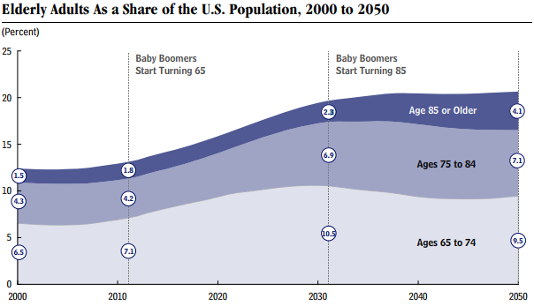

Slide 11
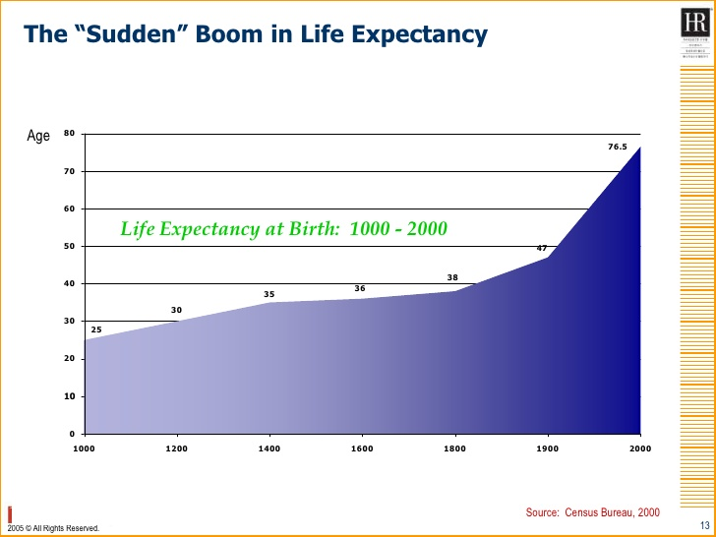
Old Age is New

Slide 12
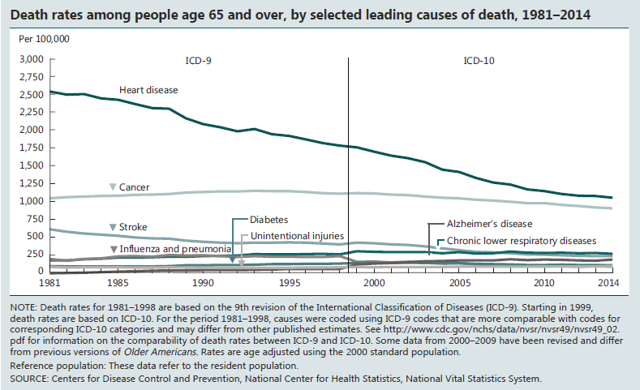

Slide 13
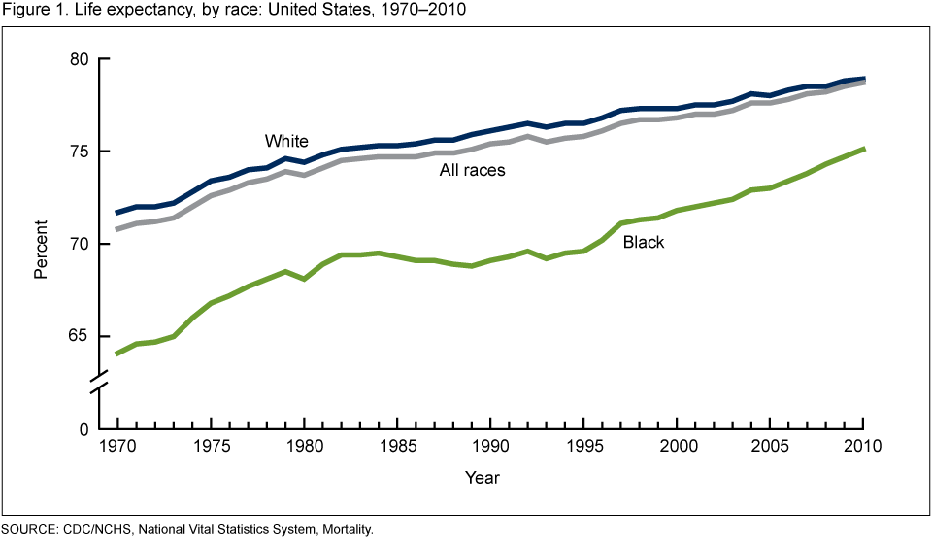
US Life Expectancy by Race 1970-2010

Slide 14
Aging 101: Normal Aging
What happens to most people as they get older

Slide 15
Aging Begins at Birth
Peak in your 30’s
Muscle mass
Bone Density
Physical Endurance
With time, most everyone
Walks more slowly
Gets a pot belly
Gets gray hair
Needs reading glasses
Has ’Senior moments’

Slide 16
Some less obvious changes
More sensitive to medications
Increased blood pressure
Balance problems
Dehydration

Slide 17
Why you become a cheaper drunk as you age
As you get older,
Higher blood alcohol concentrations
Worse for women than men
Less tolerance for quantities previously enjoyed
Brain more sensitive
Balance worse even without the alcohol

Slide 18
Who Dies During a Heat Wave?
Response to dehydration
Feel thirsty and drink
Brain releases more ADH so kidney’s retain more water
Kidneys also concentrate the urine
Heart rate increases to keep cardiac output stable (amount of blood pumped from heart into circulation).
Circulation not supported, resulting in death

Slide 19
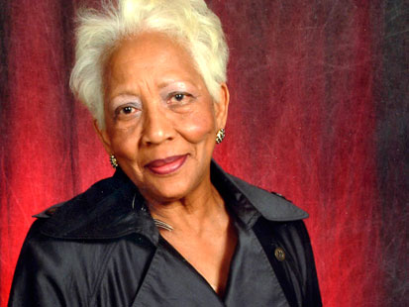
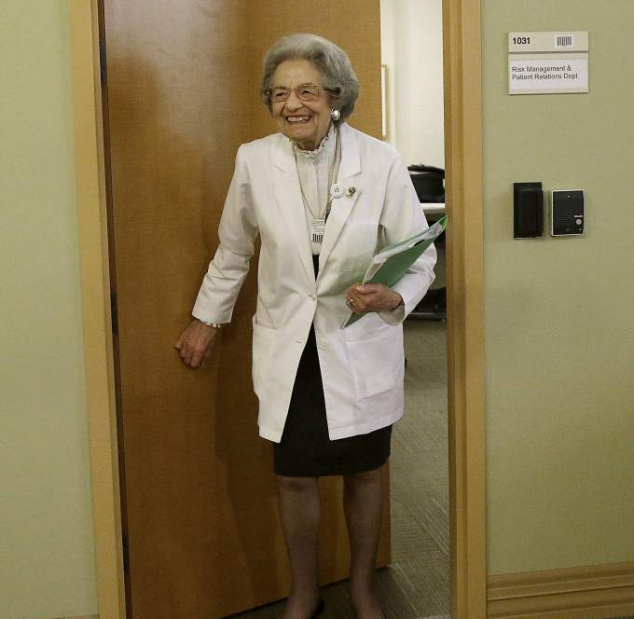
Variability in Aging: Physical and Cognitive Function
Rose
Letitia
Nancy
Notes:
Older people differ far more from each other than younger people, and individuals of the same age differ greatly in their physiologic and functional reserves and capacities, in how resilient and how vulnerable they are.
One size fits all care may work more for younger or middle aged people, but it definitely doesn’t work as you get older.
Major Take Home Point for today for anyone who cares for older adults:
Classify your patients as Fit, Frail or Vulnerable.
Rose is Fit- chronologically old (90). She needs standard care modified for age (wellness…)—to know what’s normal, what’s not, and what she can do..
Letitia is vulnerable- biologically older than Rose even though she’s only 78- she has declining capacity, having difficulty with her IADLs, she needs adapted and integrated care
Nancy is frail-- significant loss of capacity- cognitive and functional. As opposed to Rose, who is also 90, Nancy is extremely unlikely to make it to 100 (nor would she want to!)

Slide 20
Rose
90 years old
Considers her health ‘excellent’
New HTN
Good chance of making it to 100 years old
Notes:
Rose- actually this is NOT Rose– picture from the Internet, name I made up– but the stories are those of actual patients
90 years old—great shape.
Eight years ago when I became her doctor we decided to stop the statin she had been taking for years. After all, she had no risk factors for cardiovascular disease and the evidence about the benefits of statins for primary prevention was pretty unclear for those over age 80.
Now she’s developed hypertension, and last week she came in to discuss the pros and cons of restarting the statin, and the role of her pain killers in increasing her blood pressure.
Using the tool that Amy Ehrlich will discuss today, eprognosis, it’s clear that, barring something totally unexpected, she still has many years ahead of her (, she has a 60% chance of getting to celebrate her 100th birthday!)
The conversation took some time, and in the end we decided to restart the statin because she really doesn’t want a heart attack or a stroke.

Slide 21
Letitia
78 years old
PMH:
Diabetes for 40 years
Low vision from Diabetes
COPD
New Rheumatoid Arthritis
CC: pain, difficulty using hands, depressed and scared
Notes:
Letitia, a 78 year of with 40 years of insulin dependent diabetes, retinopathy and bronchiectasis, was recently diagnosed with RA with scleroderma and Reynauds, and is having pain and
difficulty using her hands for typing, cooking, and is, needless to say, very depressed and scared about all this.

Slide 22
Nancy
Just turned 90
PMH
Mild AD
COPD
SH
Lives alone
Strong social network
Closest relative NH
CC
10# weight loss, decreased exercise tolerance, more difficulty walking
Unsure what medications she’s taking
Notes:
Nancy, who has mild AD and COPD, just celebrated her 90th birthday, and
She’s been extremely independent, has no relatives in town but a close network of friends and a very involved niece who lives in NH ….
Returned from a summer in Israel with an unanticipated 10 pounds weight loss and a new feeling of having no energy
She’s having difficulty much more difficulty walking, and is unsure which medications she’s taking.
At this point I thank my lucky stars that I don't live in the world of the 15 minute primary care visit!

Slide 23
For Older Adults, One Size Fits All DOESN’T WORK
FIT
VULNERABLE
FRAIL
Notes:
Older people differ far more from each other than younger people, and individuals of the same age differ greatly in their physiologic and functional reserves and capacities, in how resilient and how vulnerable they are.
One size fits all care may work more for younger or middle aged people, but it definitely doesn’t work as you get older.
Major Take Home Point for today for anyone who cares for older adults:
Classify your patients as Fit, Frail or Vulnerable.
Rose is Fit- chronologically old (90). She needs standard care modified for age (wellness…)—to know what’s normal, what’s not, and what she can do..
Letitia is vulnerable- biologically older than Rose even though she’s only 78- she has declining capacity, having difficulty with her IADLs, she needs adapted and integrated care
Nancy is frail-- significant loss of capacity- cognitive and functional. As opposed to Rose, who is also 90, Nancy is extremely unlikely to make it to 100 (nor would she want to!)

Slide 24
Do I Need to Do Everything My Doctor Advises?
The simple answer……No
Especially if 85 or older
Evidence-free zone often
Combinations of medications and conditions
Nearly 50% of older adults take one or more medications that are not medically necessary
Particularly true for preventive medicine, both medications and screening
Will you live long enough to benefit??
Your health and healthcare are in service to your ability to live a life that’s meaningful to you
Helpful care
Burdensome care

Slide 25
What’s meaningful to you?
Lifespan
Healthspan
Connecting with others, enjoying life
Independence and Quality of life
Will I be able to live independently?
Will I be able to get around on my own?
Will I suffer?

Slide 26
Have a Health Care Proxy
Who knows what’s meaningful to you!
Don’t just put down and name, have a discussion with them about what you want and what really matters.

Slide 27
Major Concern: Cognitive Functioning
Allows you to:
Learn and remember new things
Things you hear, see, think and experience
Pay attention
Communicate with others.
Speaking and understanding
Visualize things in space
Putting together a jigsaw puzzle
Finding your parked car.

Slide 28
How a Memory is Made
Acquisition
Hearing
Encoding
Storage
Vision
Working Memory
Short-Term Memory Storage
Central Executive
Long-Term Memory
Consolidation
Permanent Storage
Sensory Memory
Taste
Attention
Smell
Touch
Retrieval
1. Anything that interferes with your sensory abilities or your ability to pay
attention can affect your ability to create a new memory
2. Try hearing aids: fewer than 30% of adults over 70 who could benefit
from hearing aids have ever used them

Slide 29
Executive Functions
Problem solving
Making decisions
Setting goals
Planning
Quickly processing new information.

Slide 30
Cognitive changes with Normal Aging: The Good News
Not all cognitive functions decline with aging.
Knowledge you learned years ago and procedures, like how to ride a bike, or brush your teeth stay with you.
When you learn something new and can remember it, you don’t forget it any more rapidly than when younger.
Attention span, ability to maintain attention, language comprehension, usage, and vocabulary don’t decline.

Slide 31
Aging Begins at Birth: Your Mind
Peak in your 30’s
Word Finding
Learning Lists
Doing calculations in your mind

Slide 32
Cognitive Changes with Normal Aging
Takes greater effort to learn new things—more attention, repetition, and strategies.
Less able to multitask.
Processing takes longer:
Reaction times are slower
Poorer performance when working under time pressure.
More difficult to manipulate information in the brain,
Calculating the tip in a restaurant,
Balancing a checkbook
Figuring out the route to get from one place to another.
Retrieving known information can be a struggle: the oft called “senior moment.”

Slide 33
Is this Normal Aging or Alzheimer’s Dementia?
If you’re concerned about your memory, AND
are able to recall something, even if you need a cue or you pick it out from a list of possibilities,
you have evidence that the information was successfully stored.
This is not Alzheimer’s Disease.

Slide 34
A Word about DELIRIUM
Delirium is a medical urgency
A sudden change in cognition
Primarily a problem with attention and awareness
Reduced ability to direct, focus, sustain, and shift attention
May nod off or be agitated
Delirium is a temporary situation

Slide 35

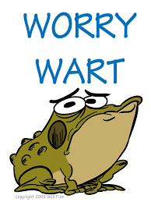

Individuals React Differently to Aging

Slide 36
The Aging Soul
Lots of losses
People
Abilities
Environments
How to adapt?
How to find meaning?
How to cultivate gratitude?

Slide 37
The Good News: Aging is Not All Downhill!
Less insecure
Say and do what you want
More likely to see the big picture
Time is limited, so greater focus on the present and what’s really important
More emotional control, intense negative emotions happen less often
Increased wisdom, including a store of coping mechanisms and problem solving strategies
Notes:
Attitude and psychological reserve

Slide 38
Make Peace with Aging
Grant me the serenity to accept
the things I cannot change,
The courage to change the things I can,
And the wisdom to know the difference.
Reinhold Niebuhr

Slide 39
Adapting to One’s New Normal
A glass half-full, with potential, not half-empty because you’re not able to do everything you were once able to do.
Oftentimes it’s how you react, not what’s actually happening, that makes life difficult.
Have a sense of humor, especially about those things that scare you or you can’t control.
Cultivate gratitude for what your life has been, and be creative going forward.
Notes:
Don’t see later life as a glass half-empty because you’re not able to do everything you were once able to; envision it as a glass half-full.
Oftentimes it’s how you react, not what’s actually happening, that makes life difficult. Losses of loved ones, functional abilities, roles, and even familiar environments are inevitable parts of aging. You could respond with anger and grief, be resentful and isolate yourself, and refuse to accept help or make changes. But these reactions aren’t going to reverse time, in fact they’re likely to make you more miserable. Have you ever noticed how many comedians live and continue performing well into old age, and that they are often the butts of their jokes? Having a sense of humor, especially about those things that scare you or you can’t control, can help when facing the unknown. Oy joke……

Slide 40
Seven Rules for Aging Well
Resist ageism
Assumptions that older people are less competent than younger people.
Has a huge negative impact on older people.
Become self-fulfilling prophecies resulting in worse memory, hearing and physical function than in those exposed to positive stereotypes.
What to do:
Cultivate a positive attitude toward aging
Speak up when you hear or see negative aging stereotypes, and surround yourself with positive role models for aging, whether in person, or in the media (watch Grace and Frankie, not Will and Grace!).
Notes:
For older people, their loved ones, and their care partners- personal and professional.

Slide 41
Seven Rules for Aging Well
Resist ageism
Rightsize your expectations
Become resilient (adaptable, flexible)
Never say never
Advocate for yourself
Select, optimize and compensate (SOC)
Get a doctor who knows the difference between caring for 80-year-olds versus 50-year-olds!
Notes:
For older people, their loved ones, and their care partners- personal and professional.
Moishe

Slide 42
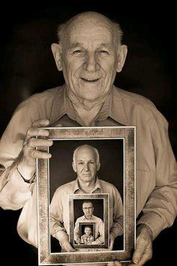
You Are 85: What’s Next?

