Slide 1
Constraints on the nuclear symmetry energy from transport equations
Daniel Coupland
Michigan State University
National Superconducting Cyclotron Laboratory
NuSym11
June 20, 2011

Slide 2
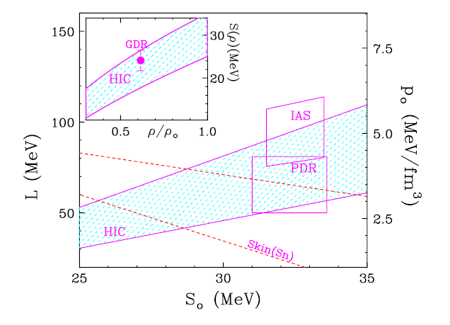
Subsaturation Constraints
To improve these constraints:
Can we understand the model dependencies?
Can we understand the parameter dependencies?
What can we measure?
M.B. Tsang, Prog. Part. Nucl. Phys 66, 400 (2011)
Notes:
Connection to liquid drop formula, uncertainty
B = a_{V}A-a_{S}A^{2/3}\pm\varepsilon-a_C\frac{Z(Z-1)}{A^{1/3}}
-C_{sym}
\frac{(A-2Z)^{2}}{A}
2

Slide 3
Dynamic Transport Models
Need dynamic models to describe dynamic system
  Nucleons moving in a self-consistent mean field (isoscaler, isovector, momentum dependence)
  Nucleon-nucleon collisions (in-medium cross section reduction)
  Fragment/cluster formation
  Excited baryon / pion production

Slide 4
Model types and codes
Boltzmann | Molecular Dynamics
Many test particles / nucleon | One particle / nucleon, with finite width
Fragments from mean-field instabilities → suppressed for many test particles / nucleon | Fragments from N-body correlations
Collision rearranges test particle → smaller fluctuations | Collision rearranges whole nucleon → larger fluctuations
Partial Pauli blocking of test particles → less restrictive | Pauli blocking of whole nucleons → more restrictive
 | Light clusters | Isovector Momentum Dependence
ImQMD05 | N-body correlations | No
pBUU | A < 4 | No
IBUU04 | No | Yes
Notes:
boltzmann vs molecular dynamics
N-body correlations in MD → fragments from correlations
no N-body correlations other than collisions in boltzmann → fragments from mean-field instabilities (spinodal decomposition)
many test particles in boltzmann → smooth out fluctuations
mean field not adequate in MD? (Bill)
MD Pauli blocking of whole nucleons → more restrictive, fewer collisions

Slide 5
This study
Vary parameters (input physics) within pBUU to study effect on isospin diffusion
Don’t try to establish constraints
Systems: ^{124,112}Sn + ^{124,112}Sn
E_{beam} = 50 MeV/nucleon
800 test particles/nucleon → fluctuations reduced

Slide 6
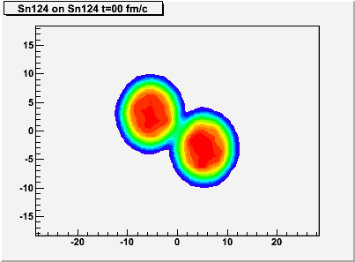
Isospin Diffusion
Probe the symmetry energy at subsaturation densities in peripheral A + B collisions, e.g. ¹²⁴Sn + ¹¹²Sn
Isospin diffusion through low-density neck region – sensitive to E_{sym}(ρ₀/2)
Non-isospin diffusion effects:
Pre-equilibrium emissions
Sequential decays
Coulomb effects
Figure courtesy M. Kilburn

Slide 7





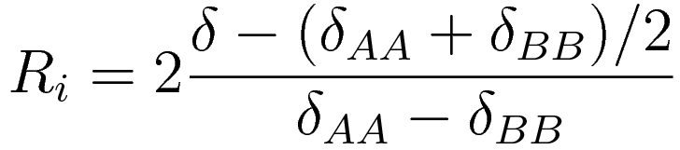
Isospin Transport Ratio
Isospin diffusion occurs only in asymmetric systems A+B
124
112
No isospin diffusion between symmetric systems
124
112
124
112
Non-isospin diffusion effects
same for A in A+B & A+A; same for B in B+A & B+B
Rami et al., PRL, 84, 1120 (2000)
δ = (ρ_{n}- ρ_{p})/ (ρ_{n}+ ρ_{p}) = (N-Z)/A

Slide 8
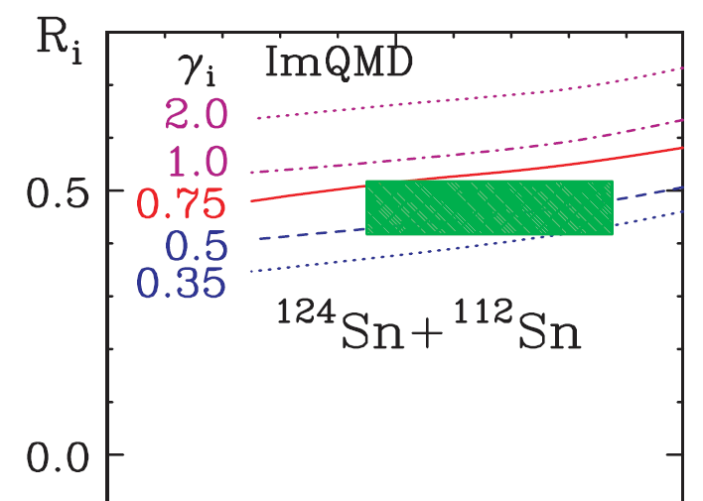
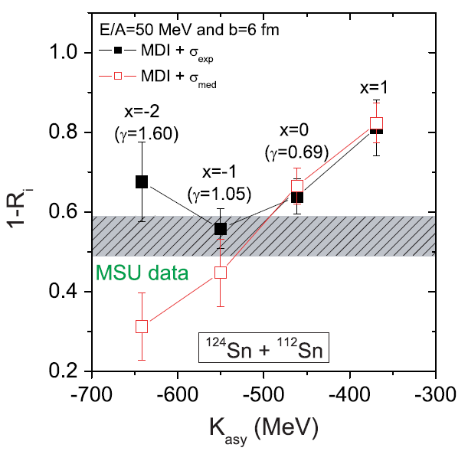
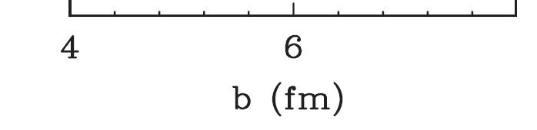
Previous studies
B.-A. Li and L.-W. Chen, PRC 72, 064611 (2005)
M.B. Tsang et al. PRL 102, 122701 (2009)

Slide 9
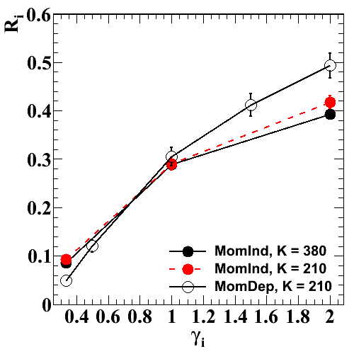
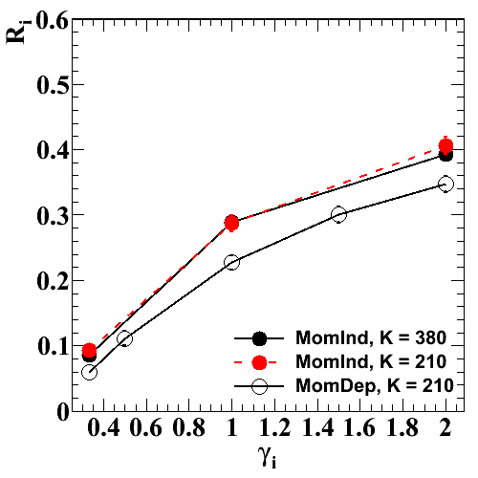
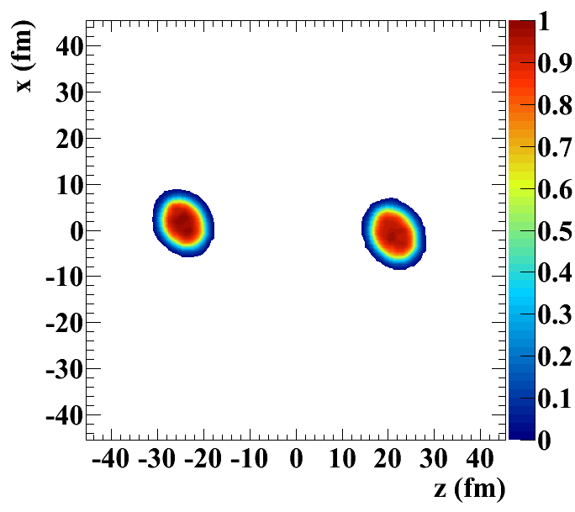
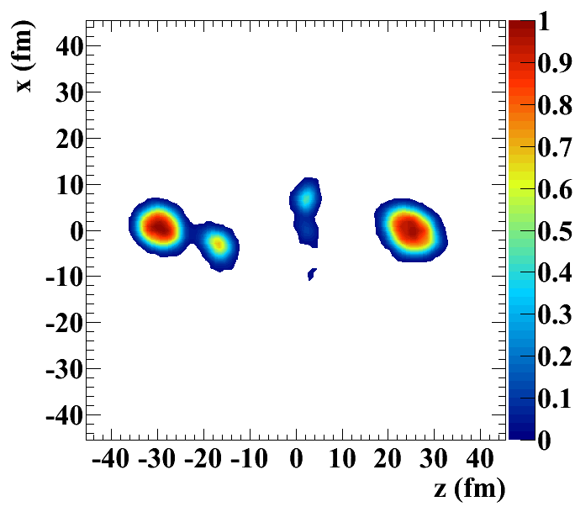
Simulation Results - Symmetric EoS
Compressibility (K)
Momentum dependence
Change in dynamics: intermediate mass fragments
Momentum dependence increases diffusion – conflicts with conclusion of Rizzo et al., Nucl. Phys. A 806 (2008)
heaviest fragment
all forward-moving fragments
MI, t=270 fm/c
MD, t=270 fm/c

Slide 10
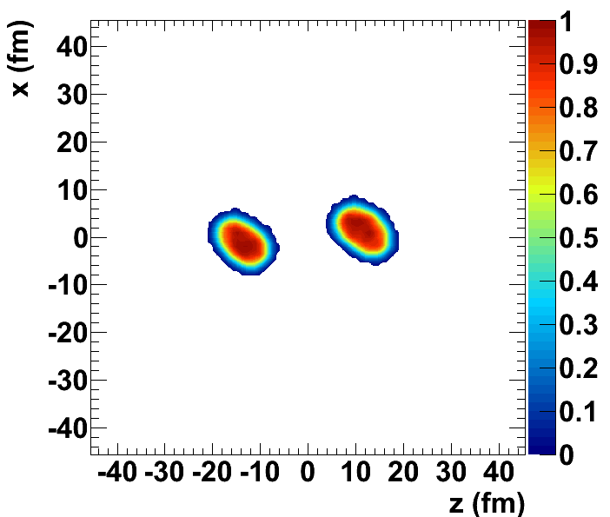
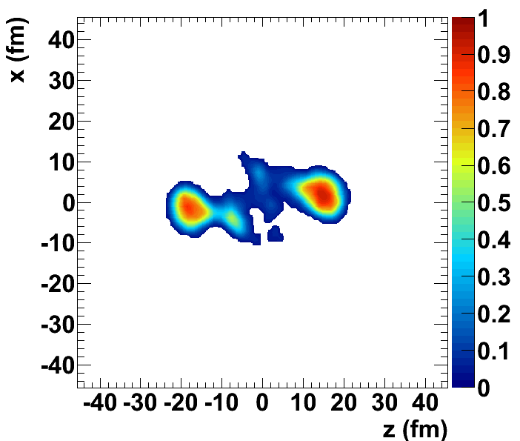
Simulation Results - Symmetric EoS
Compressibility (K)
Momentum dependence
Momentum dependence increases duration of neck
heaviest fragment
all forward-moving fragments
MI, t=162 fm/c
MD, t=162 fm/c

Slide 11
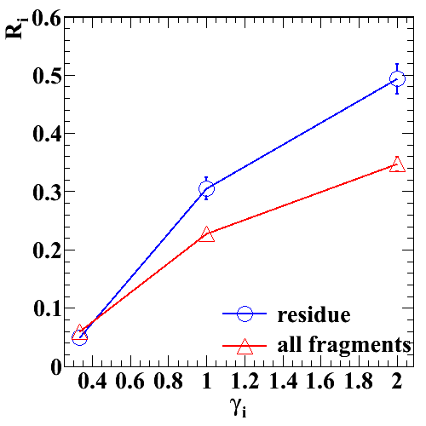
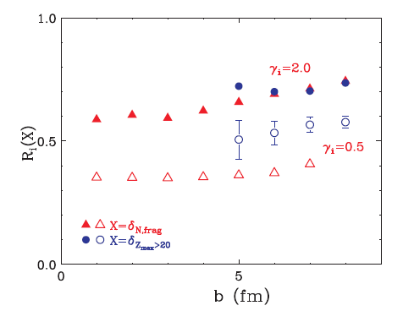
Fragments vs Residue
pBUU
ImQMD
Previous BUU constraints from residue
ImQMD constraints from all fragments
experiment ???

Slide 12
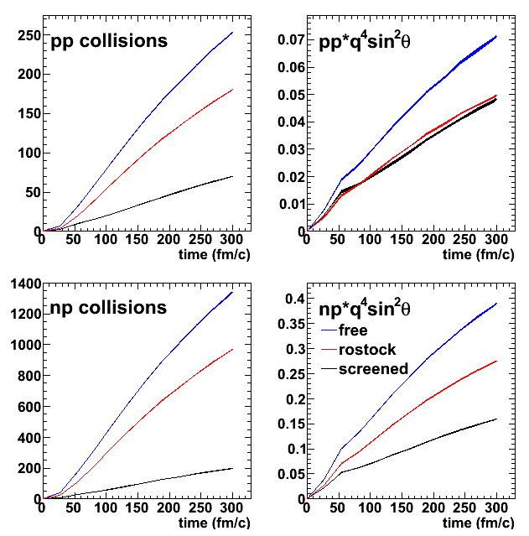
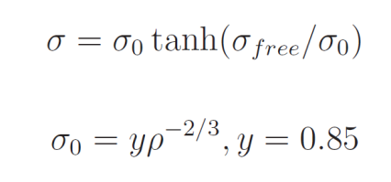
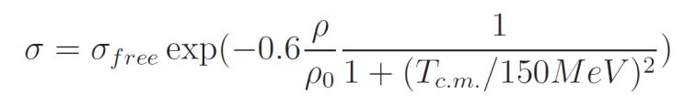
In-Medium NN Cross Sections
Screened: geometric arguments
Rostock: parameterized BHF calculations
Rostock similar in reduction used in IBUU04, ImQMD05 constraints

Slide 13
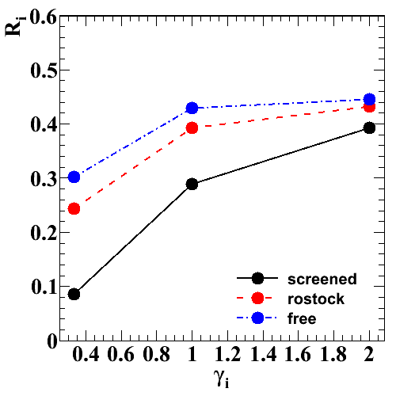
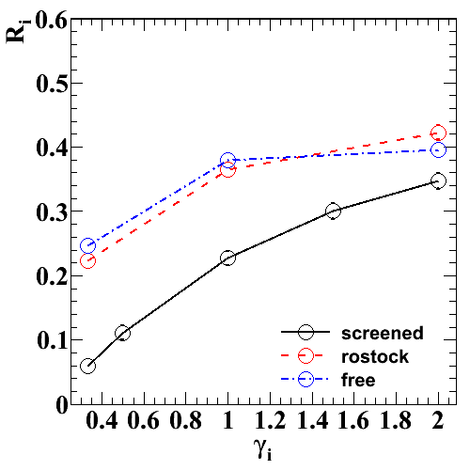
Cross section comparison
pBUU MI
pBUU –
Strong dependence on cross section, reduced by mom-dep
ImQMD – almost no dependence
IBUU04 –
Similar to pBUU Rostock
pBUU MD
ImQMD05
IBUU04

Slide 14
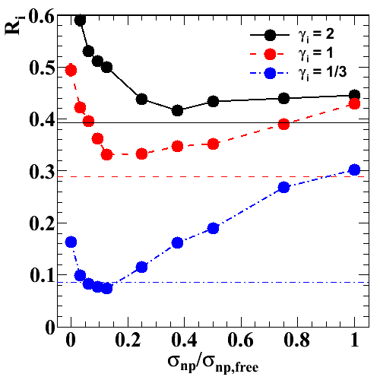
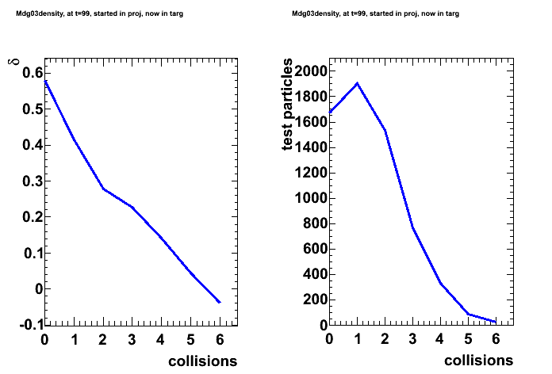
Collisions vs Mean Field
Collisions slow diffusion due to symmetry energy
Collisions cause largely isospin-independent nucleon transport
Only np cross section is significant
nucleons transferred from projectile to target

Slide 15
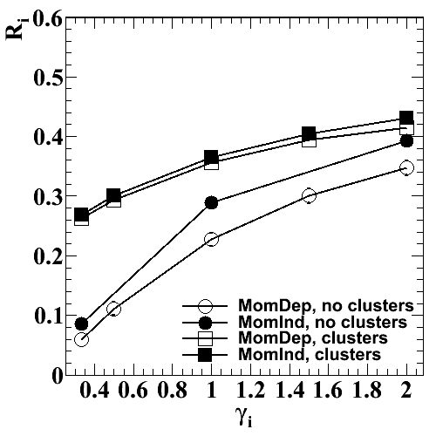
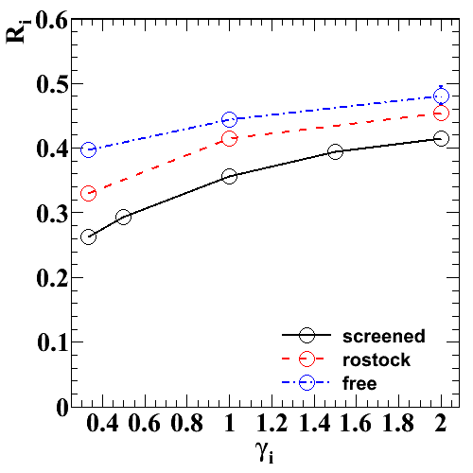
Cluster production
test particles can undergo inelastic collisions and “clump” into clusters
Not a native feature of BUU models
carefully included in the pBUU code up through mass 3

Slide 16
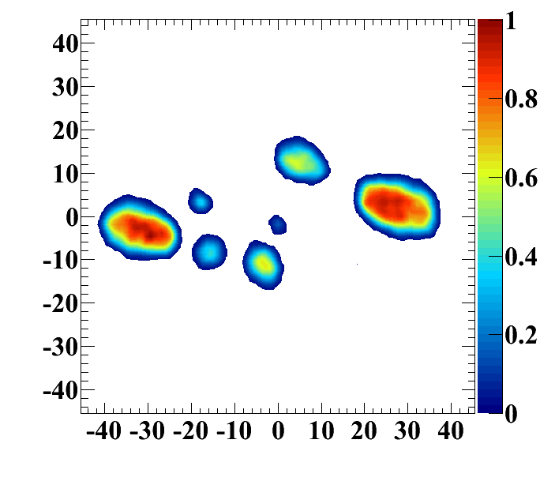
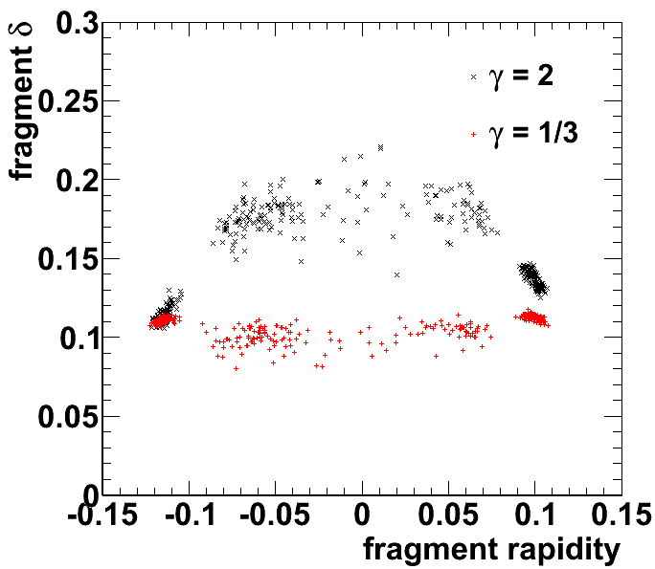
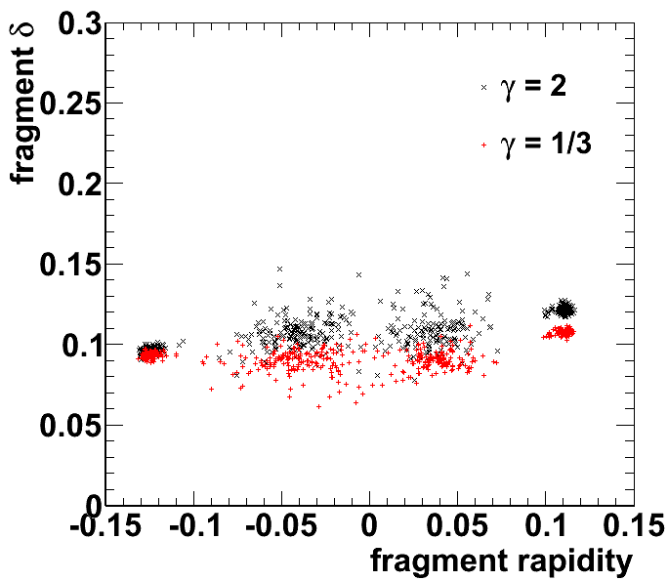
Clustering effects on dynamics
Increases mean field instabilities → more violent neck breakup
Additional NN collision channel – larger cross section
Without clusters, neck tends to be much more asymmetric than large residues. With clusters, not the case
clusters, t=270 fm/c
no clustering
clustering

Slide 17
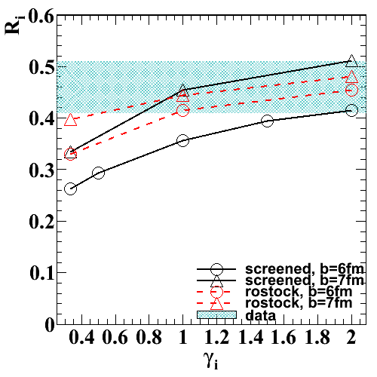
Simulation conclusions
Theoretically
Can we determine duration of neck?
Cross sections
Cluster production
Experimentally
Better impact parameter selection
diffusion measured in IMFs vs residues
smaller uncertainties
Shifts closer to ImQMD results

Slide 18
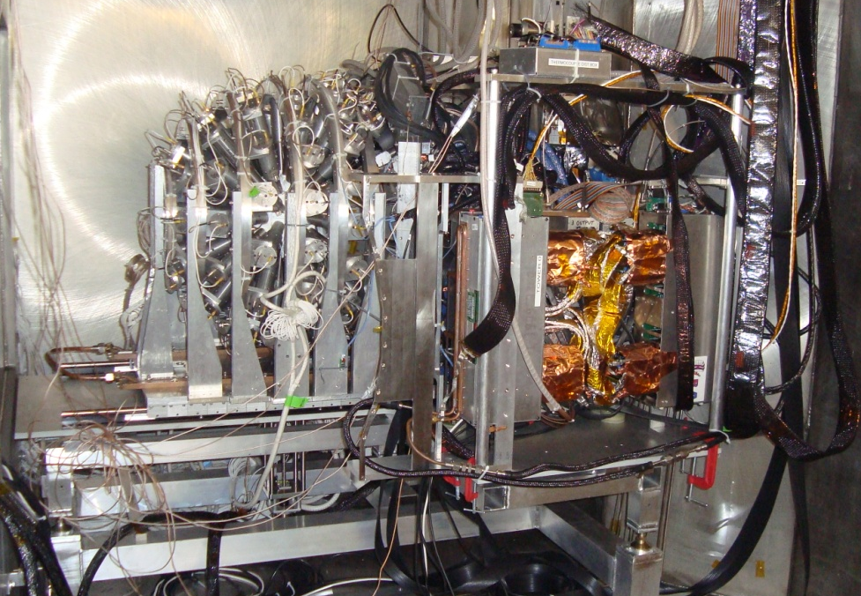
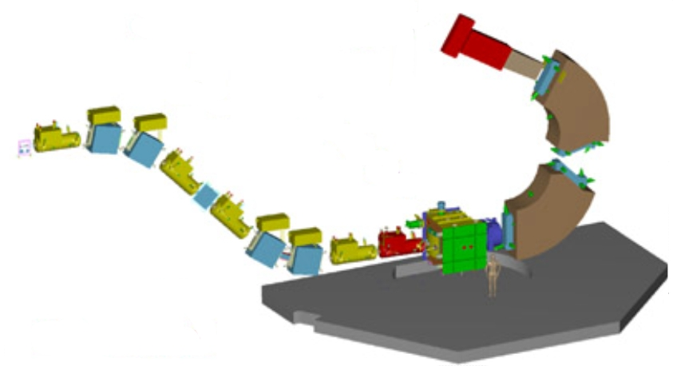
New Isospin Diffusion Experiment
Impact parameter selection – Miniball/
Miniwall
Measure isospin diffusion with both intermediate mass fragments (LASSA) and heavy residues (S800)

Slide 19
Neutron/Proton Ratio
Central (head-on) collision
Expanding neutron-rich source
Small symmetry energy
Large symmetry energy
Notes:
But, problem! Neutrons are very hard to detect. Take ratio of two ratios, cancel out experimental errors due to differences in efficiency.
19

Slide 20
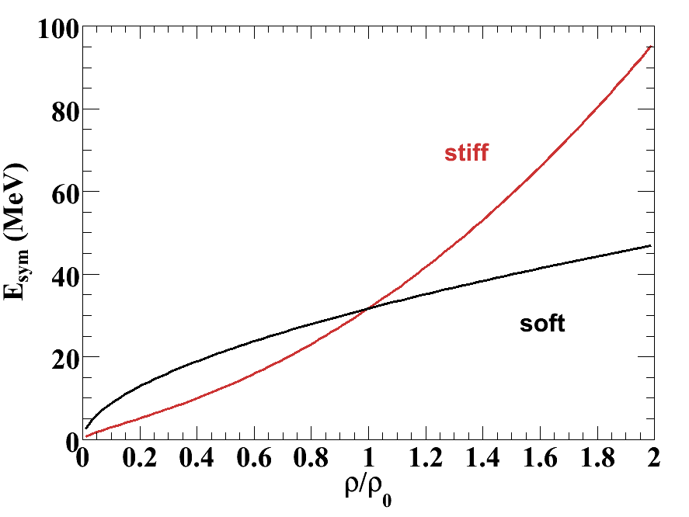
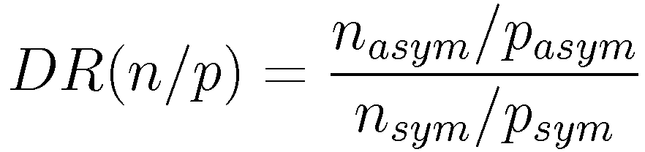
Neutron/Proton Double Ratios
Previous data has large uncertainties
Theoretical calculations from different models don’t agree
Study input physics dependencies within ImQMD05
Y. Zhang, Phys. Lett. B 664, 145 (2008)
Notes:
Predictions don’t agree. Data needs more statistics. How much can we trust results even if data is precise? What other knob can we turn to check? Beam energy dependence.” As the importance
of collisions and the mean field momentum dependence
increases with incident energy, the incident energy dependence of
DR(n/p) could provide a useful test of the description of other
transport quantities such as effective masses of neutron and protons
and the isospin dependence of the in-medium cross sections.”

Slide 21
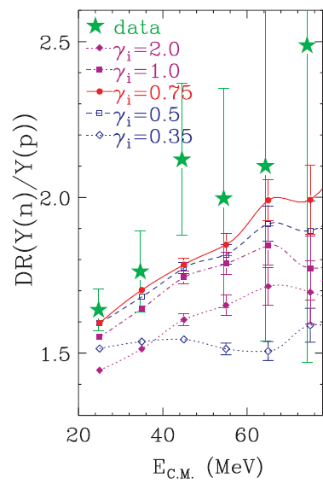
ImQMD DR symmetry energy effects
two competing effects
Stronger subsaturation symmetry energy → more neutron emission
Too strong symmetry energy → complete breakup of low density region
Notes:
Part of systematics – but does it fit in story?

Slide 22
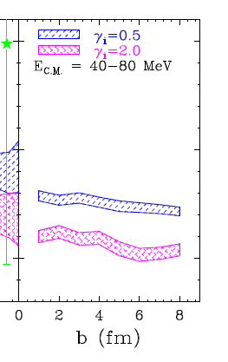
DR non-effects
Only minor effects from
cross section
impact parameter

Slide 23
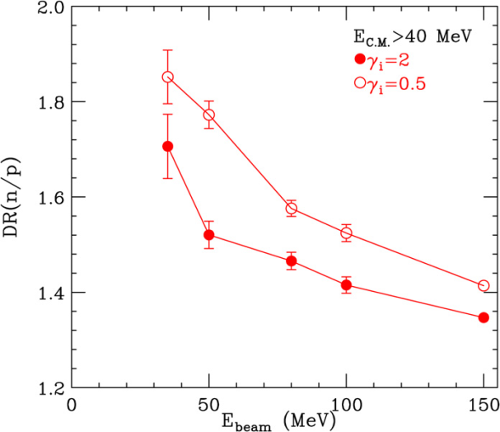
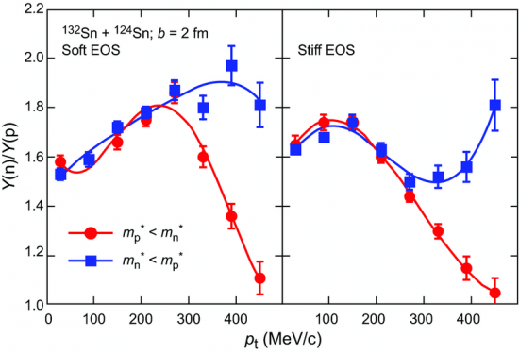
Mass splitting
Unable to test effect of mass splitting in ImQMD05
Y. Zhang, Phys. Lett. B 664, 145 (2008)
100 MeV/u
At larger beam energy
Smaller symmetry energy effect
Larger mass splitting effect
Adapted from J. Rizzo et al, Phys. Rev. C72, 064609 (2005).

Slide 24
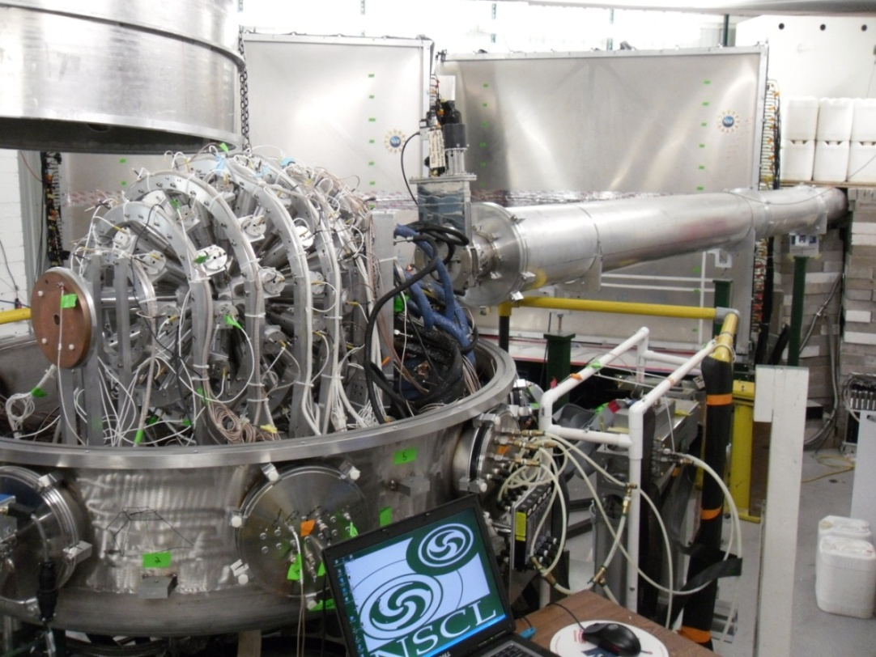
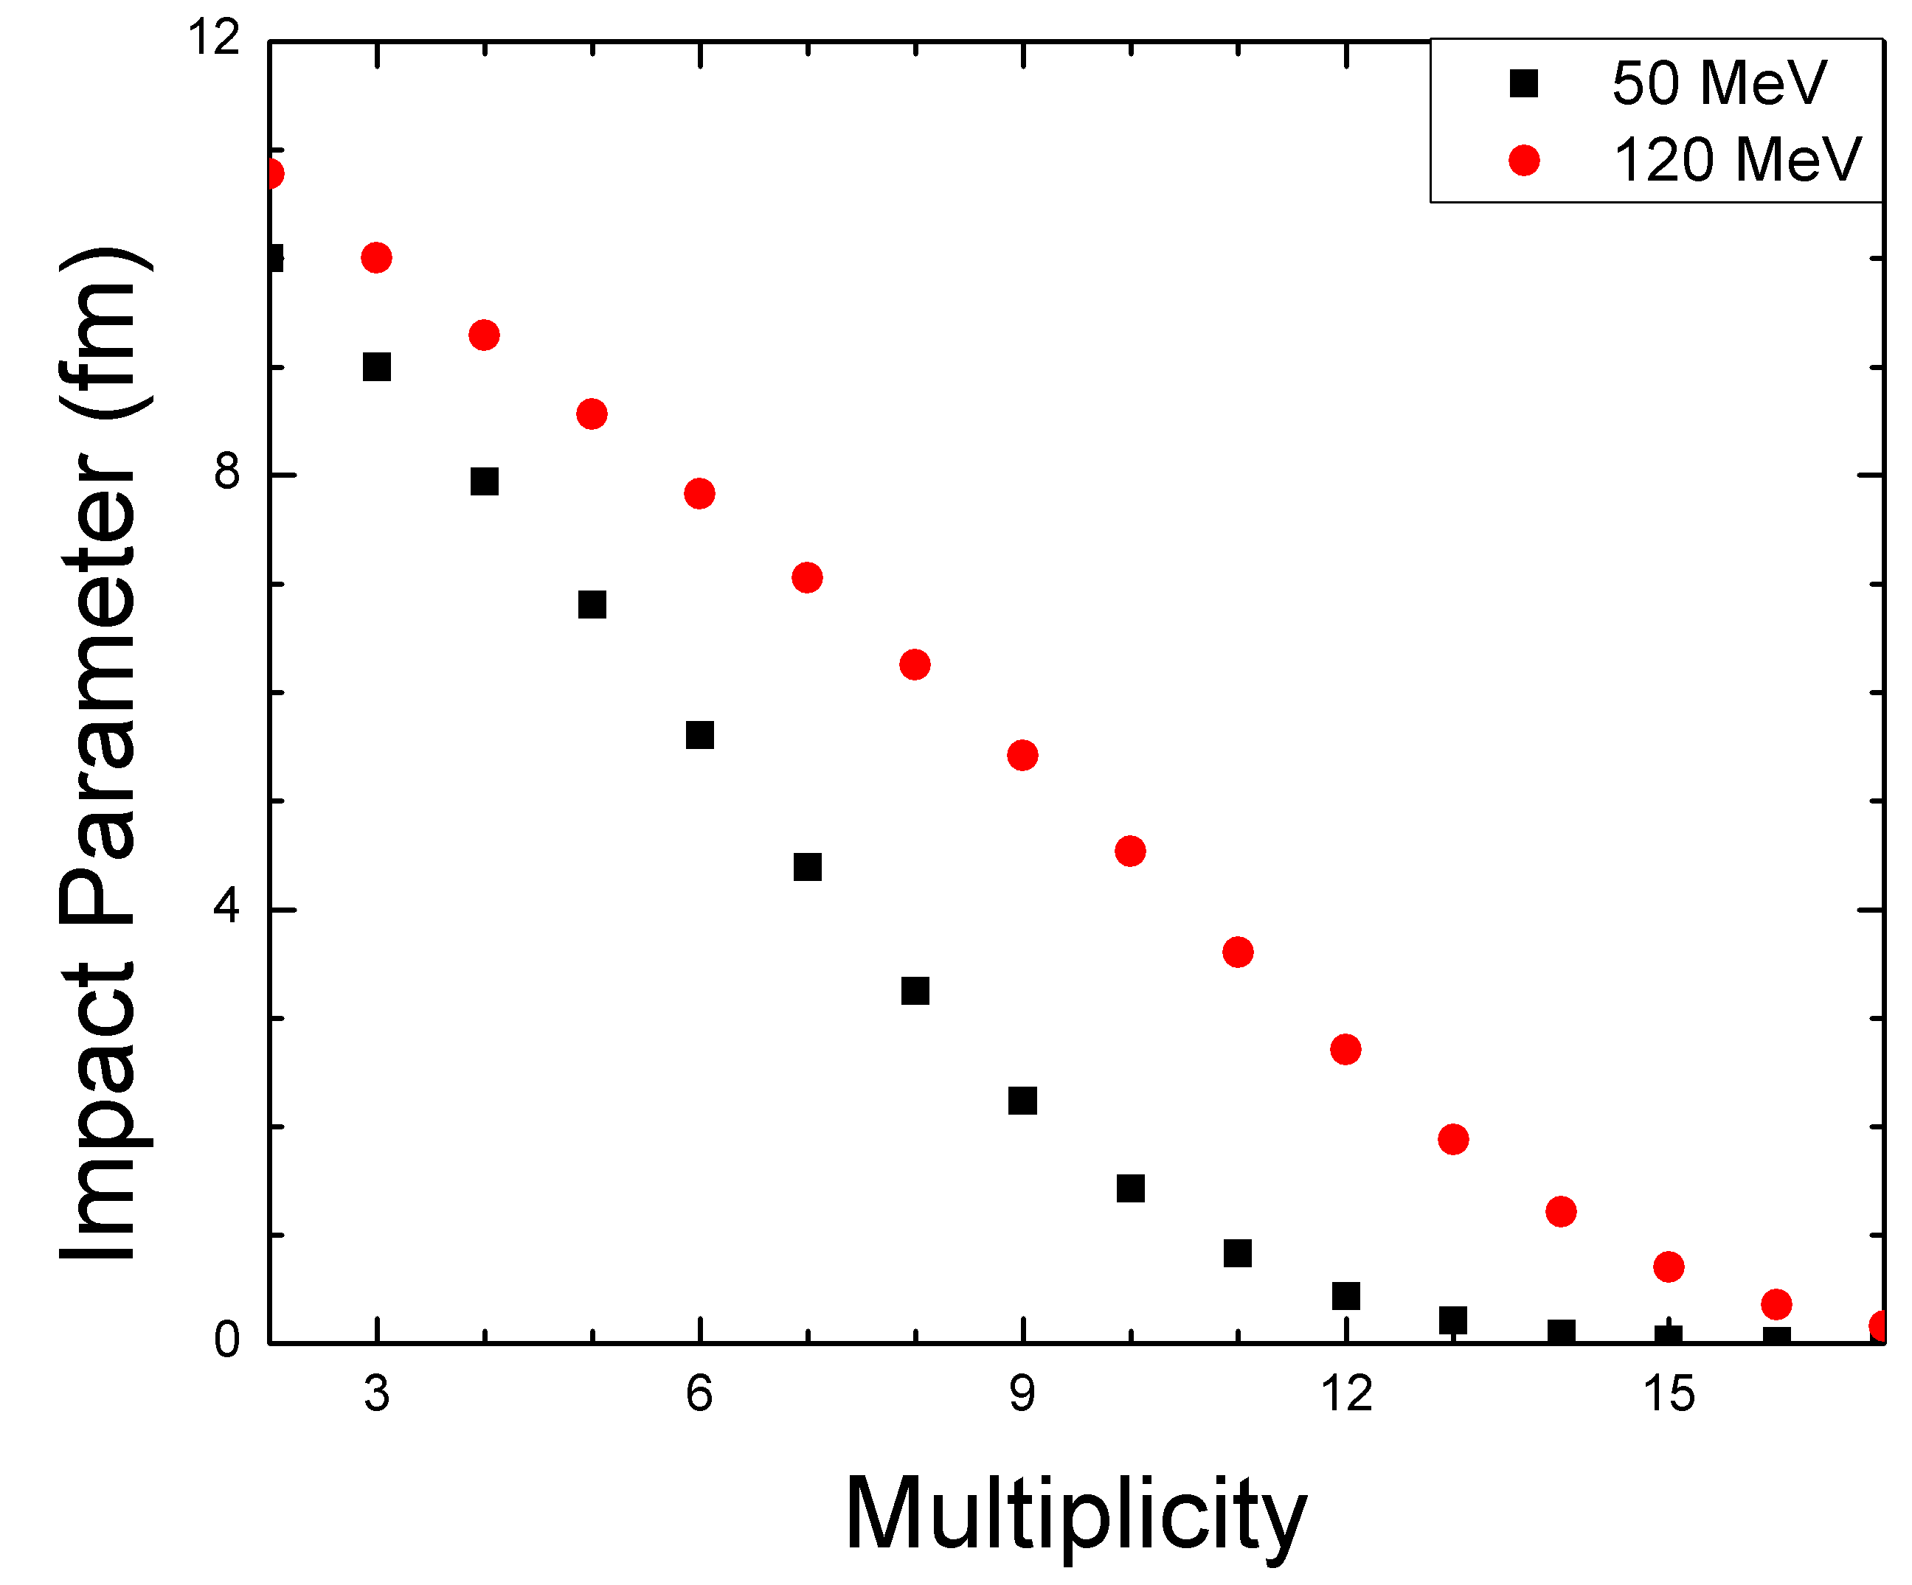
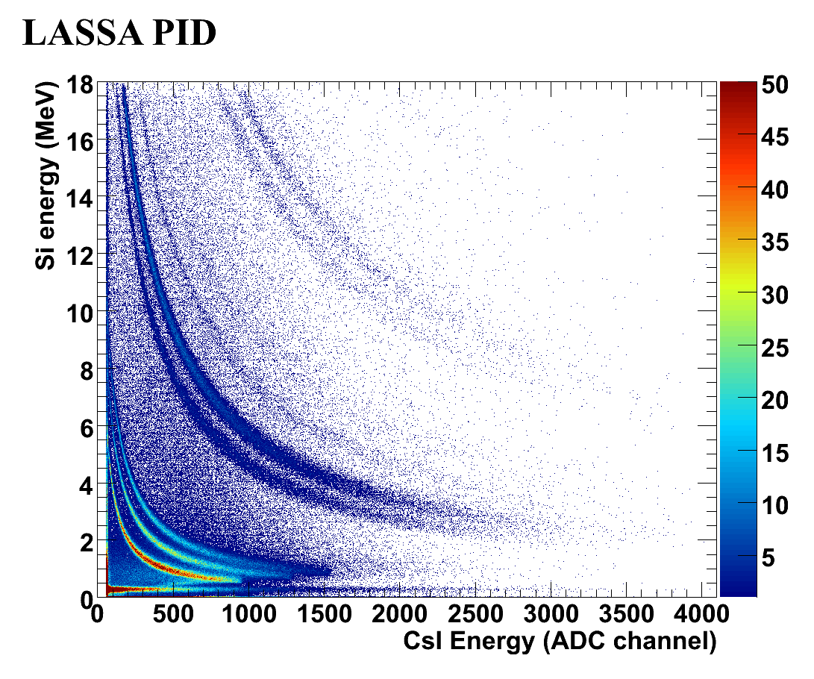
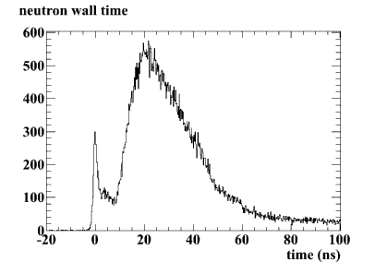
Recent experiment: November 2009
Measure neutron and proton spectra from central collisions of Sn + Sn at 50, 120 MeV/nucleon
Centrality cut – MSU Miniball
proton spectra – LASSA
neutron spectra –
Neutron Walls
112Sn + 112Sn δ = 0.107
124Sn + 124Sn δ = 0.194

Slide 25
Conclusions
Nucleon yield ratios in central collisions and isospin diffusion in peripheral collisions probe the symmetry energy below saturation density
We are studying the sensitivities of each observable with transport simulations to find ways to constrain the model dependencies
Recent and upcoming experiments will measure these observables with high precision and additional information, leading to new constraints on the symmetry energy
Still needs work to resolve model dependencies

Slide 26
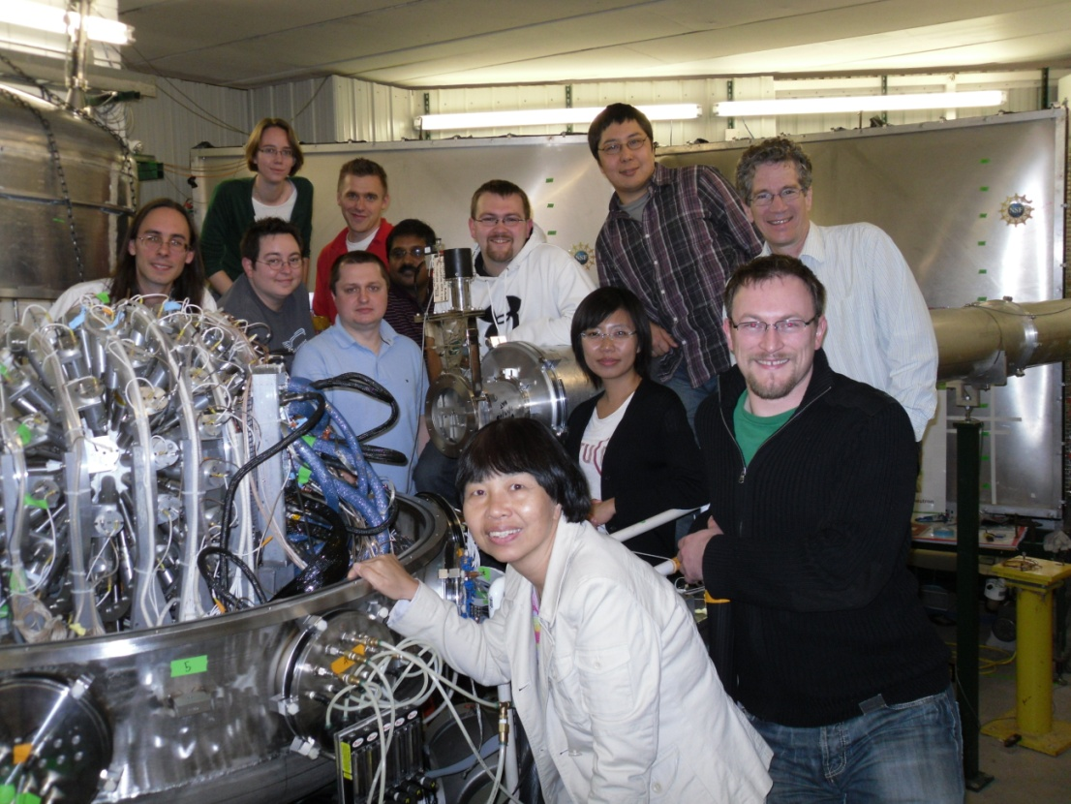



Collaborators
Pictured (from left): Dan Coupland, Rachel Hodges, Micha Kilburn, Jack Winkelbauer, Zbigniew Chajecki, Tilak Ghosh, Mike Youngs, Alisher Sanetullaev, Jenny Lee, Andy Rogers, Bill Lynch, Betty Tsang
Not pictured: Fei Lu, Michael Famiano, Brenna Giacherio, John Novak, Paulo Russotto, Concettina Sfienti, Giuseppe Verde, Pawel Danielewicz, Yingxun Zhang, Zhuxia Li, Hang Liu, Rebecca Shane, Suwat Tangwancharoen, Sebastian George, Jimmy Dunn, Steven Dye, Mohamed el Houssieny, Steven Nielsen, Andira Ramos

Slide 28
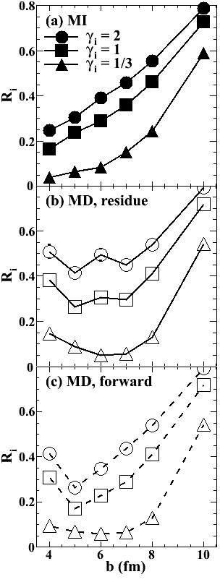
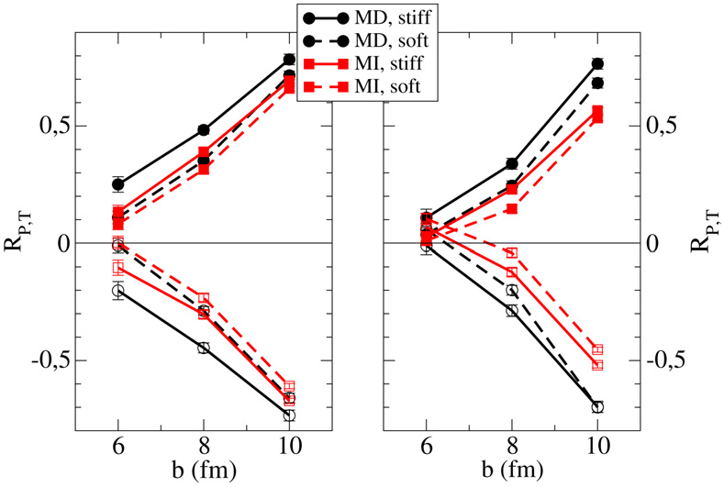
impact parameter dependence
ImQMD
ImQMD shows transparency at small impact parameters, pBUU and SMF show more equilibration
SMF
pBUU

Slide 29
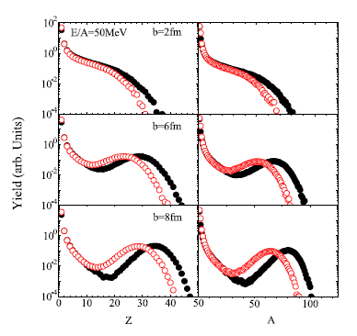
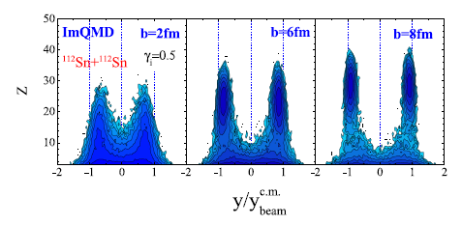
ImQMD05 fragment distributions

Slide 30
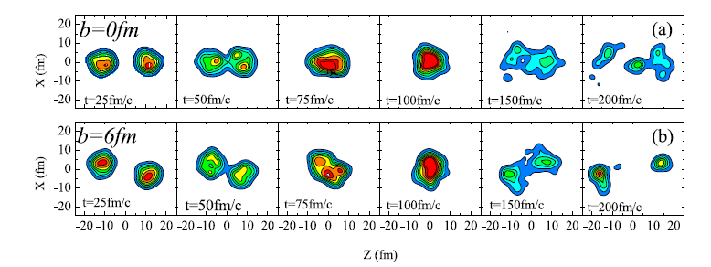
Fragment distribution

Slide 31
IMFs vs residues
Smaller R_{i} when the heavy residue is the isospin tracer rather than all fragments near that rapidity
Sensitive to neck breakup

Slide 32
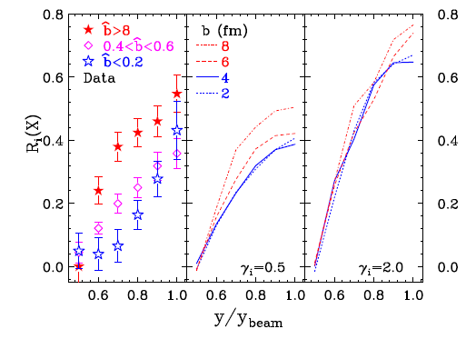
ImQMD R_{i} rapidity dependence
Too transparent at small impact parameter

Slide 33
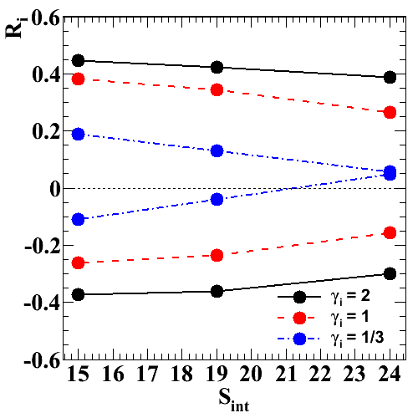
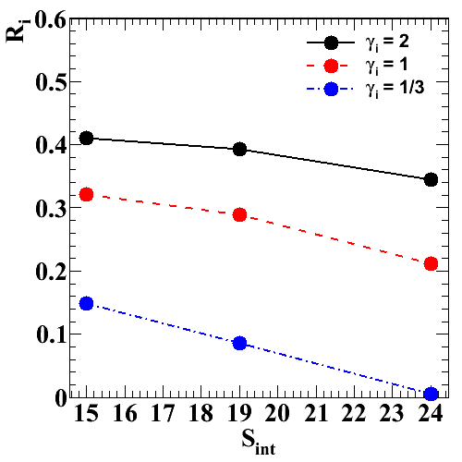
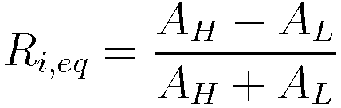

Effect of Symmetry Energy
Diffusion increases with increased symmetry energy below saturation density
R_{i,mix} “averages” forward and backward reactions

