Slide 1



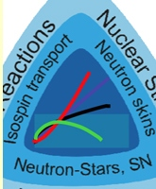
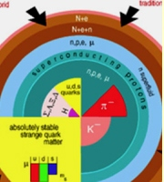
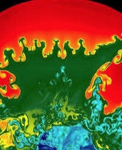


Study of nuclear equations of state: the ASY-EOS experiment at GSI
Simone Santoro^{1,2}
for ASY-EOS Collaboration
¹University of Messina
² INFN - Catania

Slide 2
Introduction
Experimental Set-up: CHIMERA
Special Configuration at GSI
Identification methods
On-line results
Digitalization
Reaction Plane reconstruction
Conclusions

Slide 3
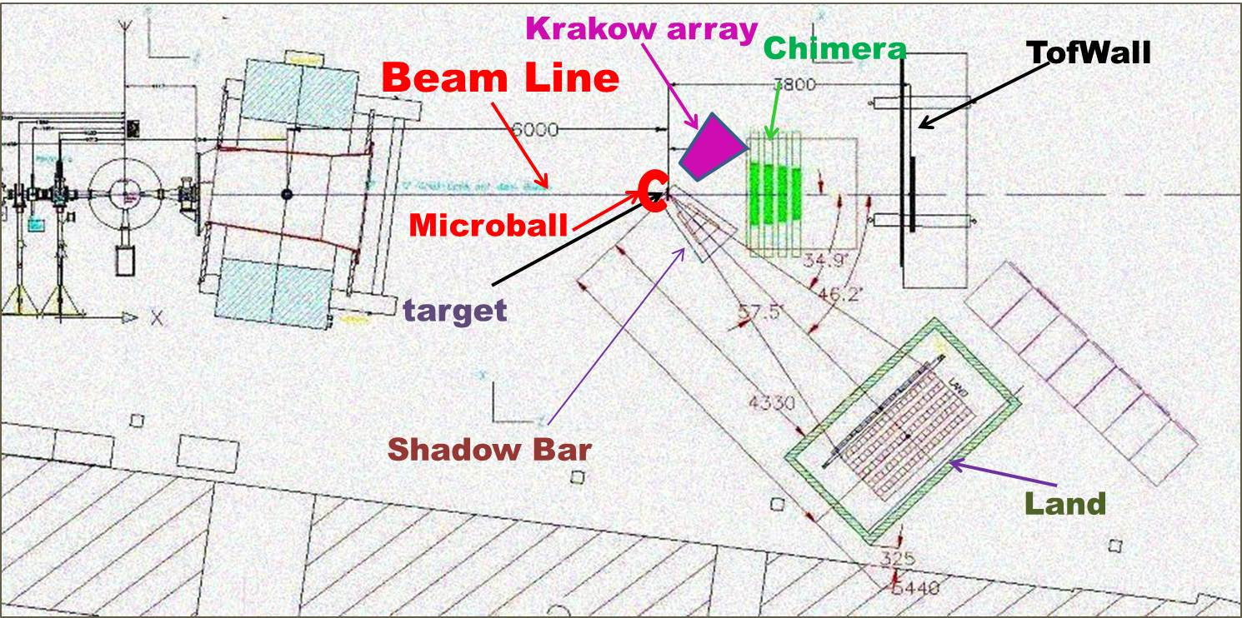
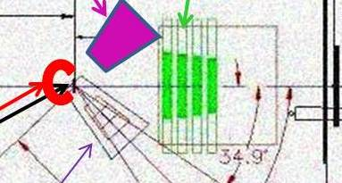
Experimental Set-up
Measured systems
on May 2011 at GSI
⁹⁶Ru+⁹⁶Ru @ 400 AMeV¹⁹⁷Au+¹⁹⁷Au @ 400 AMeV
⁹⁶Zr+⁹⁶Zr @ 400 AMeV

Slide 4
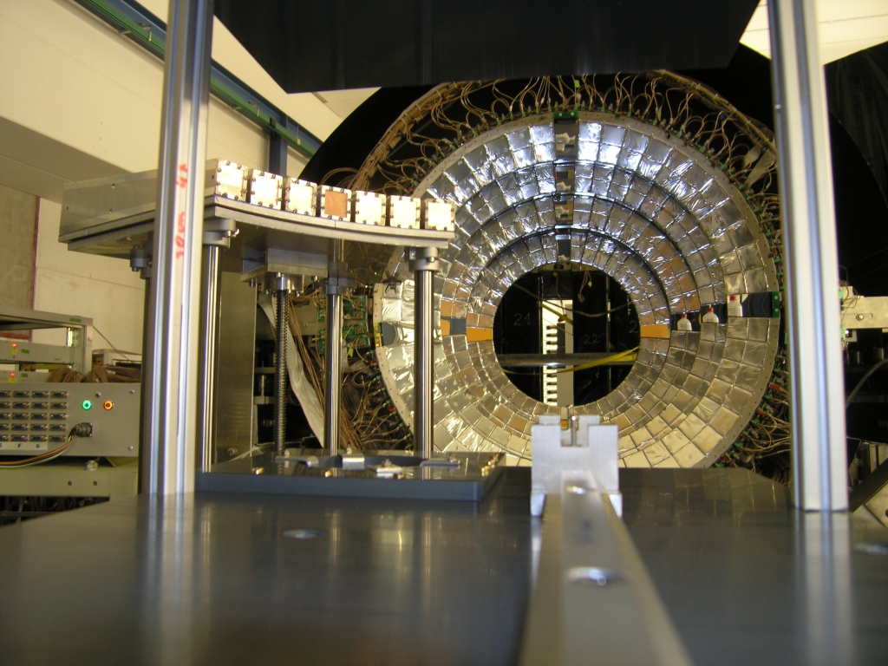

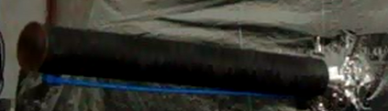
CHIMERA Special Configuration at GSI
8 forward Rings
N° 352 CsI Detectors
N° 32 Si Detectors
7° < ϑ < 20°
The frame was very light
Low Nitrogen flow inside Chimera chamber
Carbon Fiber Pipe
has been filled with circulating Helium
⁹⁶Zr+⁹⁶Zr @ 400 AMeV ⁹⁶Ru+⁹⁶Ru @ 400 AMeV

Slide 5
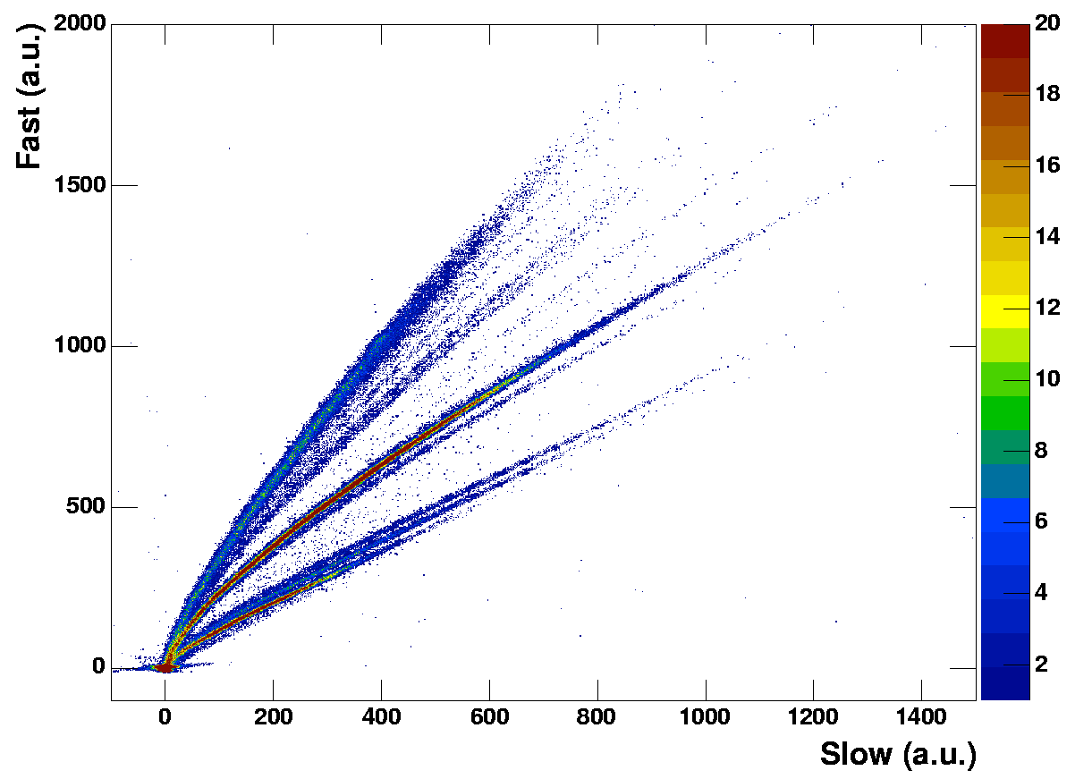
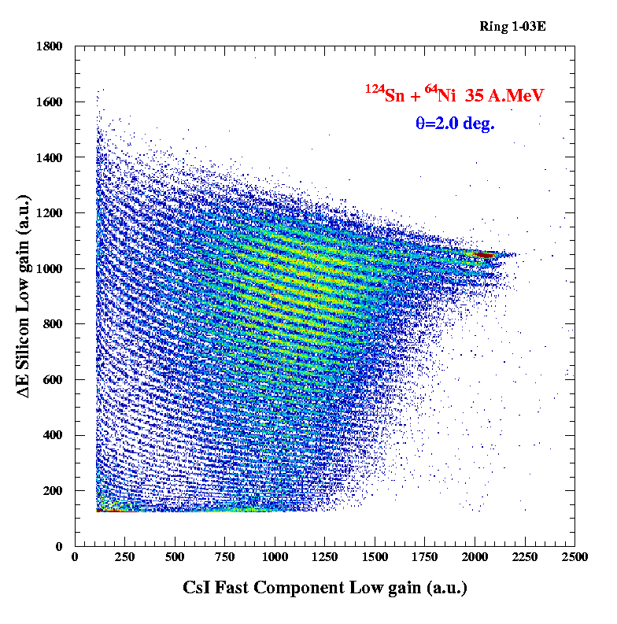
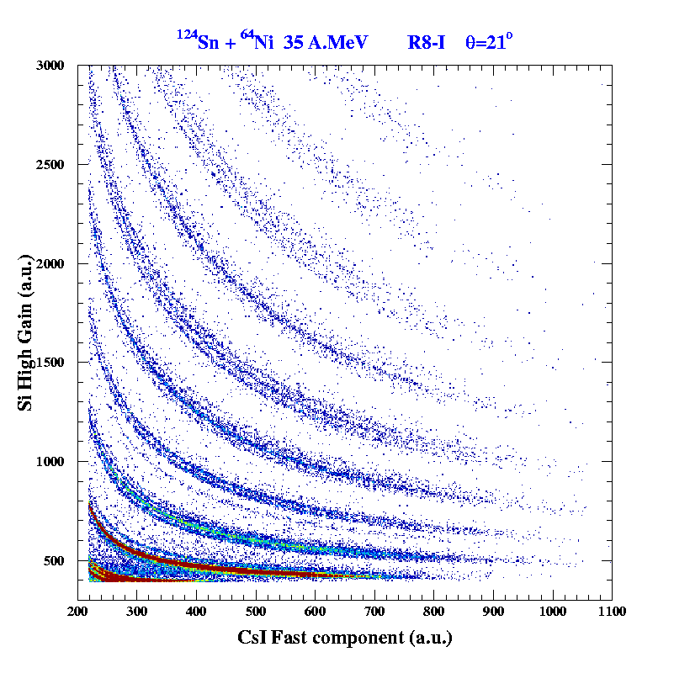
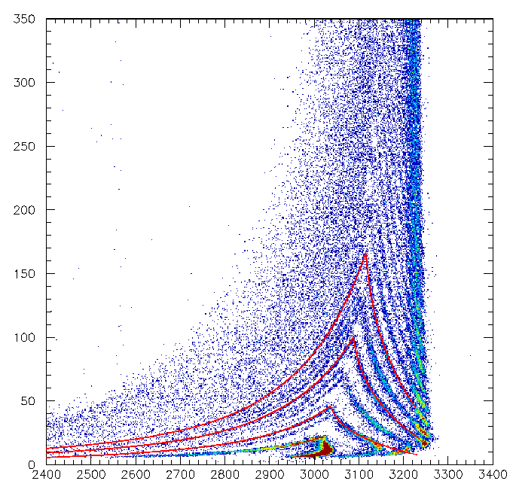
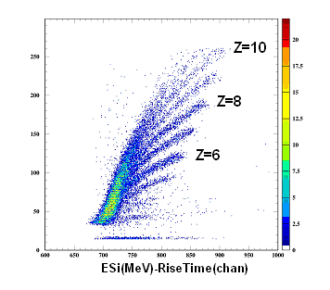
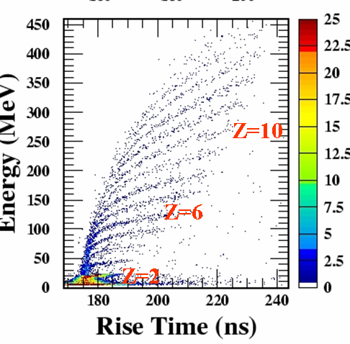
Identification Methods
ΔE(Si)-E(CsI)
Charge Z for particles punching through the Si detector
PSD in CsI(Tl)
Z and A for light charged particles
Be
Li
HI
α
³He
t
d
p
ΔE(Si)-ToF
Mass for particles stopping in the Si detector
CsI
(Tl)
Si
3-12 cm
~300 μm
ΔE(Si)-E(CsI)
Charge Z and A for light ions (Z<9) punching through the Si detector
E(Si)-Rise time
Charge Z for particle stopping in Si detectors

Slide 6
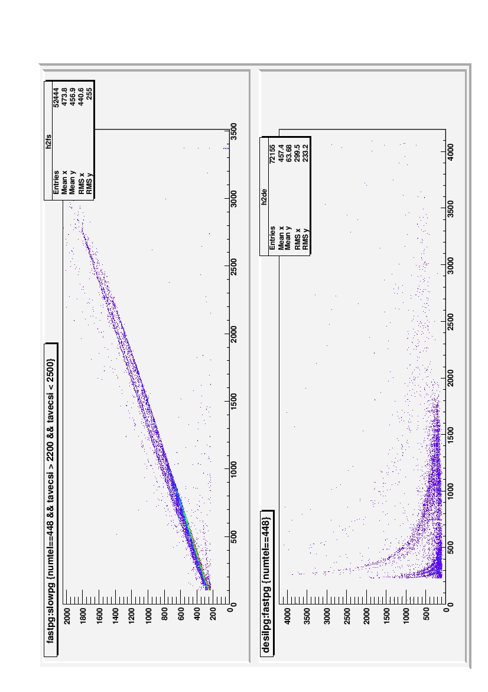
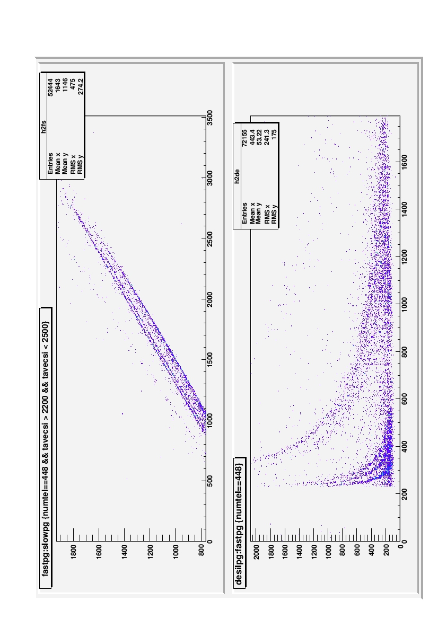
Identification Methods
Standard analogical acquisition
Fast (ch)
Slow (ch)
E Sil (ch)
Fast (ch)
¹⁹⁷Au 10⁵ pps 400 A.MeV + ¹⁹⁷Au

Slide 7
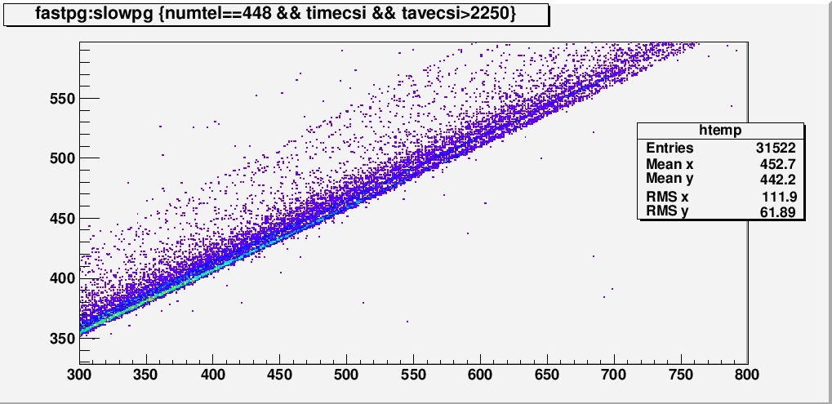
CHIMERA
Fast (ch)
Fast (ch)
Slow (ch)
Fast (ch)
¹⁹⁷Au 10⁵ pps 400 A.MeV + ¹⁹⁷Au
Slow (ch)

Slide 8
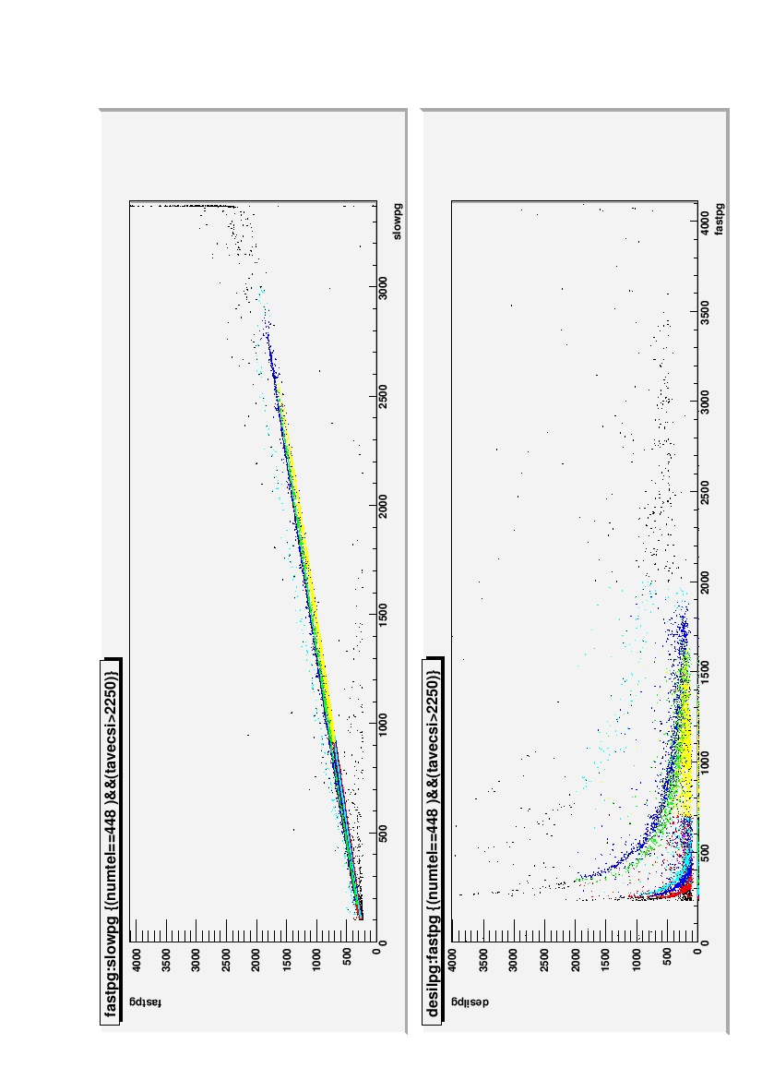
Identification Methods
Fast (ch)
Slow (ch)
E Sil (ch)
Identification via KaliVeda Grid Library
Fast (ch)

Slide 9
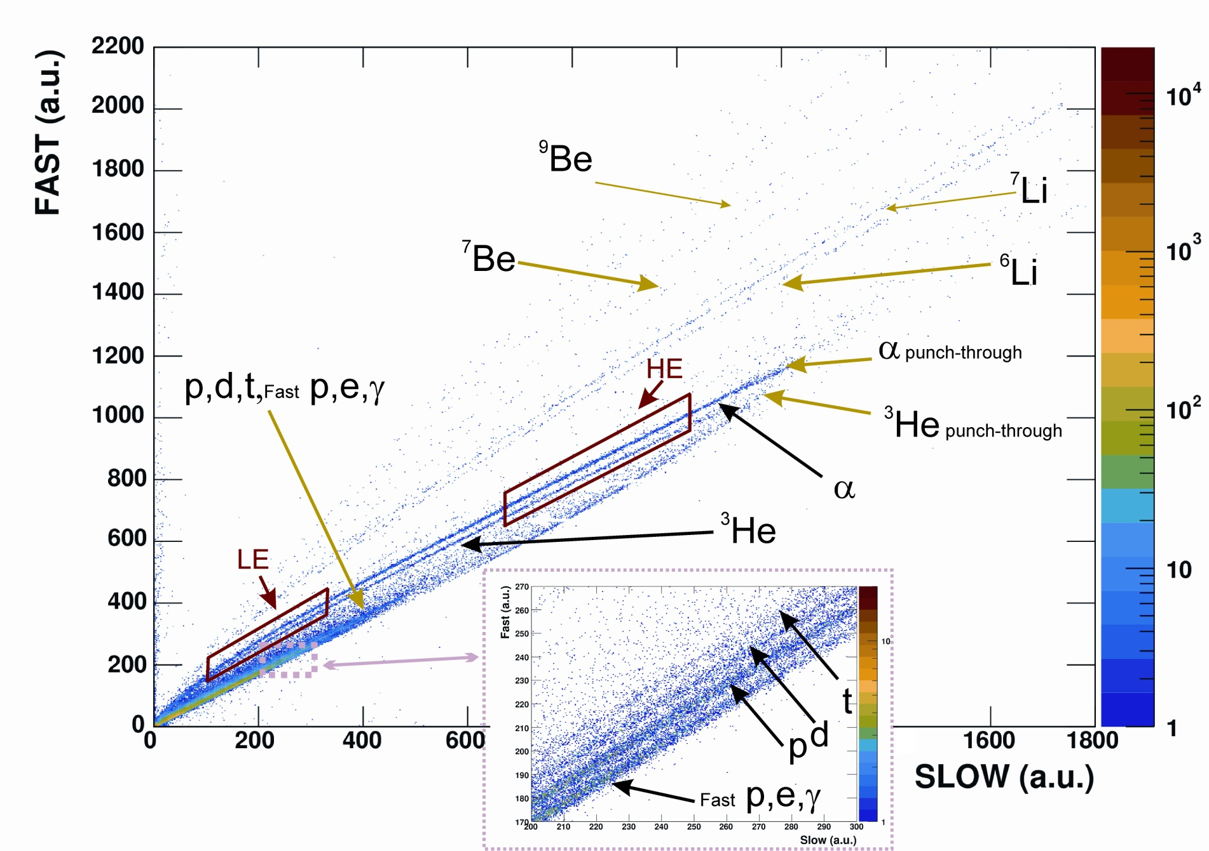
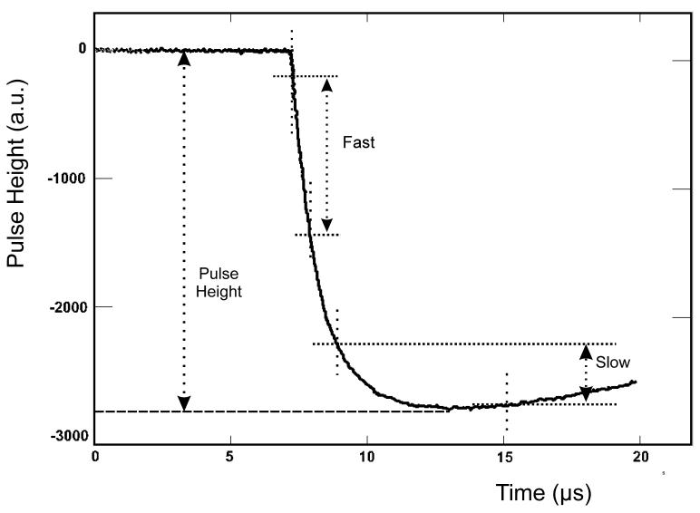
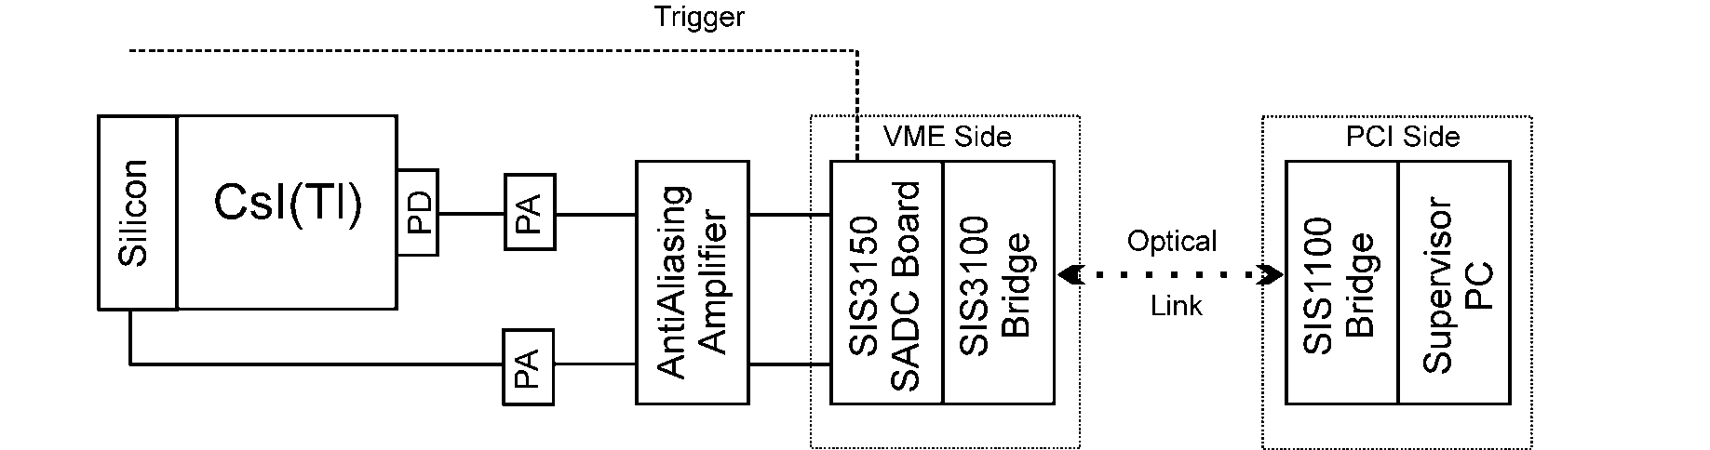
Digital Pulse Shape acquisition DSPA
100 MHz of sampling
14 bit of resolution
¹⁹⁷Au 10⁵ pps 400 A.MeV + ¹⁹⁷Au
From P.Guazzoni et al., Chimera Milano group
Notes:
9

Slide 10
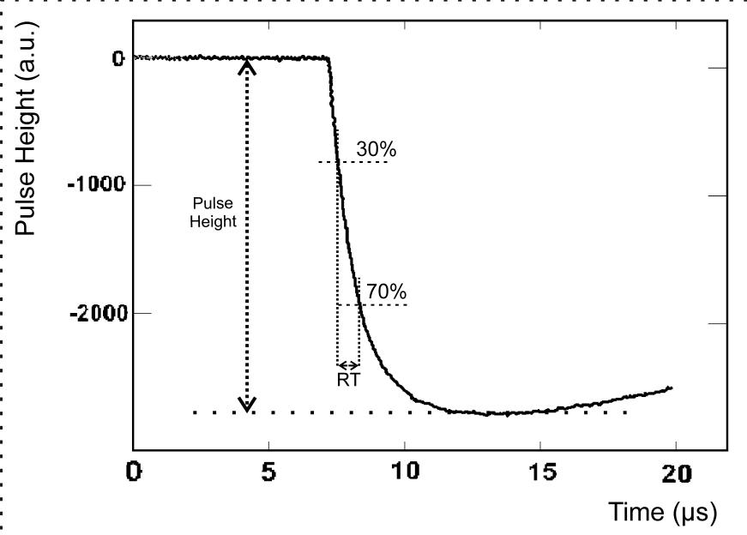
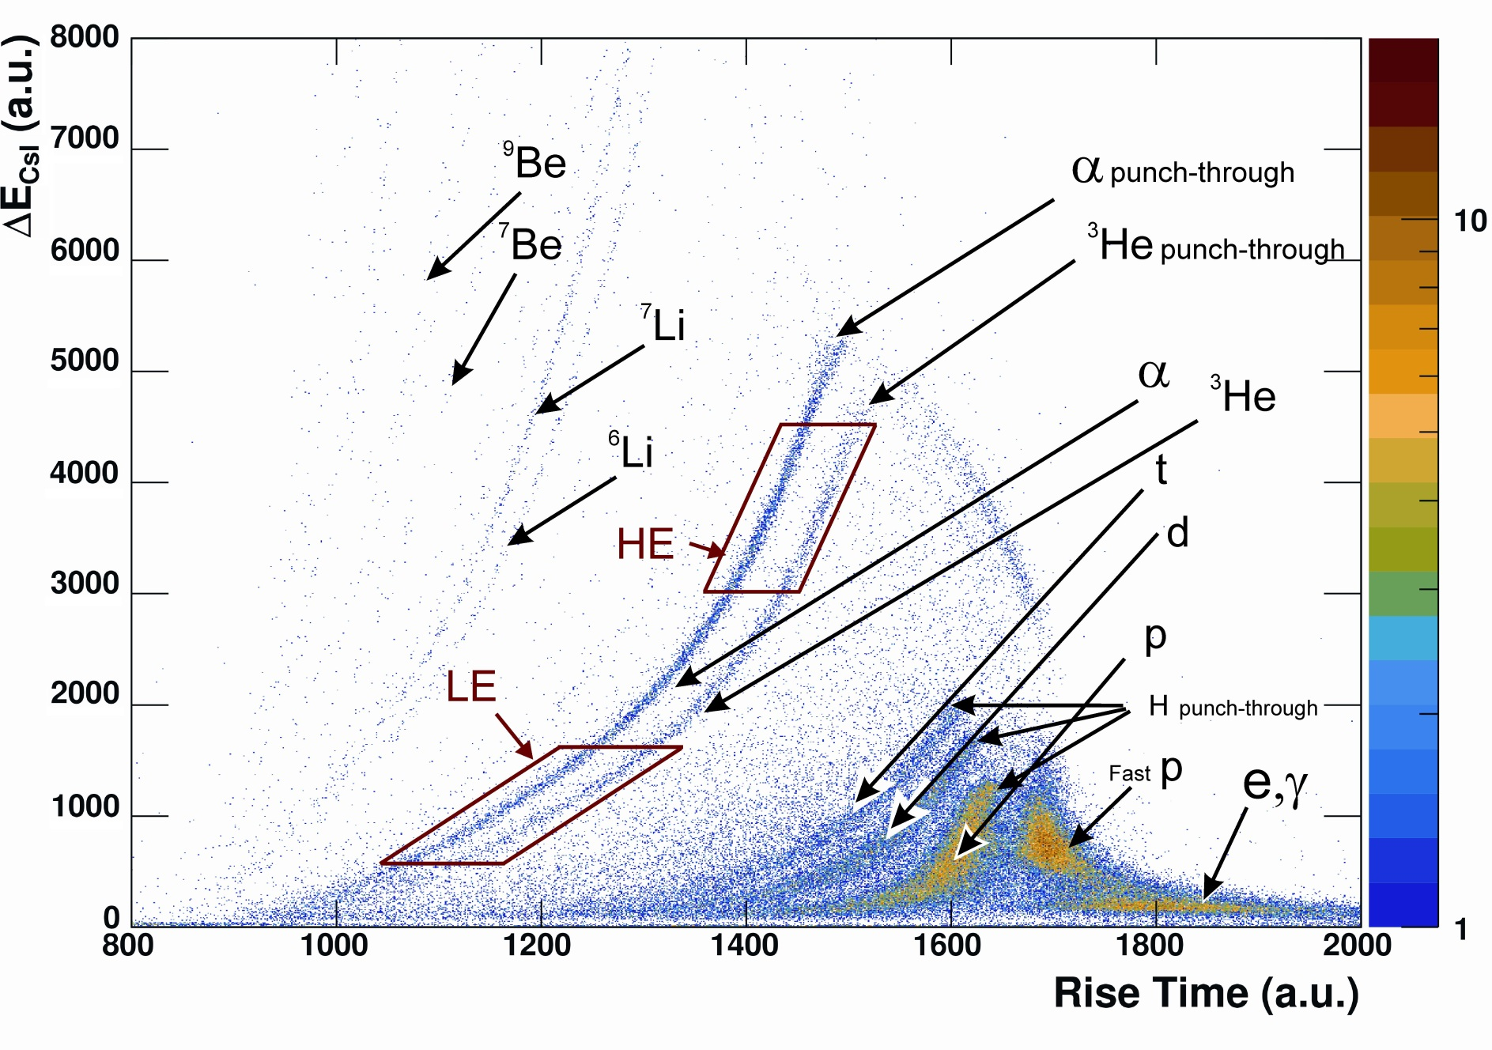
Digital Pulse Shape acquisition DSPA
¹⁹⁷Au 10⁵ pps 400 A.MeV + ¹⁹⁷Au
From P.Guazzoni et al., Chimera Milano group
Notes:
10

Slide 11
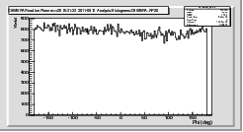
Reaction Plane reconstruction
Yield
-150
-100
-50
0
50
100
150
Phi (deg)
For monitoring on-line

Slide 12
Conclusions
CHIMERA worked well at GSI
We got isotopic identification in CsI for Z≤2
The analysis is in progress…
and…..
To realize the ASY-EOS experiment, a big international collaboration was needed:
In this sense the experiment was surely successful!!!!!

Slide 13
Thanks for the attention
Acknowledgments
PaOlo RuSSotto, Tino Minniti
Antonio Trifirò
Enrico De Filippo
Giuseppe Cardella
Giuseppe Verde
Angelo Pagano
and all CHIMERA group

Slide 14
RISERVE

Slide 15
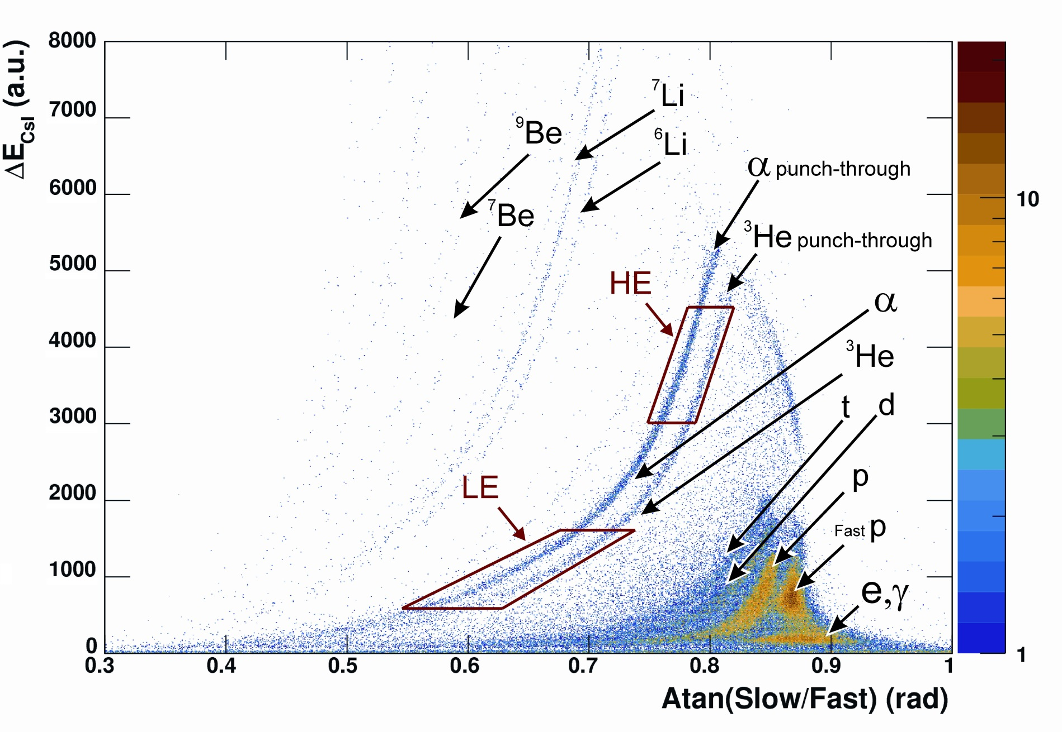
Digital Pulse Shape acquisition DSPA
From P.Guazzoni et al., Chimera Milano group

Slide 16
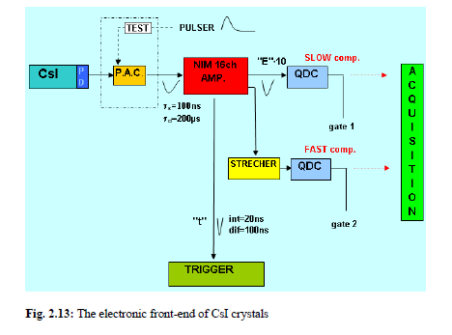
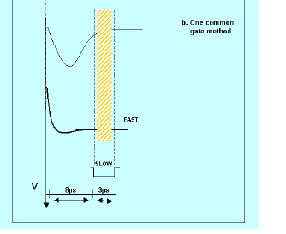
Electronic chain for CsI

Slide 17
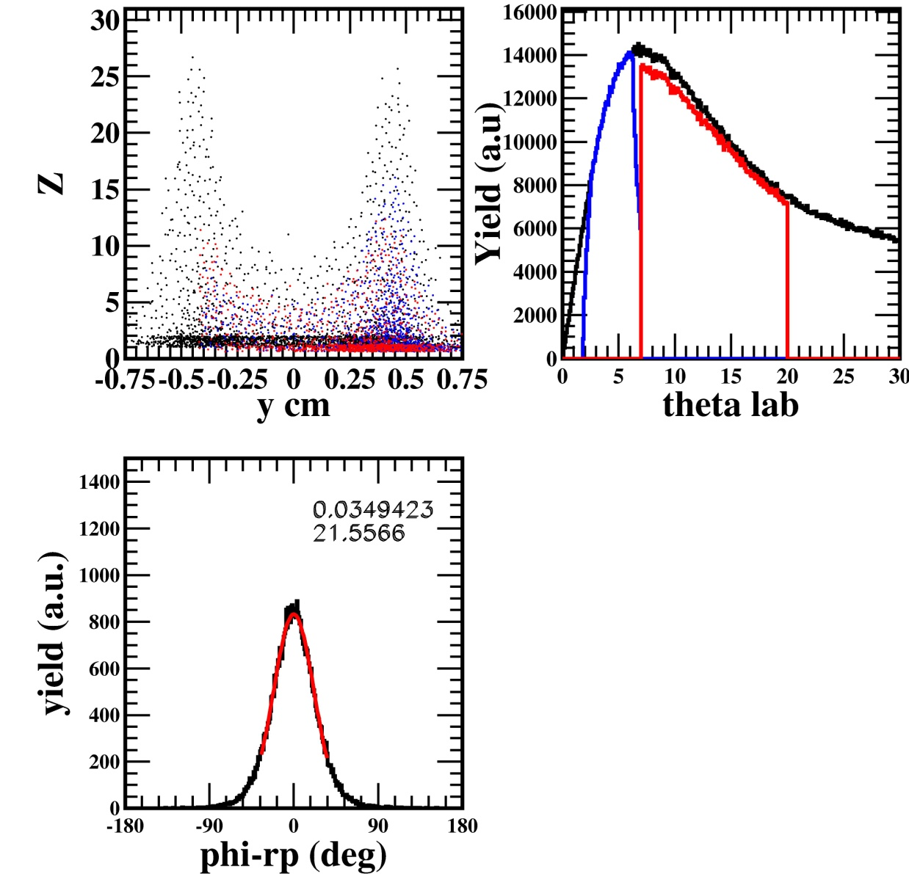
black→all charged particles
blue-red→used in reaction plane reconstrution (Q vector)
y_{cm}>0.1
Using only θ, φ, Z information
CHIMERA
Δt (Csi) =10 ns
ΔE/E (CsI) =10 %
pro-ycm-0.1+-0r4-7-dw5-10ns-10de-au-20run-covered.jpeg
NOPB New Conditions 08/10/09

