Slide 1



ASY-EOS experiment
P. Russotto*
for the ASY-EOS collaboration
*LNS-INFN and Univ. of Catania, Italy
20.38 16/06/11

Slide 2
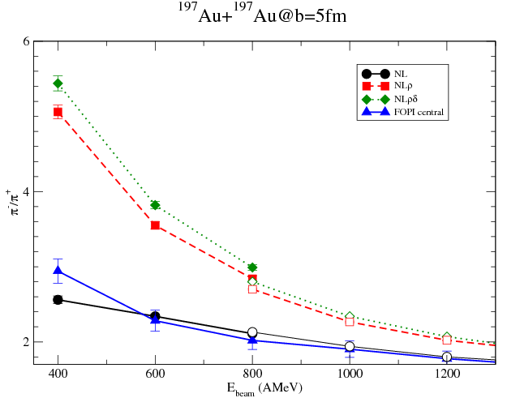
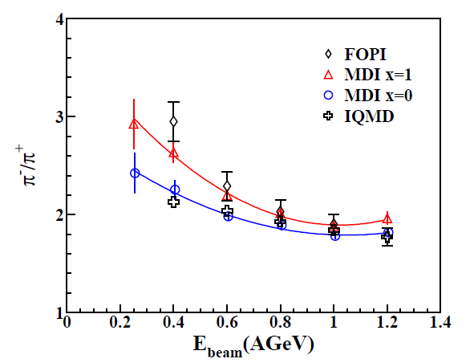
Constraints on the symmetry energy from Heavy-Ion Collisions
¹⁹⁷Au+¹⁹⁷Au
NLρδ
Ferini, at al., NPA 762 (05)
NLρ
NL
Current state at high densities
(E/A>100 MeV):
Few experimental data on isospin effects,
Few extrapolations, inconsistent with each other, big uncertainties
More work necessary on consistency of codes
Main example: π⁻/π⁺ ratio
FOPI data, W.Reisdorf et al. NPA781 (2007) 459
FOPI data, W.Reisdorf et al. NPA781 (2007) 459
Z. Xiao et al., PRL 102 (09)
Z.Q. Feng, PLB 683 (2010)

Slide 3
Constraints on the symmetry energy from Heavy-Ion Collisions
NLρ
Ferini, at al., NPA 762 (05)
NLρδ
NL
Current state at high densities
(E/A>100 MeV):
Few experimental data on isospin effects,
Few extrapolations, inconsistent with each other, big uncertainties
More work necessary on consistency of codes
Main example: π⁻/π⁺ ratio
Z. Xiao et al., PRL 102 (09)
Pion ratio->High densities:
Inconsistent with each other! Understand better mechanism!
Z.Q. Feng, PLB 683 (2010)
models for symmetry energy (SE)

Slide 4
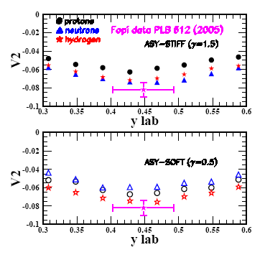
Main motivation:
symmetry energy at supra-saturation densities
UrQMD model
UrQMD vs. FOPI data:
Au+Au @ 400 A MeV
STIFF
5.5<b<7.5 fm
SOFT
How to measure?
squeeze-out more sensitive than the directed flow
See Qingfeng Li, J. Phys. G31 1359-1374 (2005) and references therein

Slide 5
Large Area Neutron Detector (LAND)
Th.Blaich et al.,NIM A314 136-154 (1992)
Neutrons efficiency>80% (for E_{n}>400MeV)
No ^{1,2,3}H isotopic discriminations
Adapted from P.Pawloski, IWM2007

Slide 6
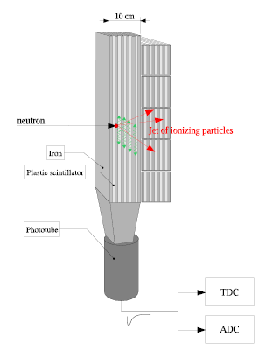
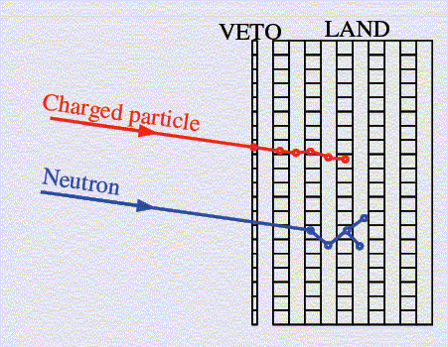
Large Area Neutron Detector (LAND)
neutron and Hydrogen detection
Th.Blaich et al.,NIM A314 136-154 (1992)
Adapted from P.Pawloski, IWM2007

Slide 7
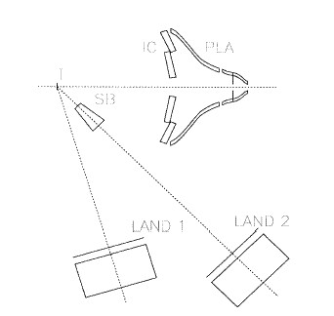
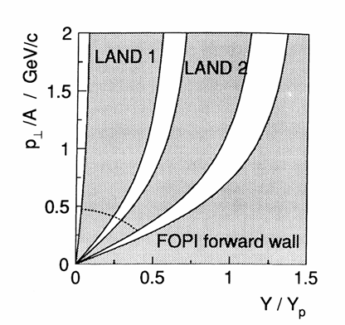
FOPI/LAND experiment on neutron squeeze out (1991)
Au+Au 400 A MeV
~ 10⁶ Events (b<7.5 fm)
LAND coverage
37°<θ_{lab}<53°
61°<θ_{lab}<85°
Y. Leifels et al., PRL 71, 963 (1993)
P.Russotto et al., PLB 697 (2011)
Re-analysys of experimental data:
see R. Lemmon talks

Slide 8
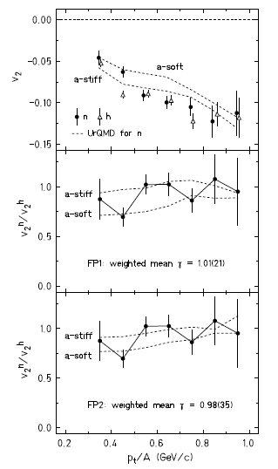
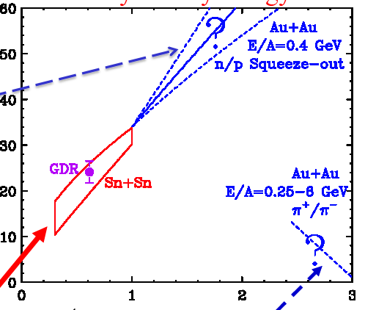
P.Russotto et al., PLB 697 (2011)
S(ρ) (MeV)
π+/π- ratio,
Feng, et al. (ImQMD)
ρ/ρ₀
π+/π- ratio
B.A. Li, et al.
Fermi Energy HIC, MSU

Slide 9
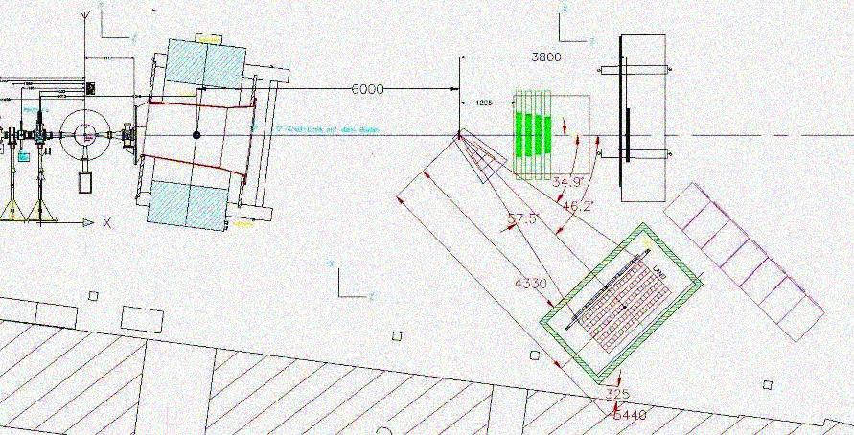
ASY-EOS experiment carried out May 2011
(possible) 1st phase toward FAIR ???
(e.g. ¹³²Sn,¹⁰⁶Sn beams)
Au+Au @ 400 AMeV
⁹⁶Zr+⁹⁶Zr @ 400 AMeV
⁹⁶Ru+⁹⁶Ru @ 400 AMeV
~ 5x10⁷ Events for each system
Experimental setup
Krakow array
Chimera
TofWall
Beam Line
MicroBall
target
Shadow Bar
Land
(not splitted)

Slide 10
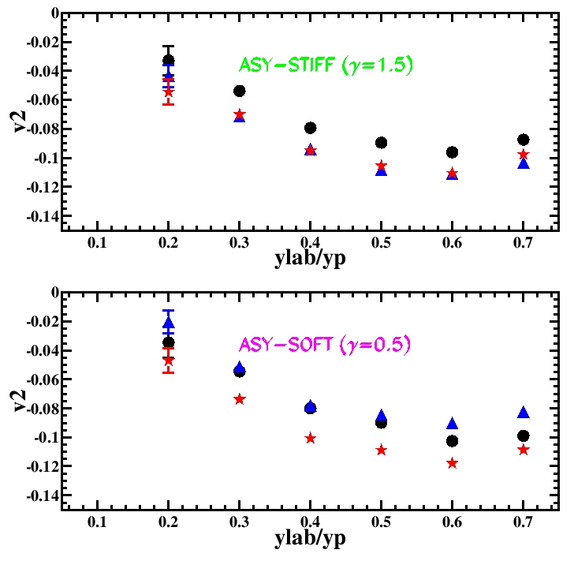
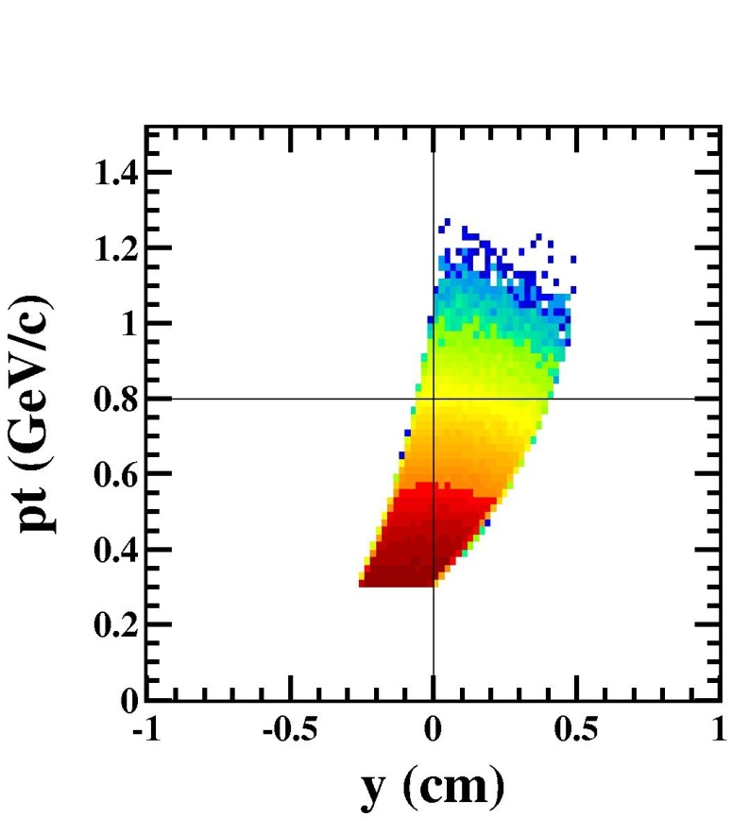
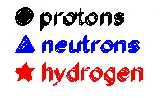
Land acceptance in the ASYEOS experiment: better coverage of mid-rapidity
Au+Au @ 400 AMeV
b=5.5-7.5 fm
UrQMD simulations
33.1<ϑ_{lab}<58 deg

Slide 11
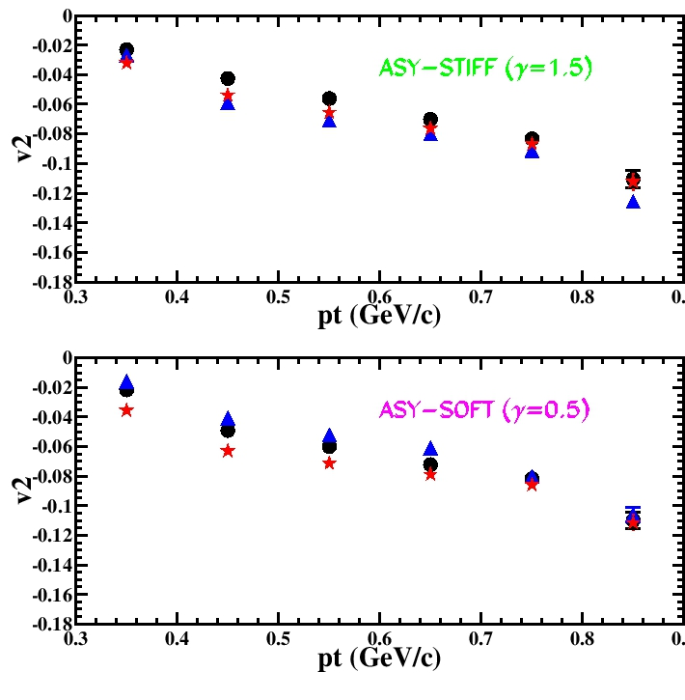
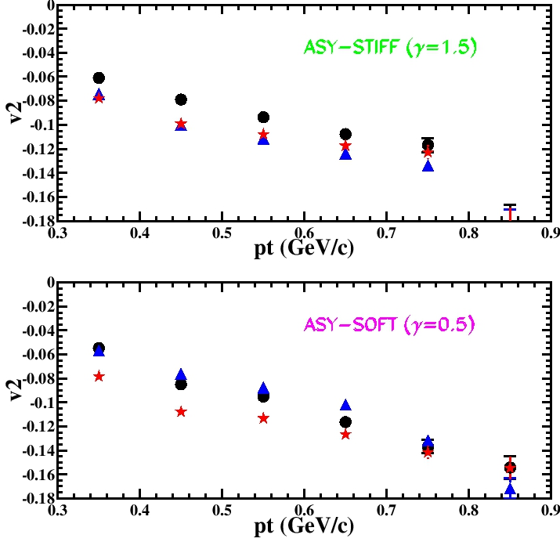
Au+Au @ 400 AMeV
b=5.5-7.5 fm
UrQMD simulations
33.1<ϑ_{lab}<58 deg
unfiltered
filtered
inversion survives acceptance cuts of the experiment
v2-pt-zoom-vxxx-exp.jpg
v2-pt-zoom-vxxx-exp.jpg

Slide 12
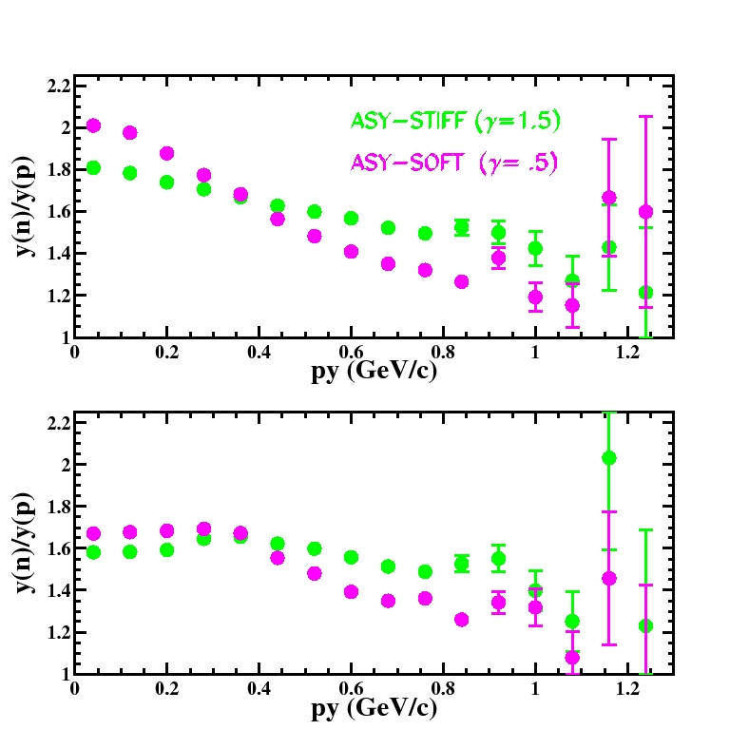
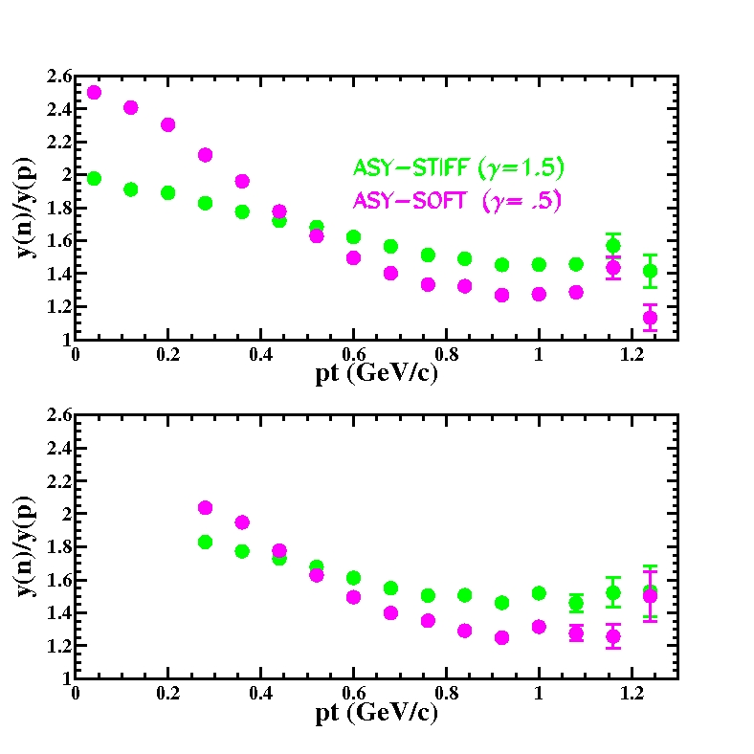
URQMD simulations
Au+Au @ 400 AMeV
0.35<y/yp<0.65
5.5<b<7.5 fm
b<3 fm
v932 23/10/09

Slide 13
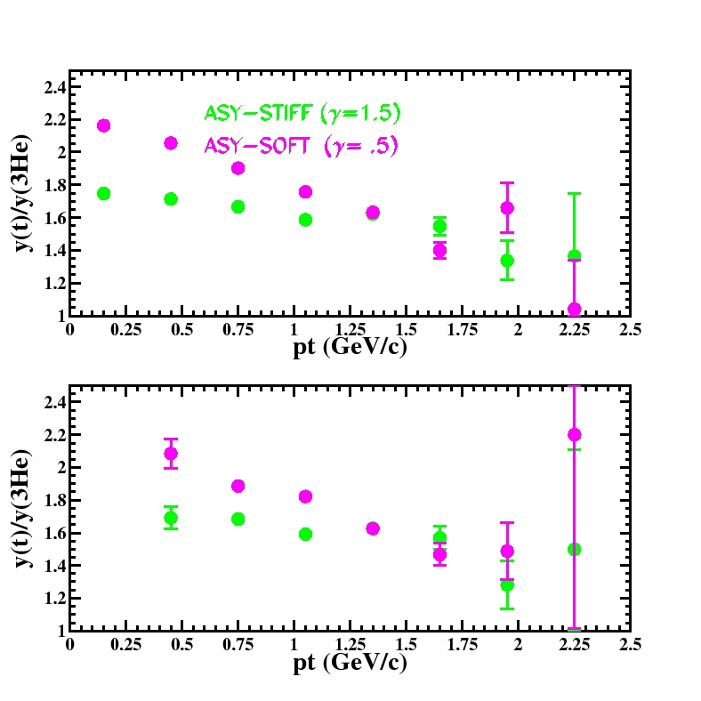
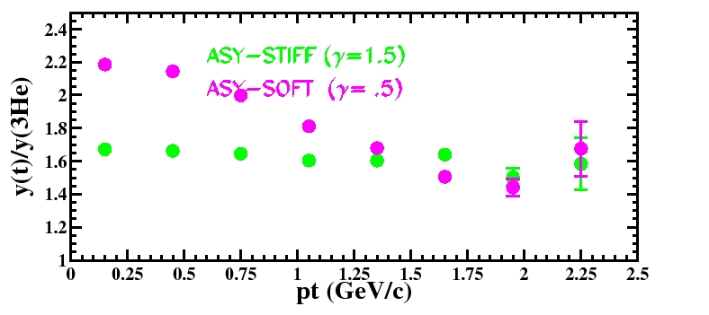
Au+Au @ 400 AMeV
0.25<y/yp<0.75
5.5<b<7.5 fm
b<3 fm
v932 22/10/09

Slide 14
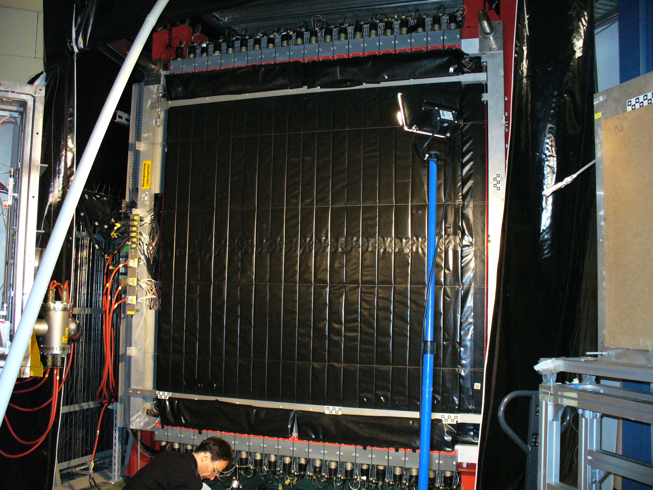
LAND
With new TACQUILA (GSI-ASIC) electronic

Slide 15
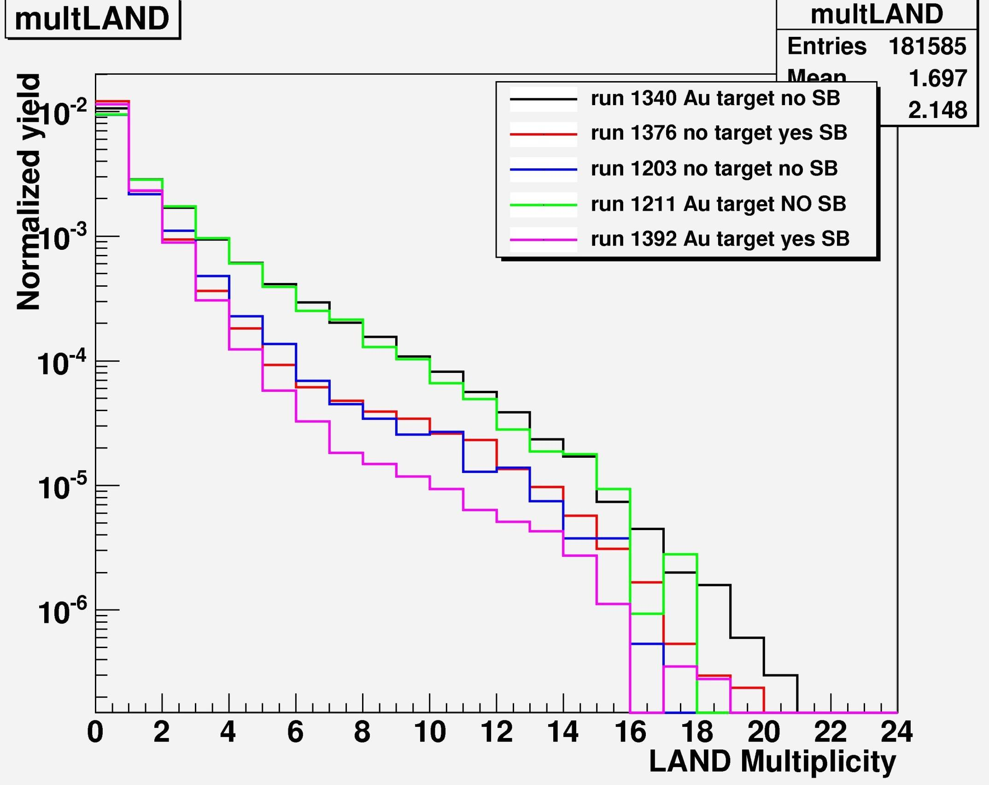
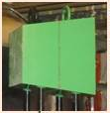
LAND
Au+Au @ 400 AMeV

Slide 16
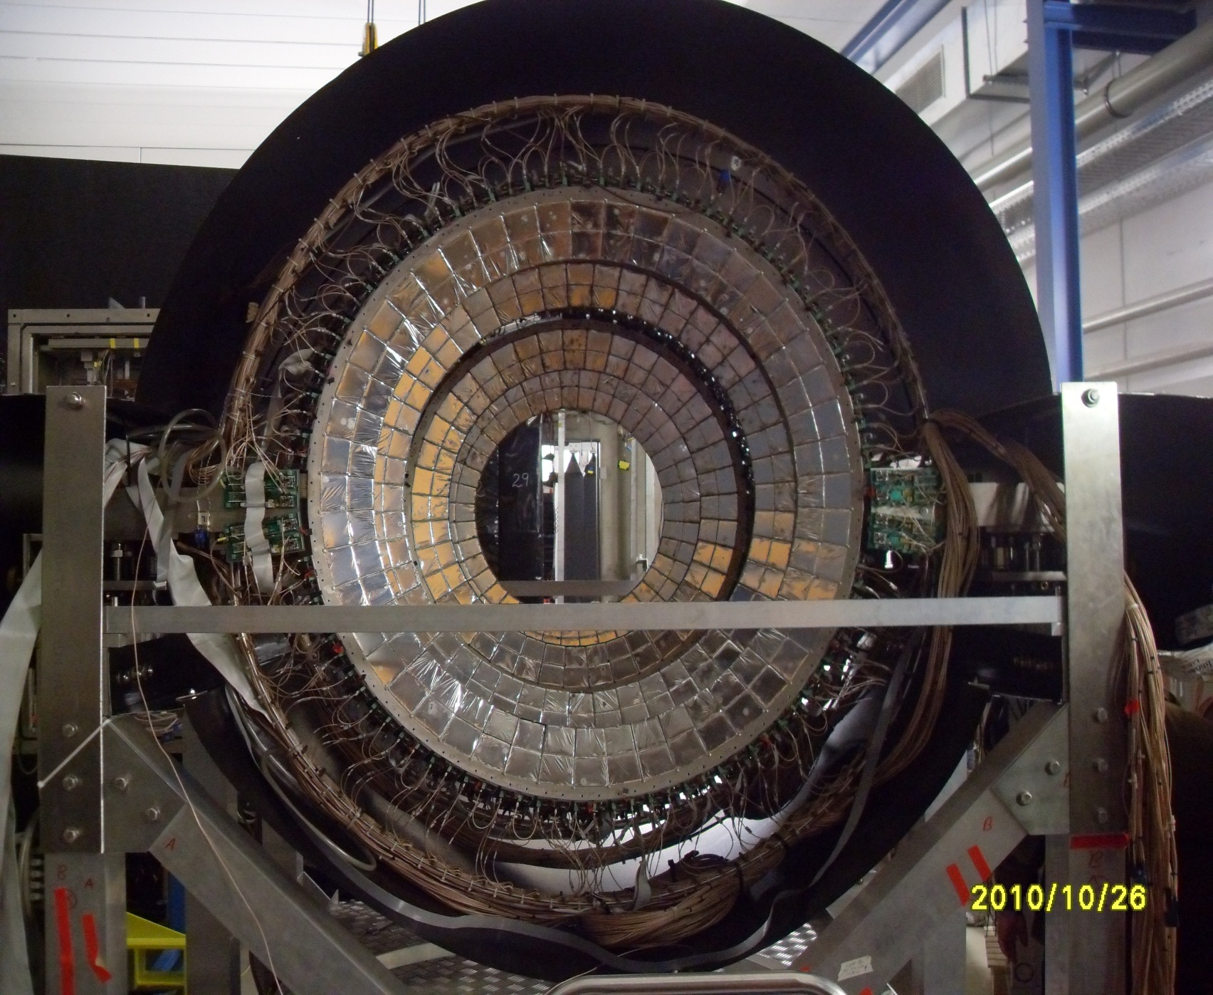
CHIMERA
300 μm
CsI
Si
12 cm
8 Rings
7-20 deg
352 CsI
32 Si
see S.Santoro talks

Slide 17
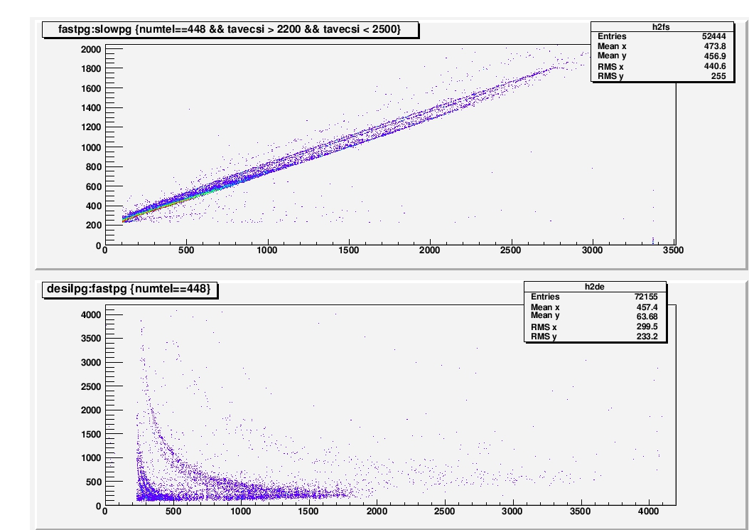
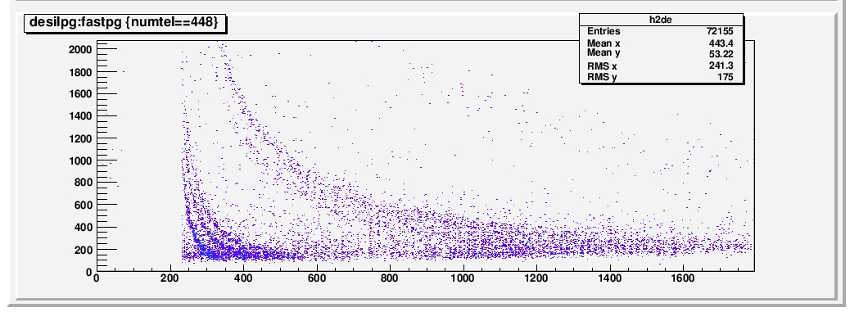
CHIMERA
Fast (ch)
Slow (ch)
E Sil (ch)
Fast (ch)
see S.Santoro talk

Slide 18
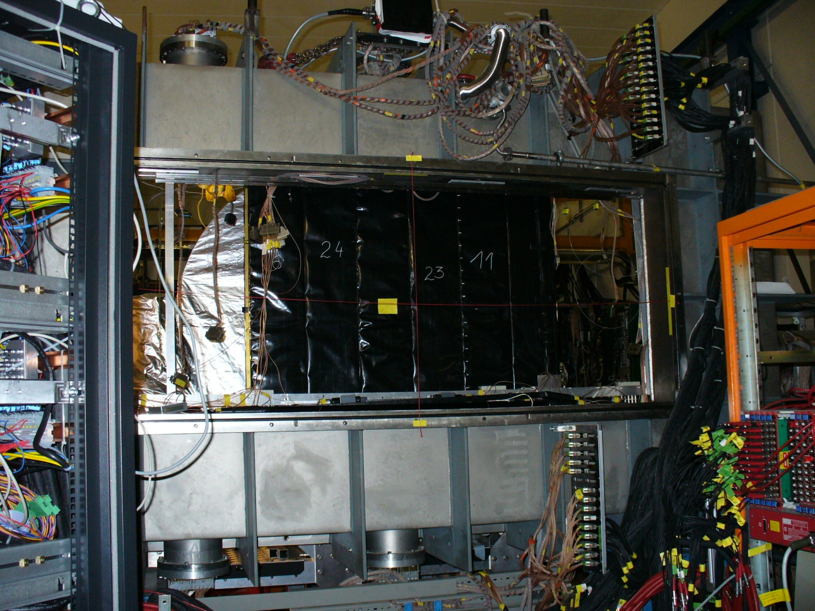
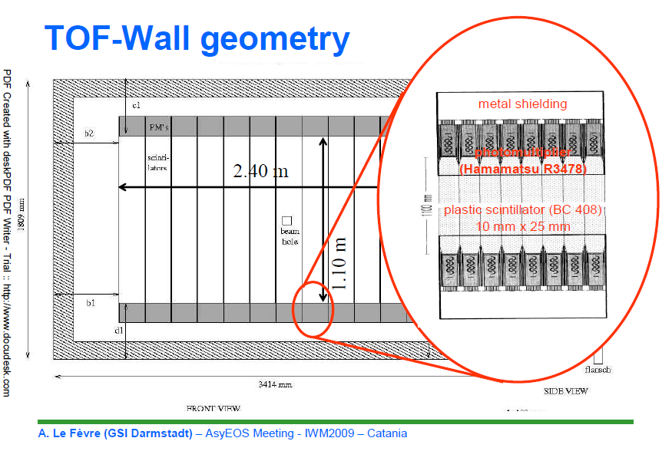
Aladin ToF-Wall
2 walls (front and rear)
96 plastics
2.5X 100 cm
ϑ < 7°

Slide 19
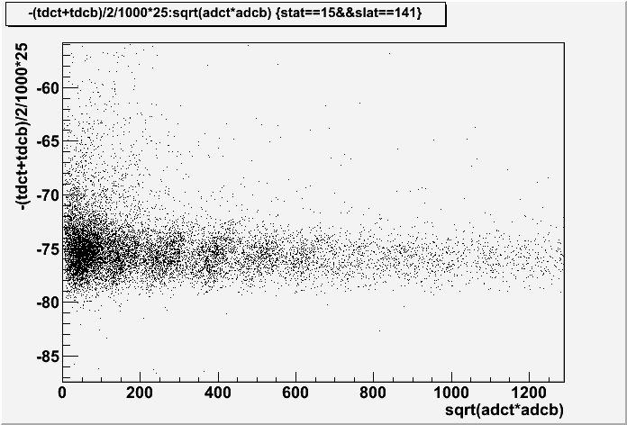
Au+Au @ 400 AMeV
Aladin ToF-Wall
ToF (ch)
Energy (ch)

Slide 20
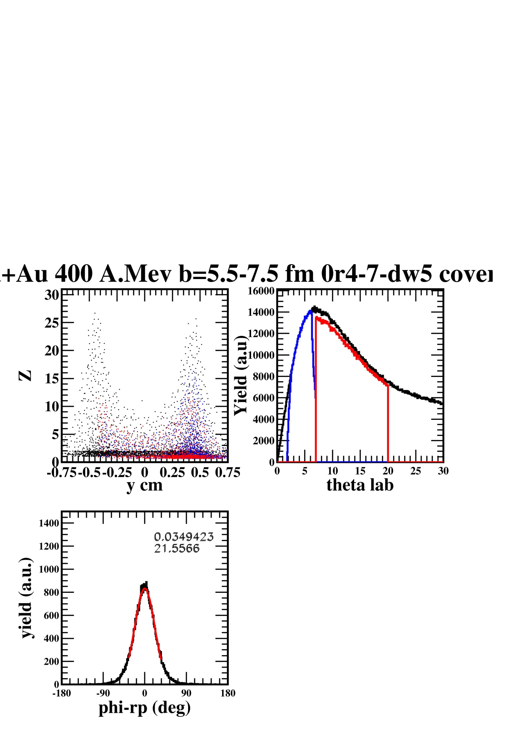
black→all charged particles
blue-red→used in reaction plane reconstrution (Q vector)
y_{cm}>0.1
Using only θ, φ, Z information
Au+Au @ 400 AMeV
b=5.5-7.5 fm
simulations
CHIMERA
Δt (CsI) =10 ns
ΔE/E (CsI) =10 %
pro-ycm-0.1+-0r4-7-dw5-10ns-10de-au-20run-covered.jpeg
NOPB New Conditions 08/10/09

Slide 21
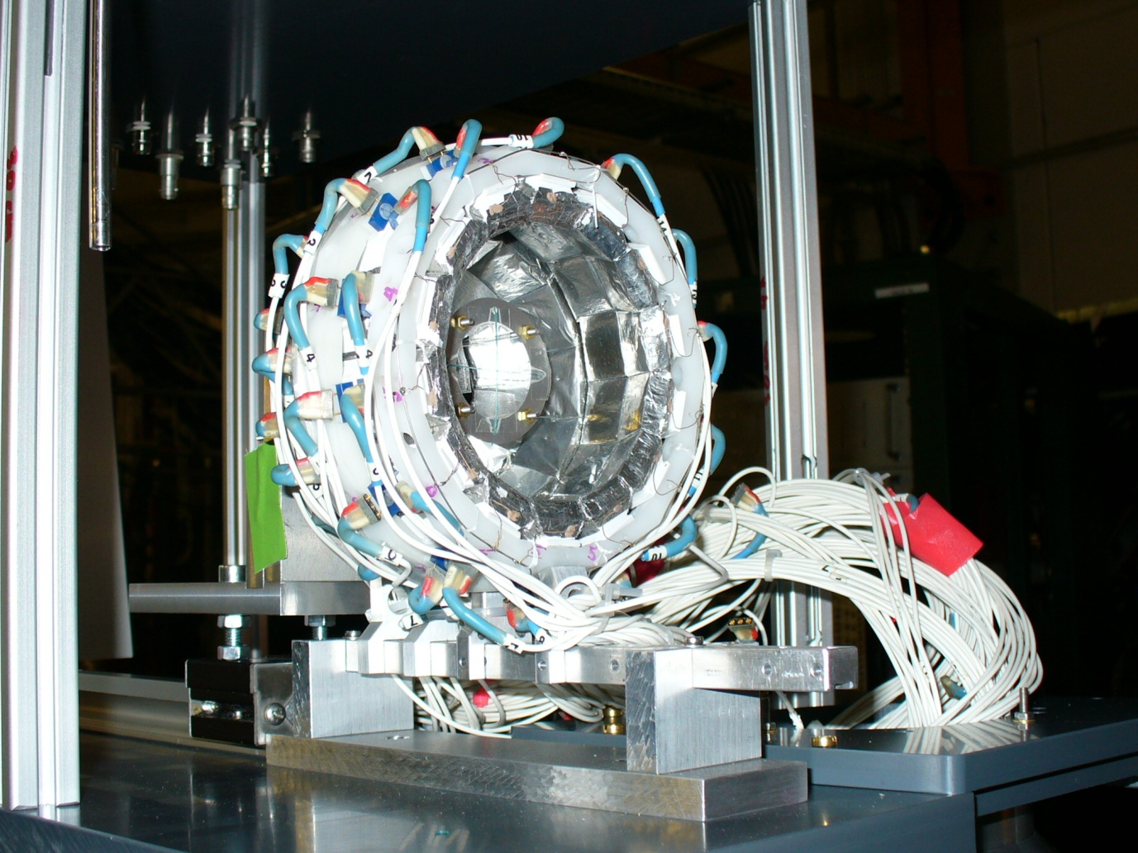
MicroBall
4 Rings
60-147 deg
50 CsI
~ 1cm thick CsI

Slide 22
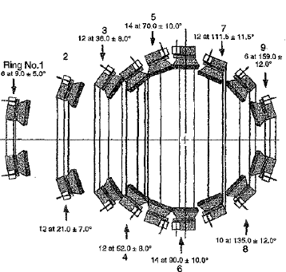
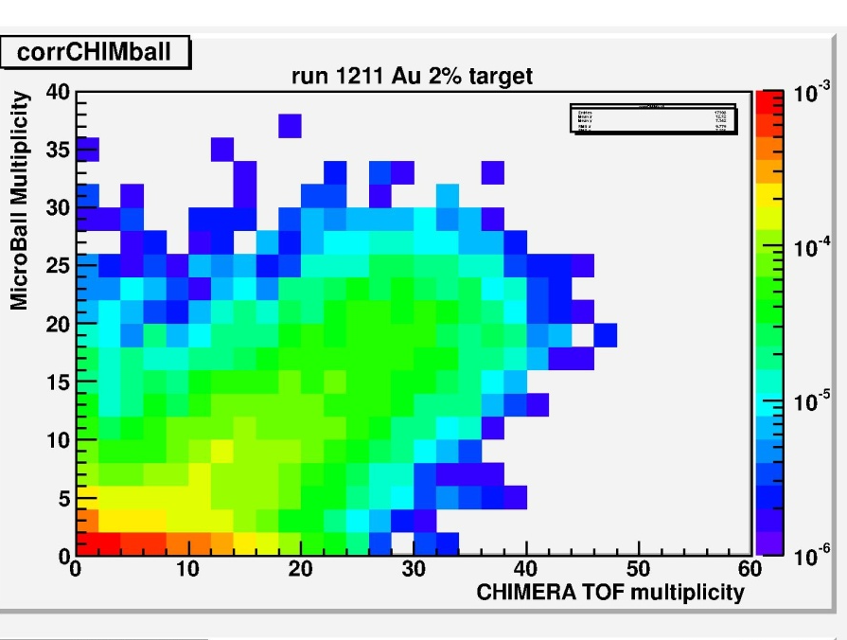
Au+Au @ 400 AMeV
MicroBall
210 cm
beam
~10 cm
θ>=7°
140 cm
θ=<20°
Not in scale
CHIMERA: MicroBall ~ 10:1

Slide 23

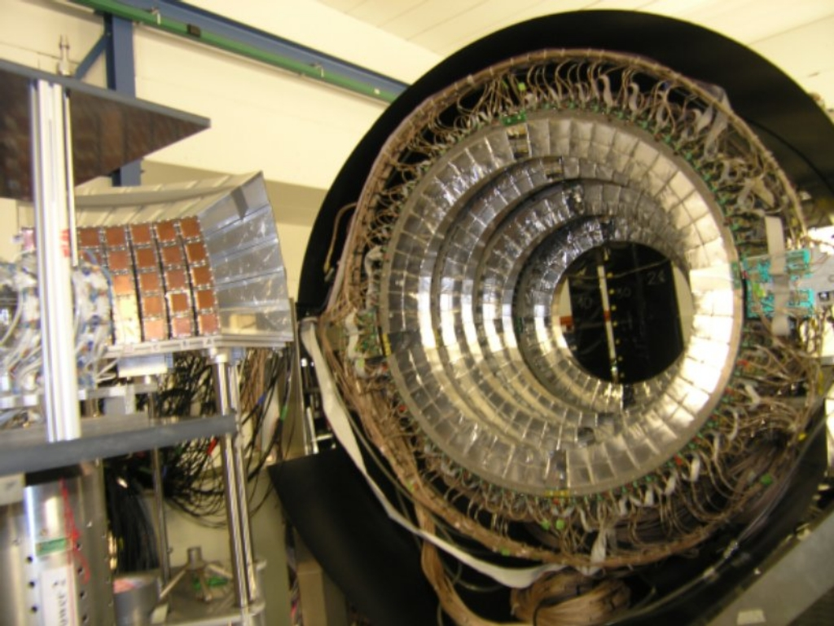
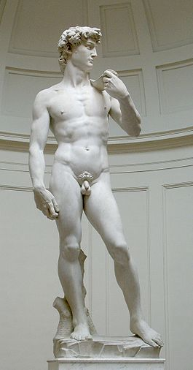
Goliath
David
beam
Michelangelo et al., Florence (1501)
Caravaggio et al., Rome (1609)

Slide 24
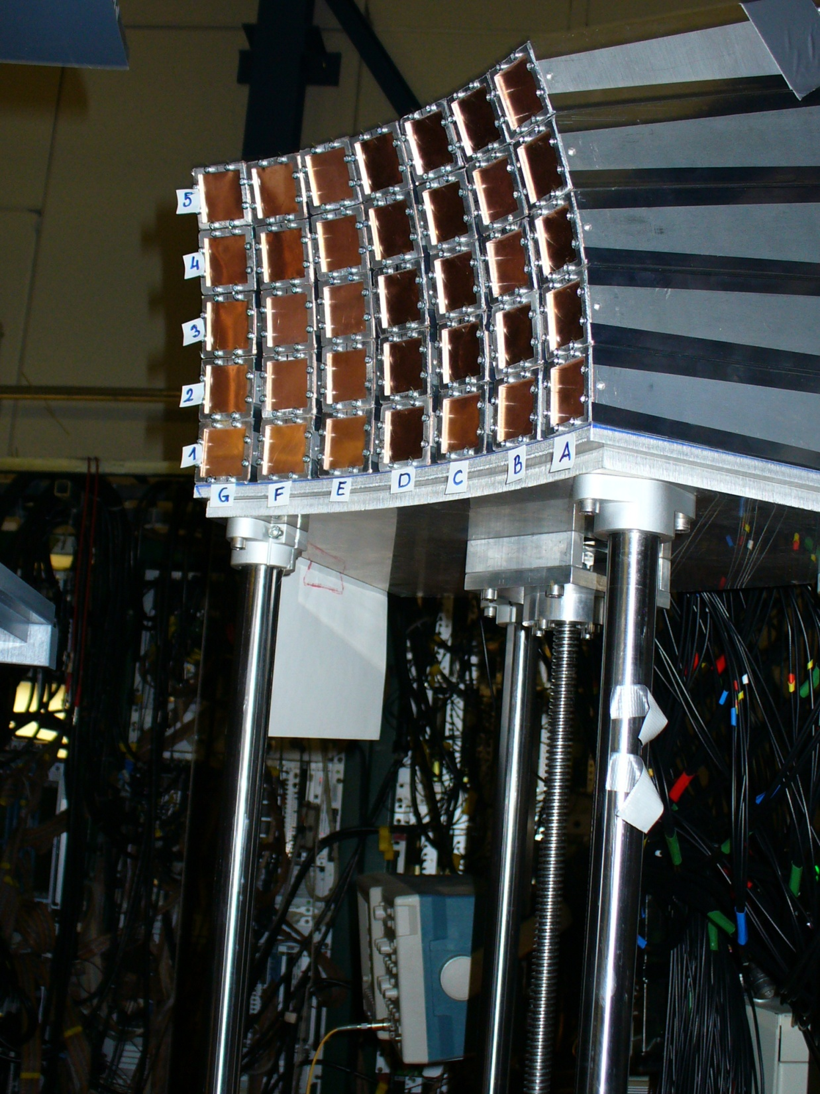
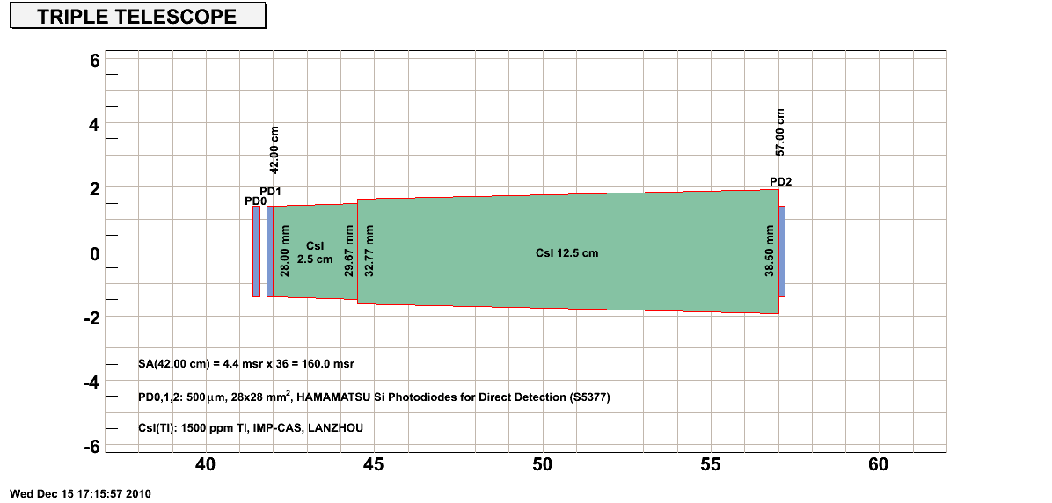
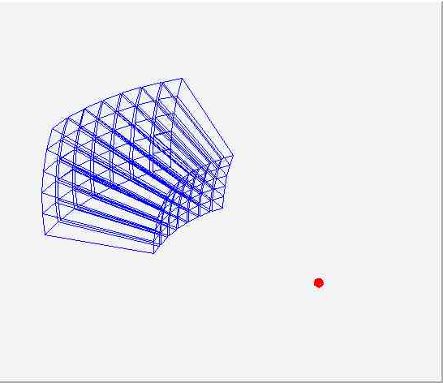
Krakow Array
35 modules
Coverage: 20.7 - 63.5 deg.
Distance from the target: 402 mm.
Digitized with 100 MHz, 14 bits Flash ADCs

Slide 25
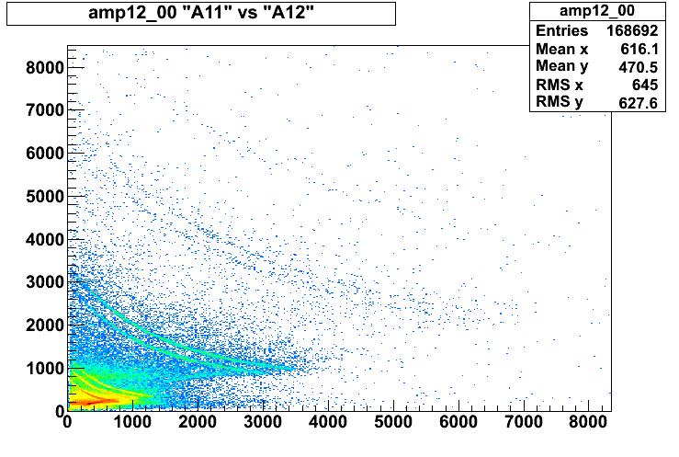
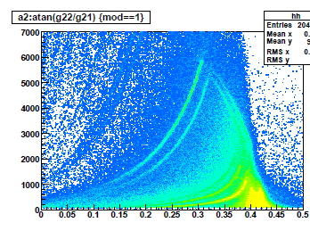
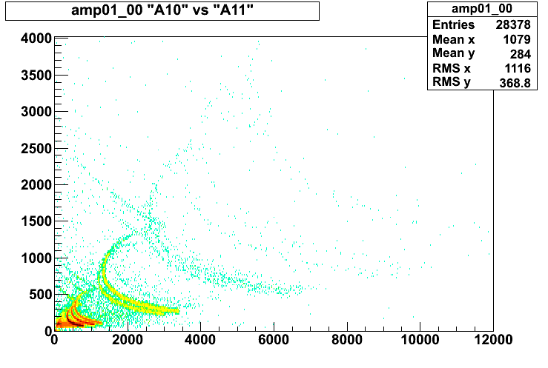
Krakow Array
http://www.gsi.de/informationen/wti/library/scientificreport2010/index.html#PHN-NQM-FOPI

Slide 26

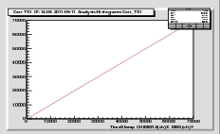
KaliMera 2.0 library
Optical link
chimera
6U
9U
TITRIS
V2718
V2718
V2718
Event builder Chimera
VME
VME
UDP/IP
Titris Bus
MBS: Multi Branch System
Local on-line analysis
TCP/IP
RIO3
TRIVA
TITRIS
MBS Chimera Receiver
Trigger bus
Scalers
Land
TofWall
Krakow Array
MicroBall
Time ordering,sorting,
Data storing
Global on-line analysis
Event builder MBS
Remote DAQ servers

Slide 27
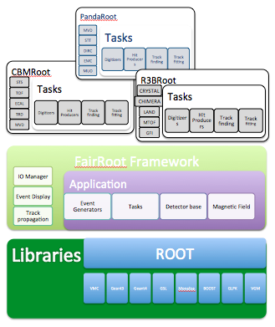
Analysis is in progress inside FairRoot framework
cbmroot.gsi.de
The FairRoot framework is fully based on the ROOT system. The user can create simulated data and/or perform analysis with the same framework. Moreover, Geant3 and Geant4 transport engines are supported, however the user code that creates simulated data do not depend on a particular monte carlo engine. The framework delivers base classes which enable the users to construct their detectors and /or analysis tasks in a simple way, it also delivers some general functionality like track visualization. Moreover an interface for reading magnetic field maps is also implemented.

Slide 28
Prescriptions:
Theory
coalescence
reproduce full reaction features
momentum dependence, mass spltting, in medium cross section
codes consistency, codes comparison
……
Experiments
Better experiments
New detectors
Radioactive beams
……
Collaborations!

Slide 29

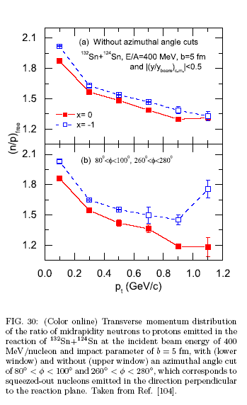
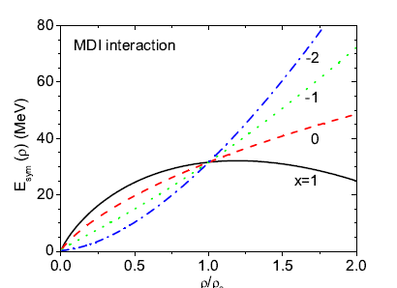
arXiv:0704.2340

Slide 30
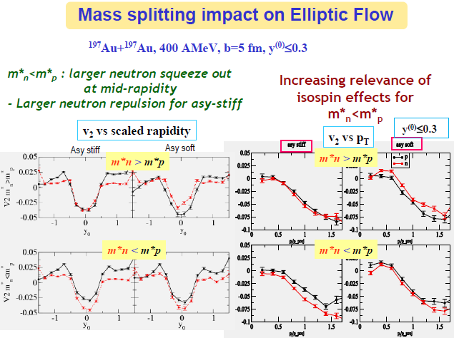
From M.Di Toro talk at Asy-Eos2010

Slide 31
Conclusions
Several heavy Ion reactions observables have been useful in order to get information on symmetry energy at sub-saturation densities (giant and pigmy dipole resonances, isobaric analogue states and masses, isospin diffusion, n/p ratios, ³H/³He ratio…).
Viceversa, more extended data sets and consistency checks (π⁻/π⁺) are needed in order to arrive at firm conclusions at supra-saturation densities
Neutron-proton elliptic flow is a promising observable
In the ASY-EOS experiment at GSI we
tried to measure such (and other) observables……….???
Model predictions consistency ???
……“a good constraint” of symmetry energy at supra-saturation density
??????

Slide 32
THANKS to all ASYEOSers!
GSI, Germany
Ganil, France
Daresbury, UK
Liverpool, UK
Milano, Italy
Catania, Italy
Messina, Italy
MSU, USA
TAMU, USA
WMI, USA
Krakow, Poland
RIKEN, Japan
Zagreb, Croatia
Santiago, Spain
KSU, Saudi Arabia && others…

Slide 33
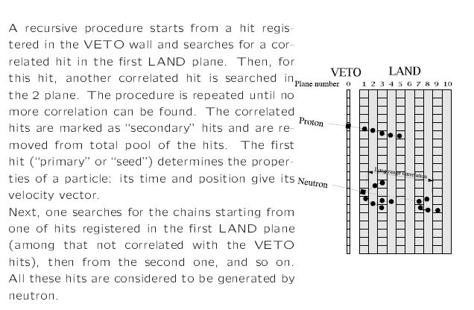
Adapted from P.Pawloski, IWM2007

Slide 34


Slide 35
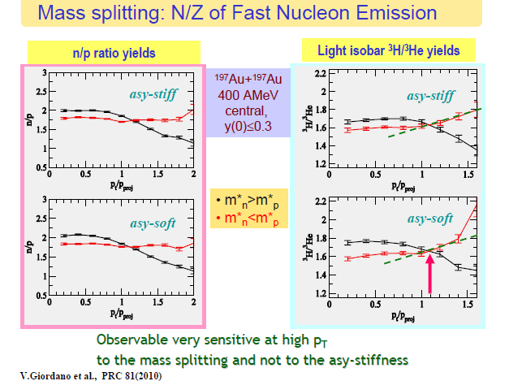
From M.Di Toro talk at Asy-Eos2010

Slide 36
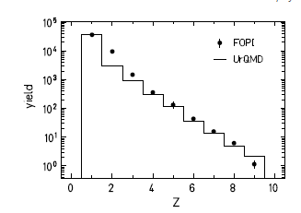
Main motivation:
symmetry energy at supra-saturation densities
UrQMD simulations
UrQMD vs. FOPI data:
Au+Au @ 400 AMeV
b< 2.5 fm
STIFF
*
SOFT
* W. Reisdorf, et al.,
Nucl. Phys. A 612 (1997) 493.
Coalescence condition:
Dr <3 fm and Dp< 275 MeV/c
See Qingfeng Li, J. Phys. G31 1359-1374 (2005) and references therein

Slide 37
Neutron and proton elliptic flow
UrQMD vs. FOPI data:
Au+Au @ 400 A MeV
5.5<b<7.5 fm
How to measure?
inversion of neutron
and hydrogen flows
stiff
soft
A. Andronic et al., Eur. Phys. J. A 30 (2006) 31.
Z=1
squeeze-out more sensitive than the directed flow
400 AMeV maximum V2

Slide 38
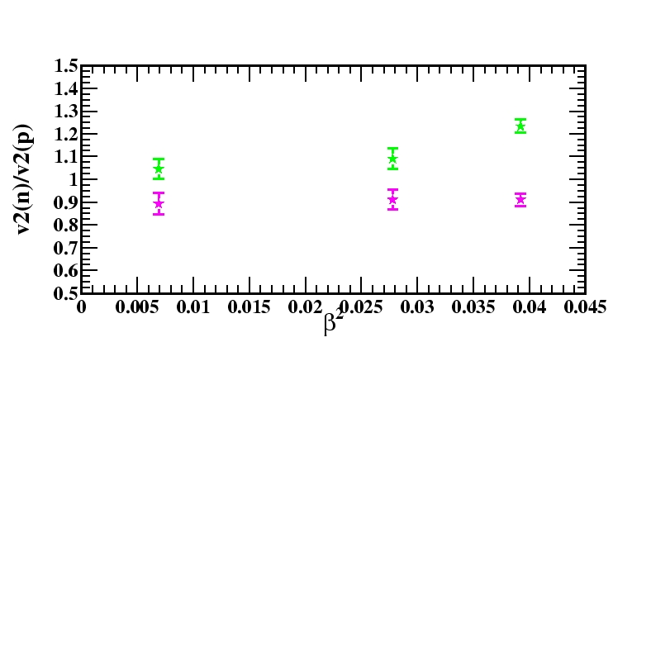
URQMD simulations: @ 400 AMeV
V2 for |(y/yp)^{c.m.}|<0.1
Au+Au
⁹⁶Zr+⁹⁶Zr
STIFF
⁹⁶Ru+⁹⁶Ru
β=(N-Z)/(N+Z)
SOFT
Au+Au b=5.5-7.5 fm
⁹⁶Zr+⁹⁶Zr b=4-6 fm
⁹⁶Ru+⁹⁶Ru b=4-6 fm
NTD 13/10/09

Slide 39
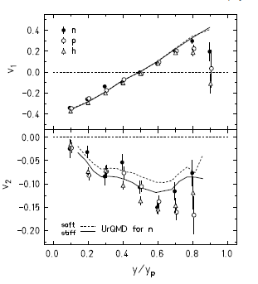
LAND coverage
37°<θ_{lab}<53°
61°<θ_{lab}<85°

Slide 40

Time, charge and space resolution
Aladin ToF-Wall
FWHM = 2.35 σ
A. Schüttauf

