Slide 1
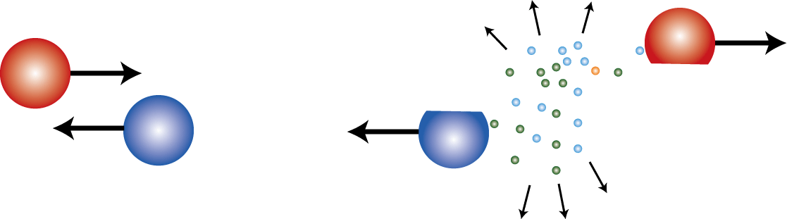
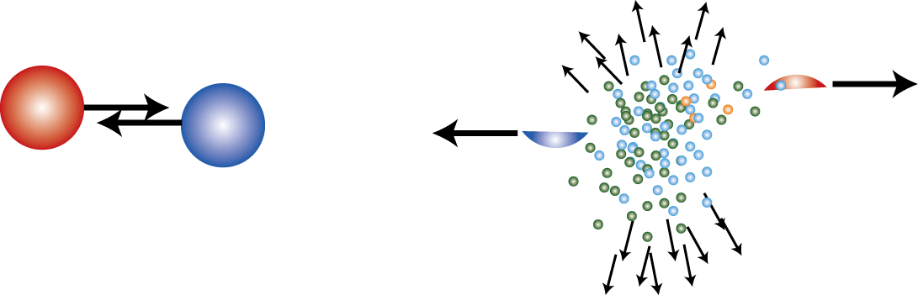
HIMAC Pion Experiment and
Pb Isotope Radius Measurements
Pion Ratios and ESYM
Department of Physics
Kyoto University
Tetsuya MURAKAMI

Slide 2
Neutron Star vs Nuclear EOS
Mass
High Density
Mass Limit
Phase
Transition
Observations of
Mass and Radius
Low Density
Radius
Tolman–Oppenheimer–Volkoff equation
MR(Mass-Radius) Relation
TOV equation
EOS
E/A
Low Density
Phase
Transition
(nucleon,electron,μ)
High Density
L
(nucleon,hyperon,
meson,quark)
ρ₀
2ρ₀
Density (ρ_{B})

Slide 3
Useful Notations

Slide 4
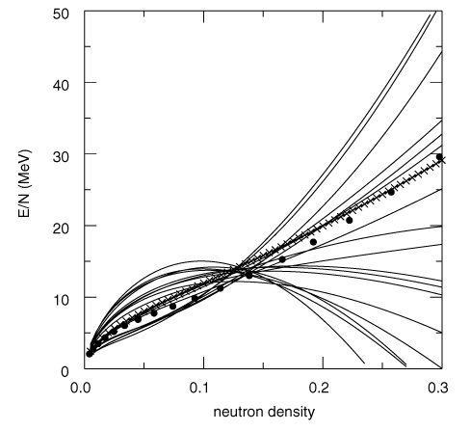
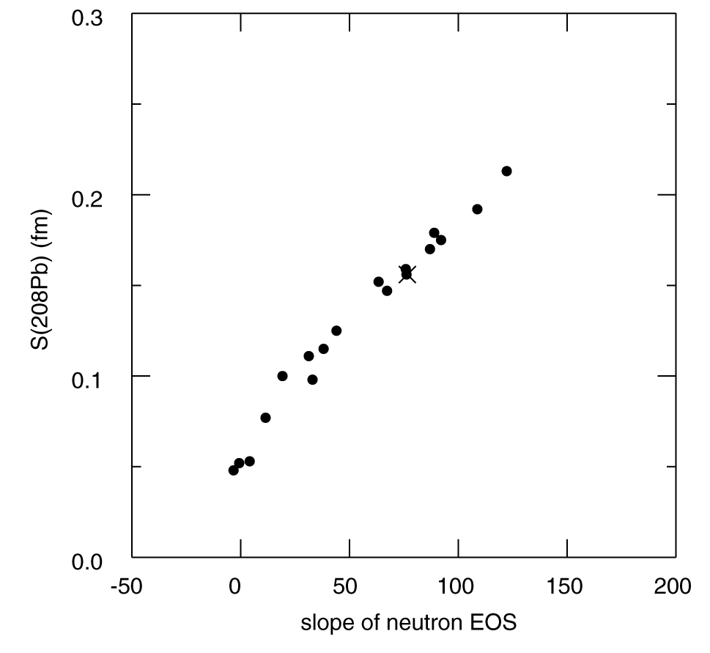
It started in 2000 from Alex`s paper,
PRL85, 5296 (2000)
He urged experimentalists to measure a neutron skin thickness of ²⁰⁸Pb precisely.
We challenge to ALEX and PREX.

Slide 5
Neutron Density Distributions of Pb Isotopes
From J. Zenihiro’s PhD thesis 2011
PRC82, 054607 (2010)

Slide 6
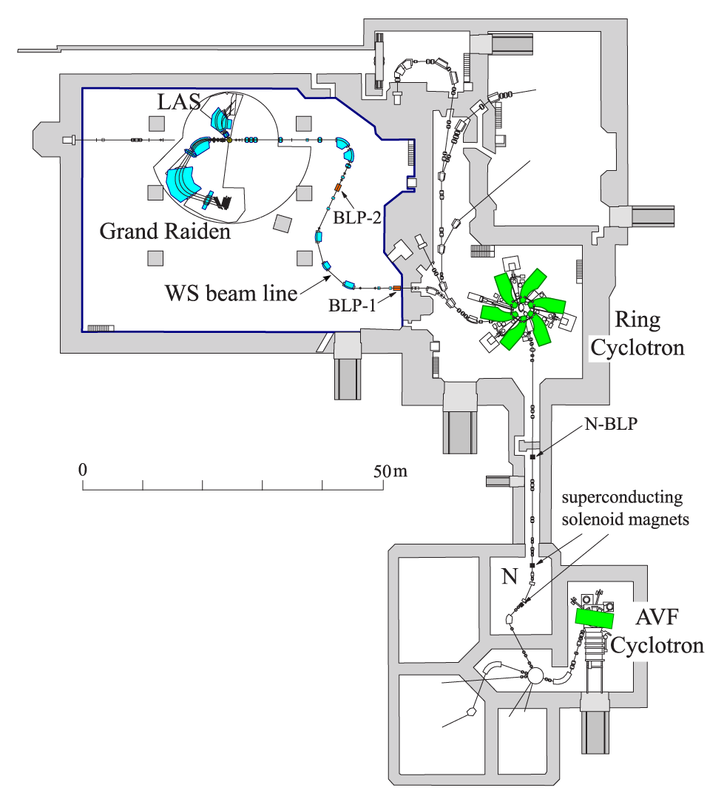
RCNP, Osaka University
Polarized Proton beams of 295 MeV
Typical polarization ~75%

Slide 7
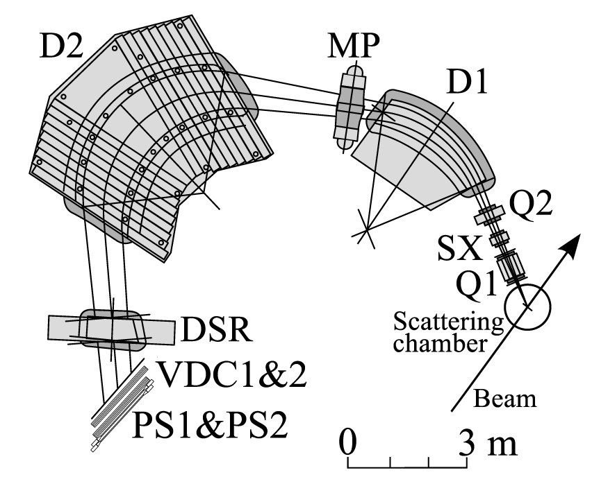
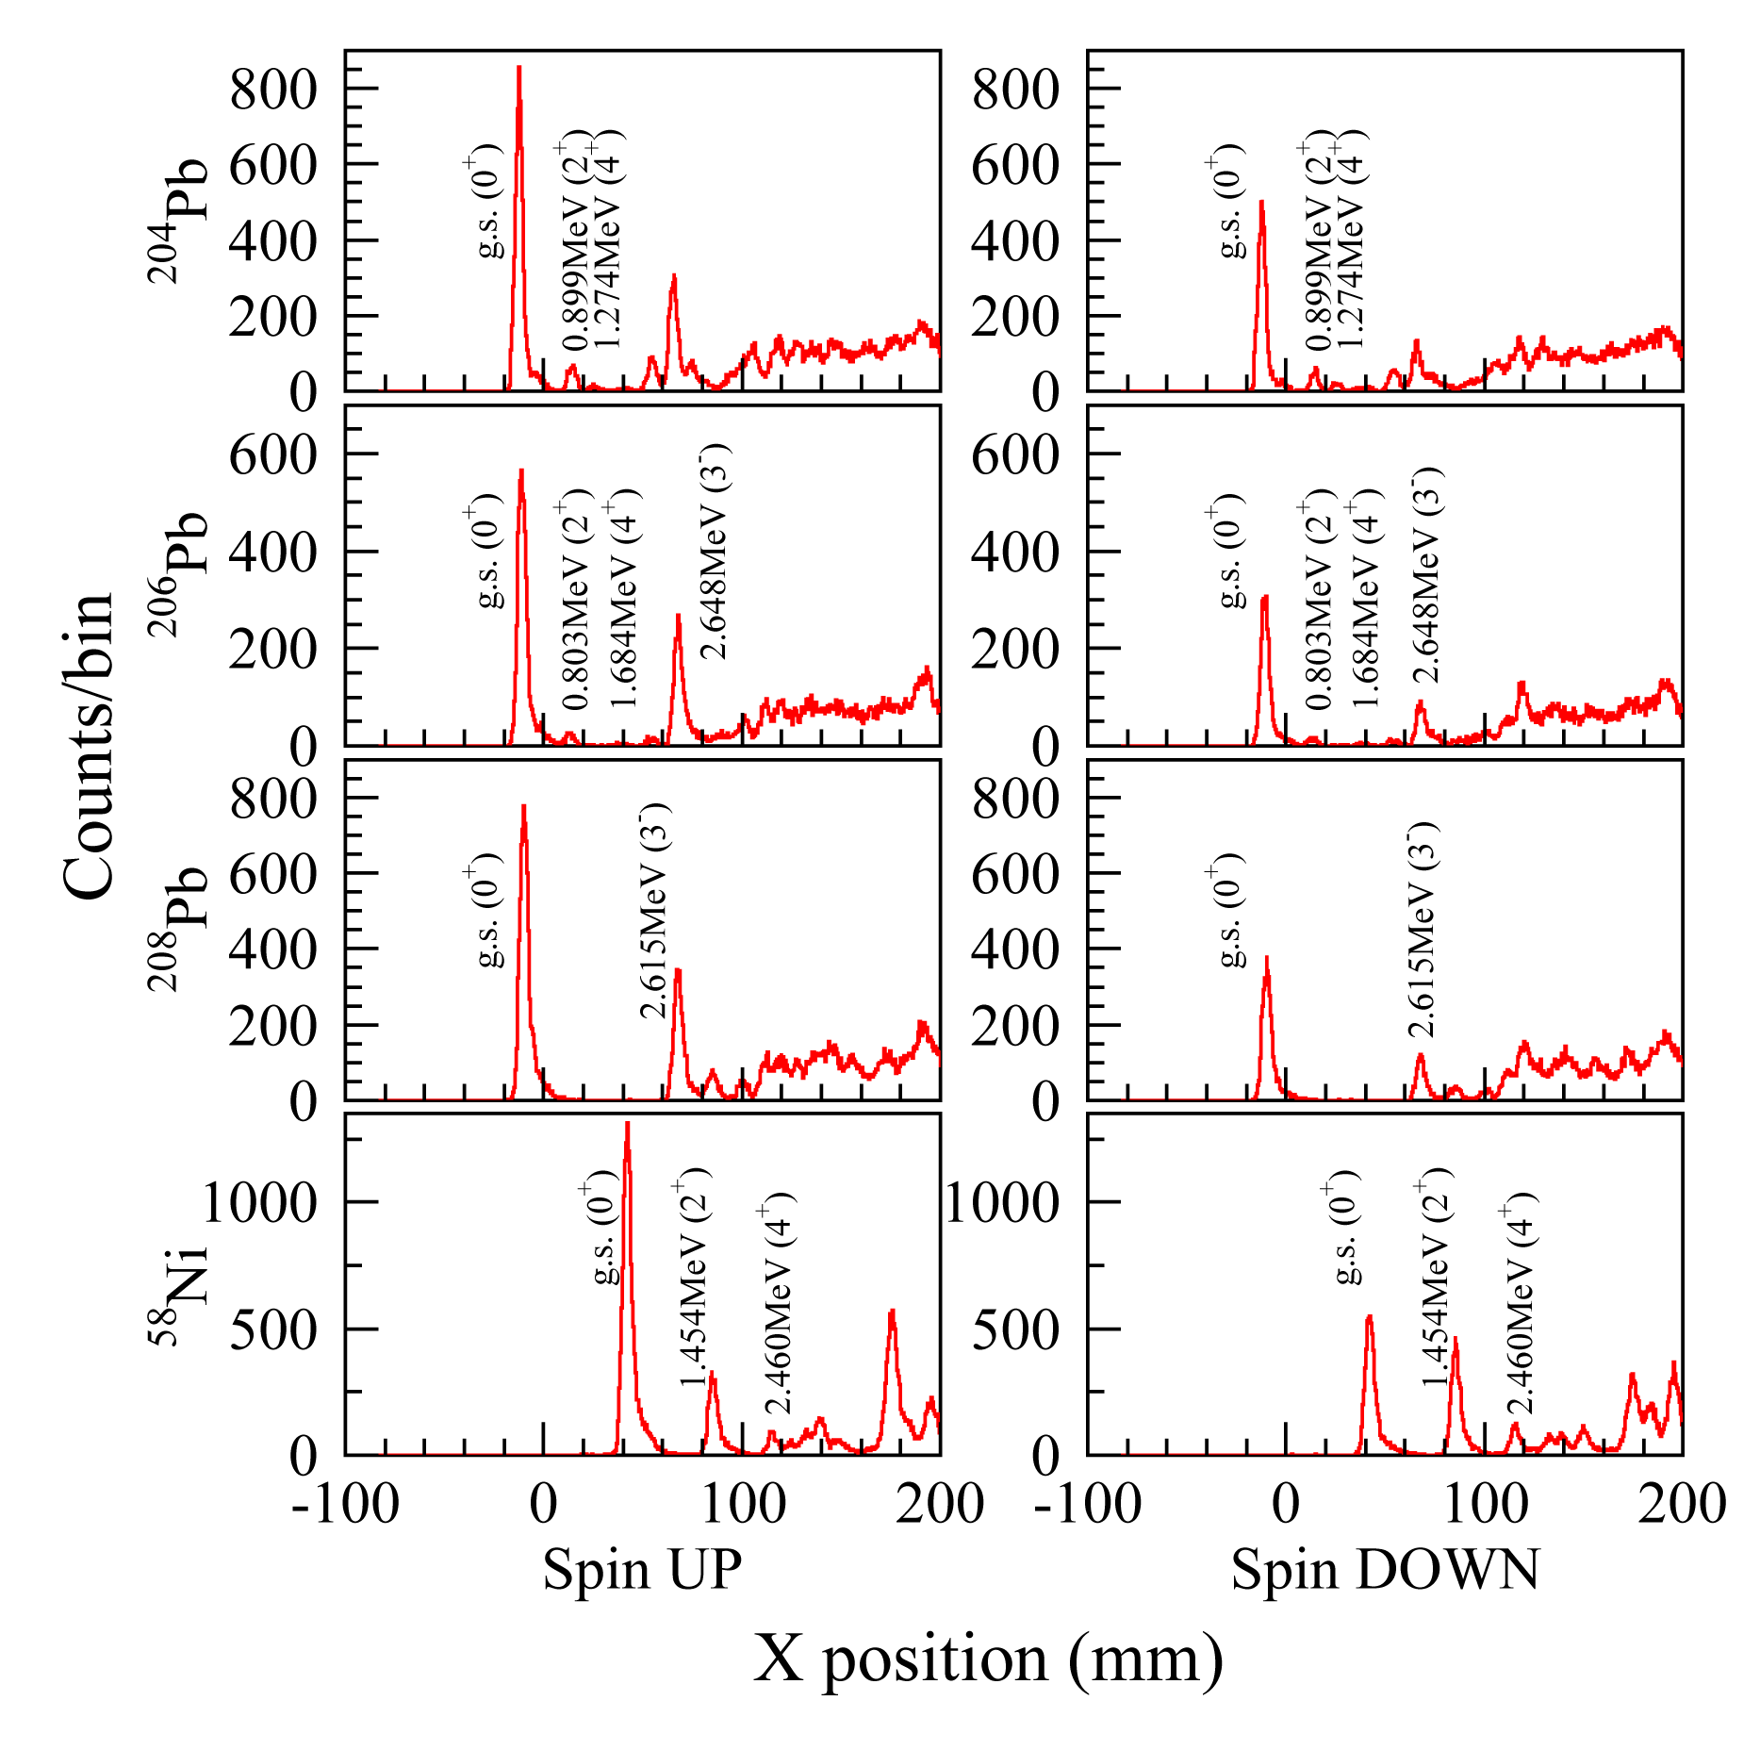
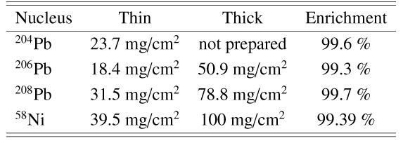

Slide 8
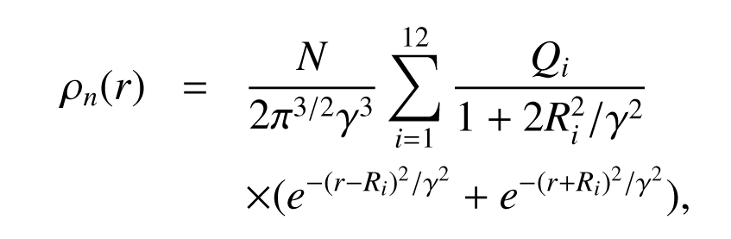
Analysis
Relativistic Impulse Approximation developed by Murdock and Horowittz (MH)
Realistic point proton density distribution deduced from electron scattering data
Scalar density = 0.96 Vector density
Neutron density = Sum of Gaussian

Slide 9
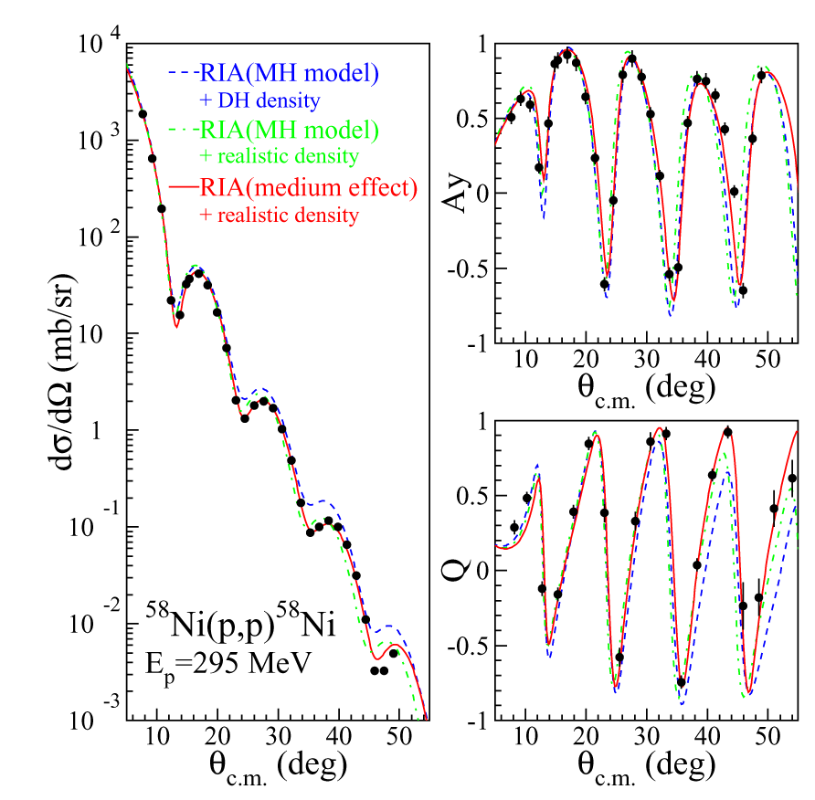
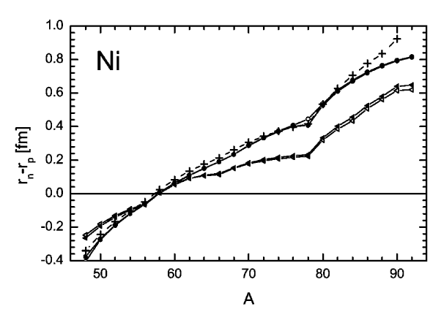
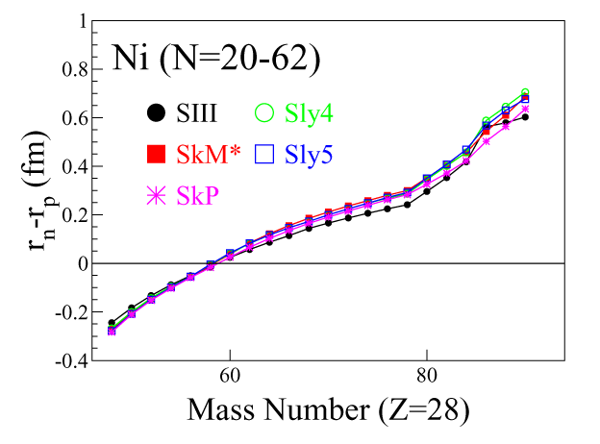
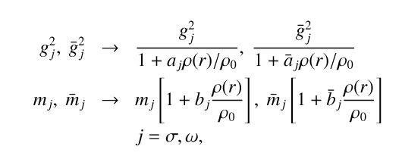
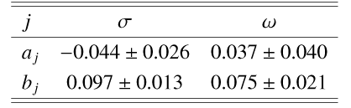

Slide 10
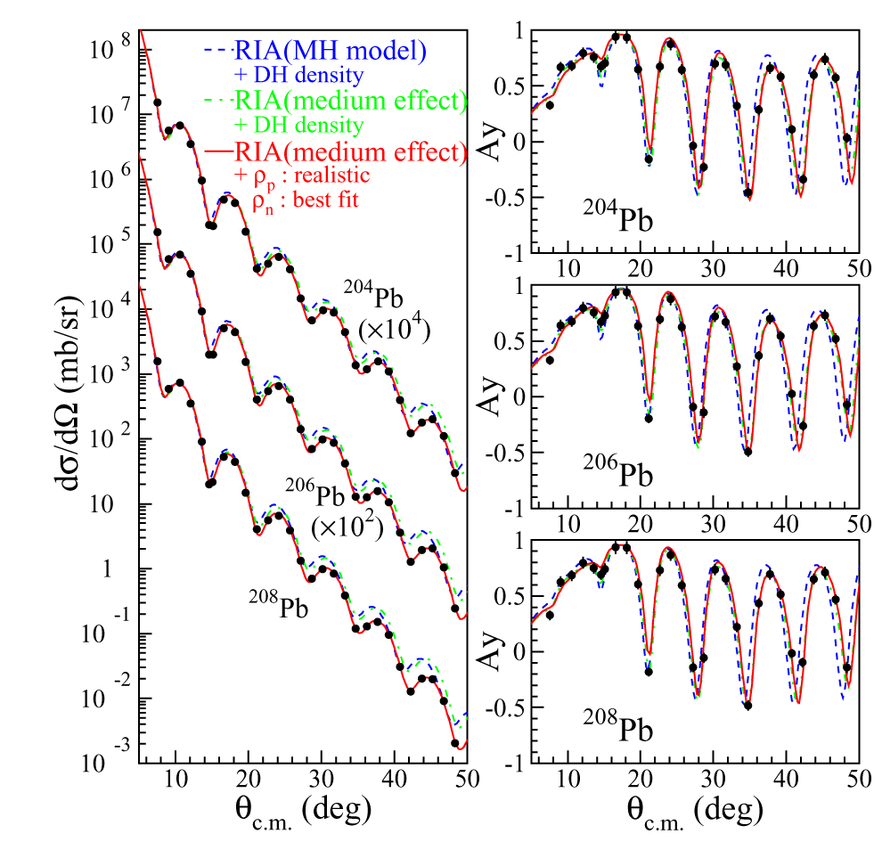

Slide 11
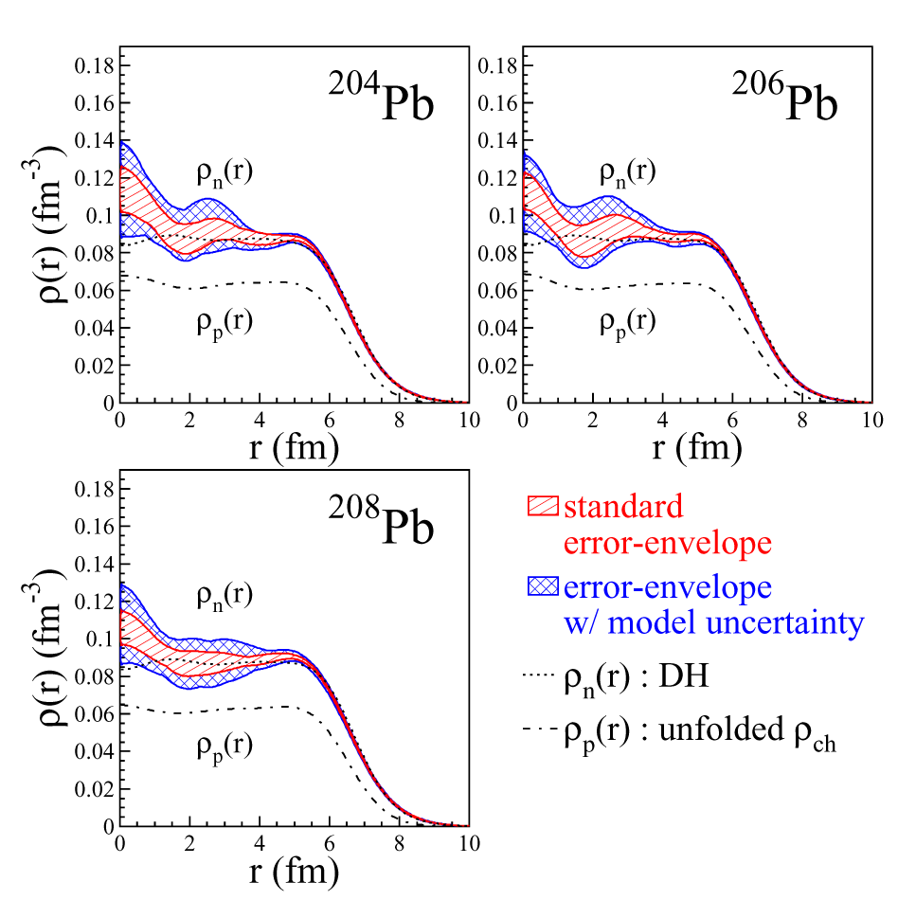
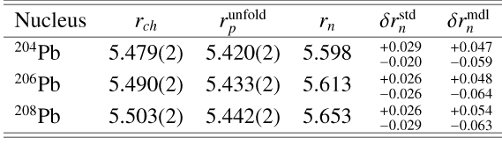

Slide 12
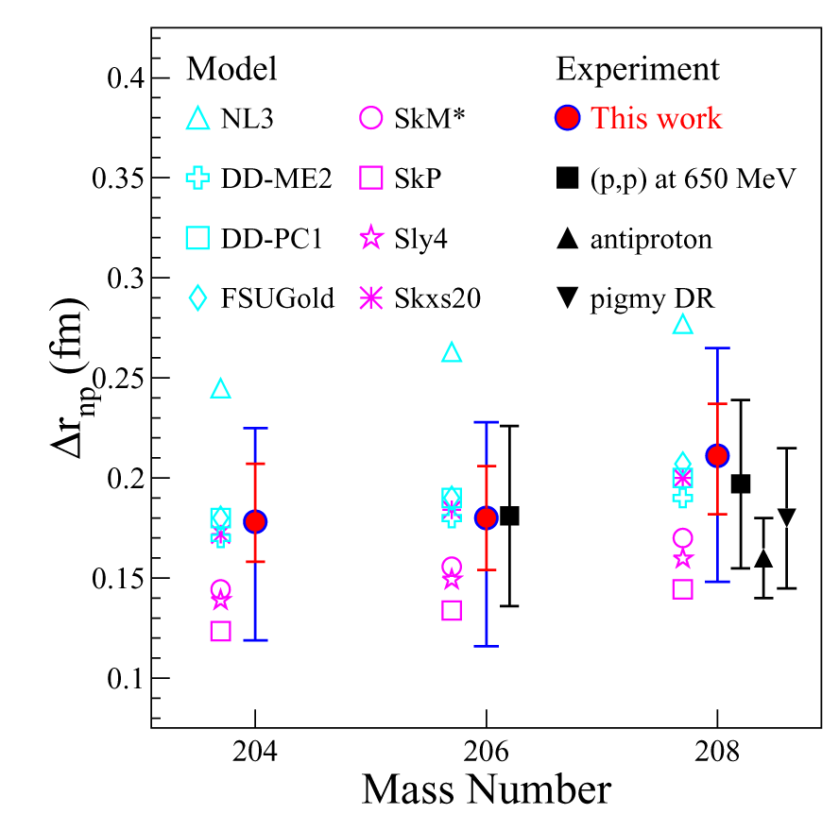

Slide 13
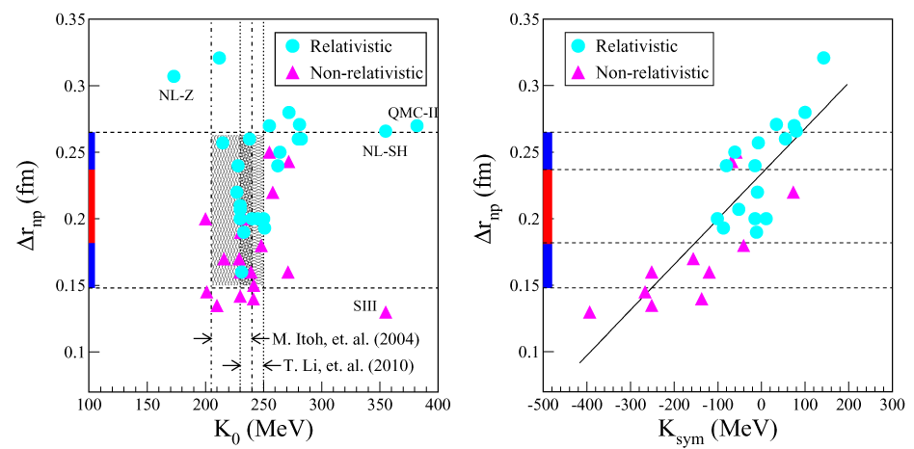
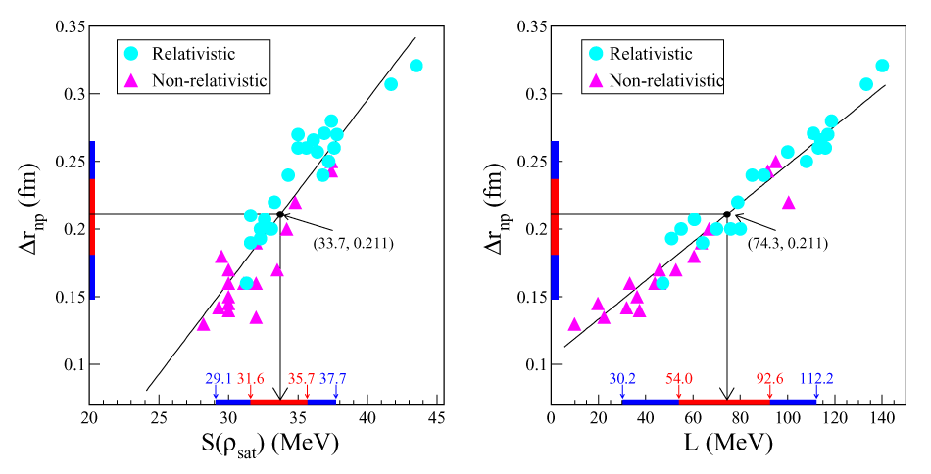

Slide 14
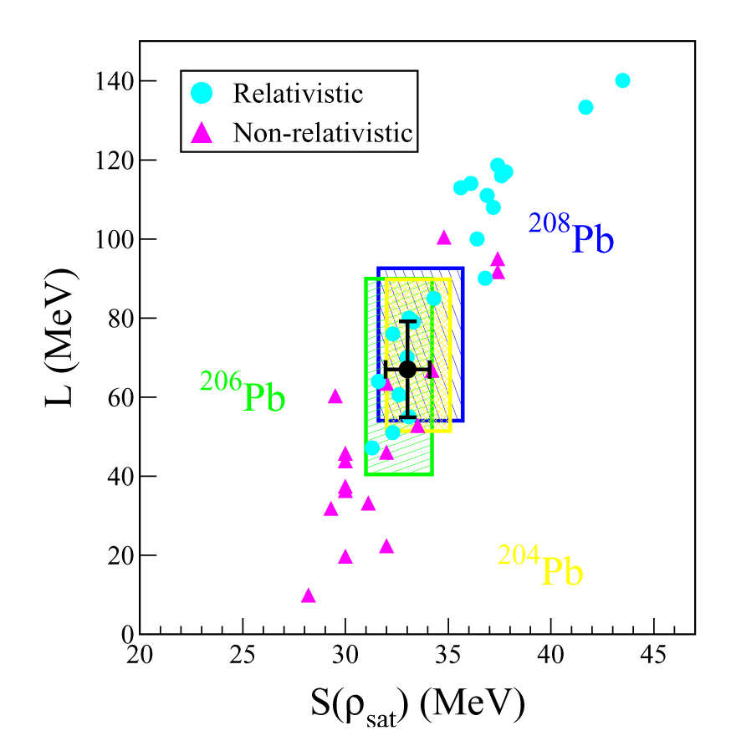
S=33.0±1.1 MeV
L=67.0±12.1 MeV

Slide 15
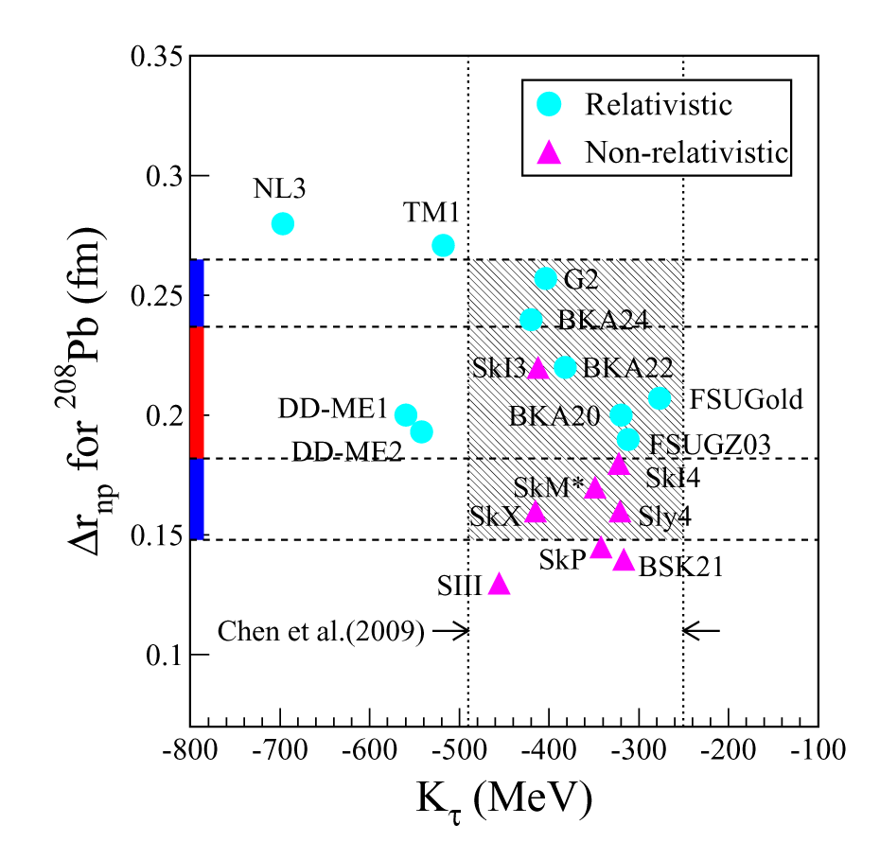
Li et al.(2009)

Slide 16
Summary of neutron skin thickness
S=33.0±1.1 MeV
L=67.0±12.1 MeV
Unfortunately,
doesn`t look like sufficiently precise.

Slide 17
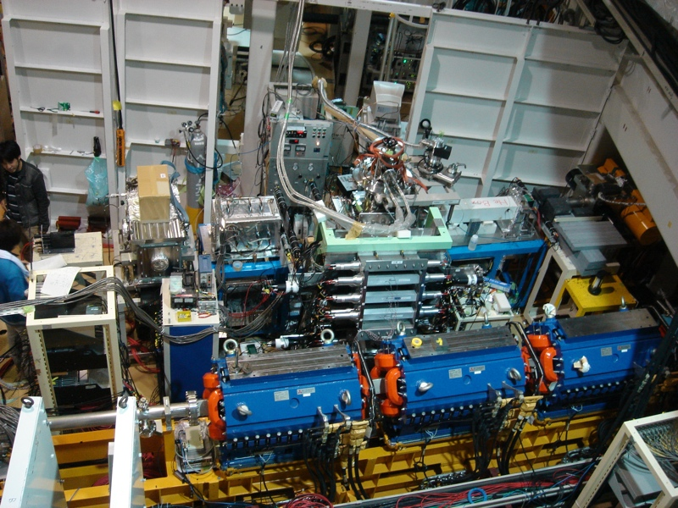
ESPRI (Elastic Scattering of Proton with RI beam) Project
One of Future Directions
Beam line MWDCs
Solid hydrogen
target (1mm thick)
Large MWDCs for
recoil protons
Array of 14 NaI(Tl)
Array of Silicon
Strip Detectors
We have measured elastic scatterings on ²⁰O, ⁹⁻¹¹C, and ^{66,70}Ni.

Slide 18
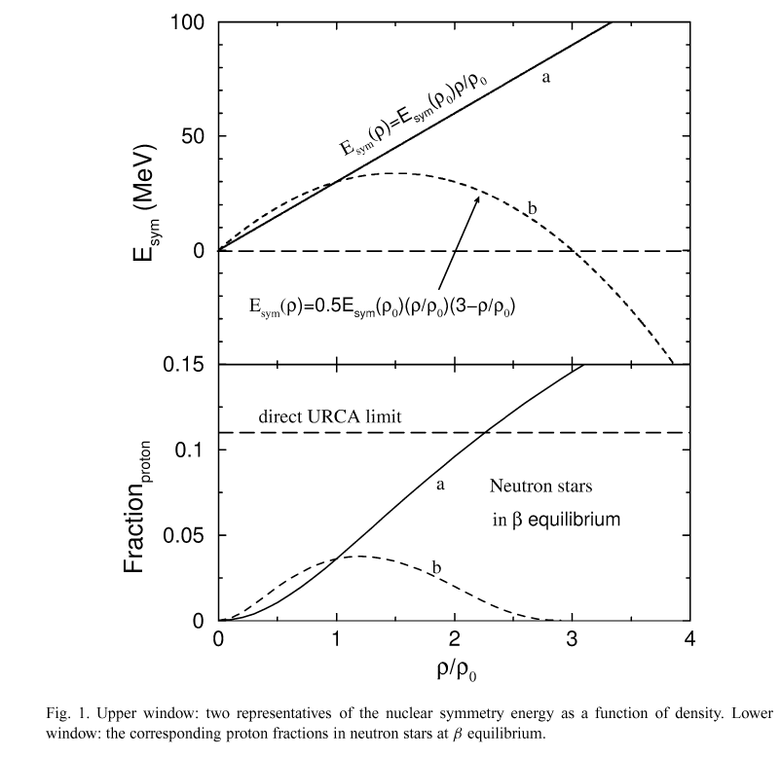
According to Bao-An’s calculation from NPA 708 (2002) 365.

Slide 19
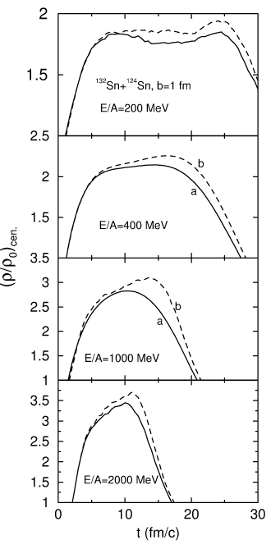
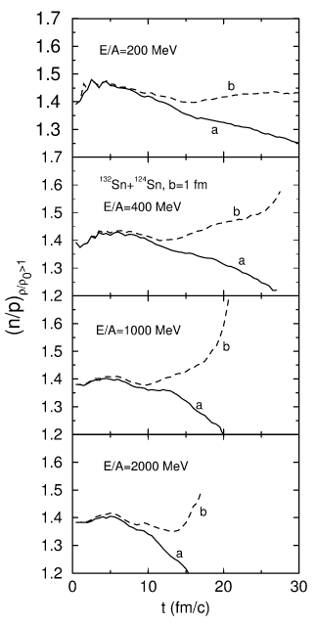
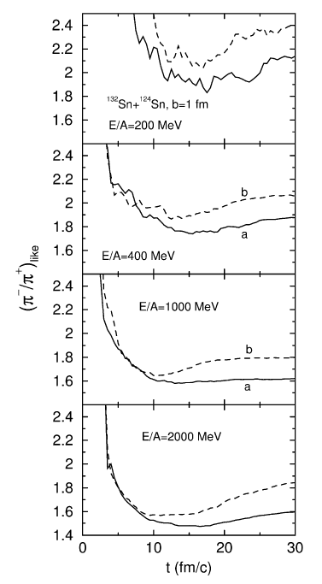

Slide 20
RIBF
?
S=33.0±1.1 MeV
L=67.0±12.1 MeV
K_{sym}=-148±124 MeV
GSI
MSU
Isospin diffusion, n-p flow
Au+Au
Xiao, et al., arXiv:0808.0186 (2008)
Reisdorf, et al., NPA 781 (2007) 459.
Pion production

Slide 21
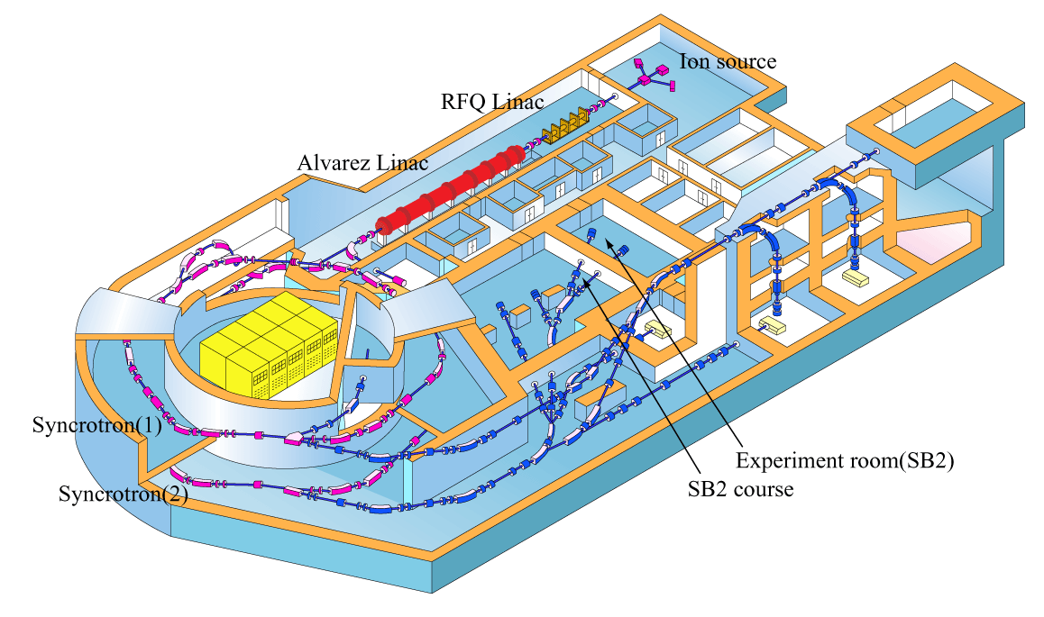
HIMAC Pion Experiments
Details will be presented by Mr. Sako tomorrow.
Our on-going SAMURAI-TPC project along the same direction will be presented by Dr. Isobe this afternoon.

Slide 22
Using Minimum Setup
Centrality Filter
  Multiplicity filter for Charged Particles
      Portable, If possible.
Pion Detector
  Simple and portable system
HIMAC

Slide 23
Performed Experiments
Target | Beam | energy | 30deg
45deg | 60deg | 75deg | 90deg | 120deg
2008.11 | In (Pb) | ¹³²Xe | 400 MeV/u
2009.7 | In (Pb) | ²⁸Si | 400 MeV/u
2009.10 | In (Pb) | ²⁸Si | 600 MeV/u
2009.11 | In | ²⁸Si | 800 MeV/u
○
○
○
○
○
○
○
○
○
○
○
○
○
○
○
○
○
○
○
○
○

Slide 24
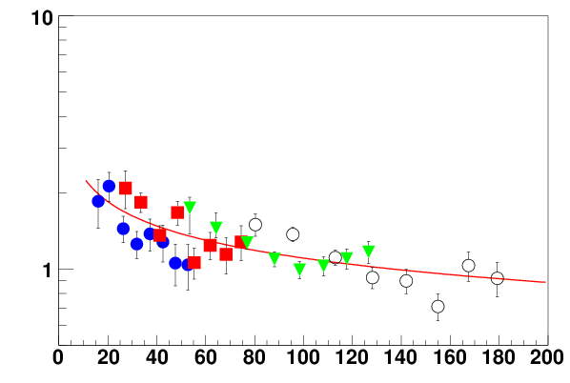
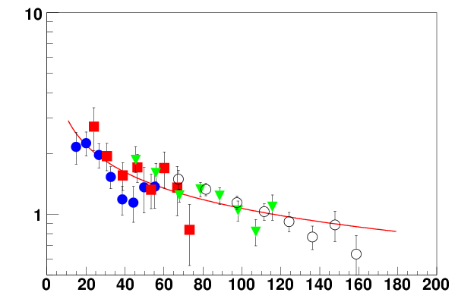
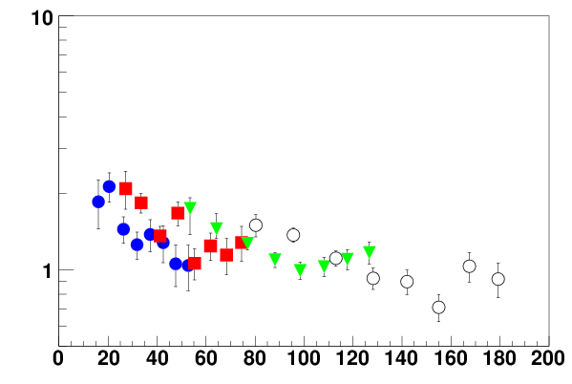
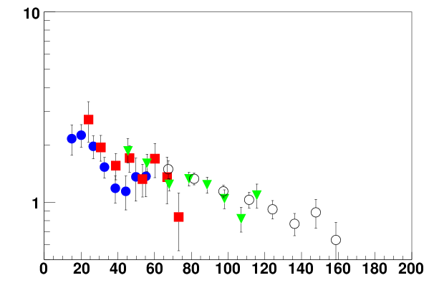
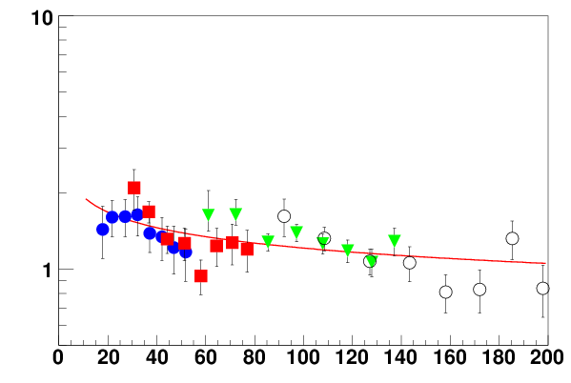
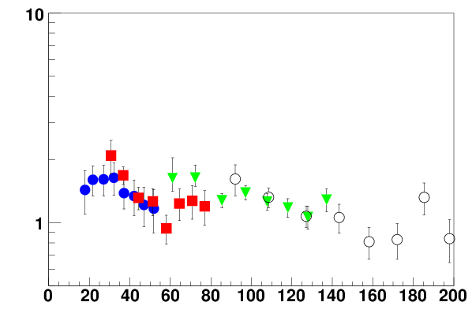
Beam Energy Dependence : Si
400 MeV
600 MeV
log scale π⁻/π⁺
Fitting : C*X^{-α}
log scale π⁻/π⁺
800 MeV
slope α:
400 : (4.5±0.5)×10⁻¹
600 : (3.2±0.5)×10⁻¹
800 : (2.0±0.5)×10⁻¹
● 45deg
■ 60deg
▼ 90deg
○ 120deg
log scale π⁻/π⁺
Slopes depend on Beam Energy
E_{rapπ} (MeV)
Notes:
This is the mid rapidity frame.
Horizontal axis is pion kinematic energy in mid rapidity frame and vertical axis is pion ratio in log scale.
I put the every angle data by beam energy.
circle is 45deg data, square is 60deg, triangle is 90deg, and open triangle is 120deg.
We can see some dependence in beam energy.
Slope of data point is decrease with beam energy
When we fit the data with exponential function.
we got the slope parameter like this
When we compare between 400 and 800 MeV data,
slope parameter is twice as high.
We think that the ratio at high energy is almost one and then the ratio at low energy is different between three data.

Slide 25
If we are lucky, we are going to measure pions from ^{129,132,136}Xe on CsI reactions at 400 MeV/u in FY2011.
Ｐｌｅａｓｅ come back ｆｏｒ Ｍｒ． Ｓａｋｏ‘ｓ ｔａｌｋ
Ｔｈａｎｋ ｙｏｕ

Slide 26
Members of Collaboration
RCNP E248 Collaboration
Kyoto University
J. Zenihiro, Y. Iwao,
H. Sakaguchi, S. Terashima,
Y. Yasuda, M. Yosoi
Research Center for Nuclear Physics
M. Itoh, M. Uchida, H.P. Yoshida
HIMAC P226 Collaboration
Kyoto University
M. Sako, S. Ebesu, Y. Ichikawa, S. Imajo,
R. Sameshima
Rikkyo University
K. Ieki, Y. Ikeda, H.
Kawamura, M. Matsushita, J. Murata, M. Nitta, T. Toyoda
RIKEN Nishina Center
Y. Nakai, S. Nishimura
NIRS
E. Takada,

