Slide 1
Constraining the properties of dense matter
William Lynch, Michigan State University
What is the EOS? ⇒
0. Relationship to energy and to nuclear masses ⇒
1. Important questions⇒
B. What observables are sensitive to the EOS and at what densities?
0. Astrophysical observables (neutron stars) ⇒
1. Binding energies ⇒
2. Radii of neutron and proton matter in nuclei ⇒
3. “Pigmy” and giant resonances ⇒
4. Particle flow and particle production: symmetric EOS ⇒
5. Particle flow and particle production: symmetry energy ⇒
C Summary ⇒
Notes:
This is my outline that lists the topics I will try to cover. I will return to it periodically as the talk progresses

Slide 2
The EoS
The EoS at finite temperature:
  Suppose you want the pressure (P) in nuclear matter as a function of density (ρ), temperature (T) and asymmetry
Zero temperature (appropriate for neutron stars)
Practical approach is to calculate ε(ρ,0,δ) theoretically by some density functional approach (e.g. Hartree Fock), by a variational calculation
or to constrain it experimentally
or both.
energy/nucleon
entropy/nucleon
Notes:
The equation of state is an equation relating thermodynamic properties. It tells how the medium response to mechanical changes and to changes in temperature or chemical composition. We have all encountered equations of state. The ideal gas law pv=nrt is a good example. If our goal were to describe the pressure of a nuclear system, we start with an expression for the Helmholtz free energy as our equation of state. THen pressure is obtained by ... go through it.
For neutron stars, temperature is effectively zero. Except near a phase transition, the temperature dependence may be simpler that the volume or density dependence becasue the latter depends on PE.

Slide 3
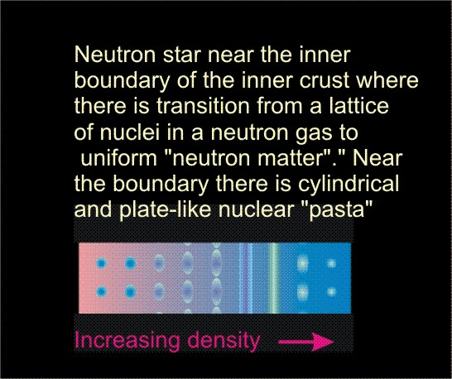
More about the EoS
Some facts about the EoS may be useful:
At saturation density, S_{int}(ρ)≈0.6S(ρ).
S_{int}(ρ) is the uncertain contribution to S(ρ).
A homogenous EoS is approximate in the vicinity of phase transition.
Matter outside the shock wave in type II supernovae and to the inner crust of a neutron star, is a mixed phase of nuclei in a more dilute gas.
There, Coulomb forces introduce long range order (solid phase).
The EoS for homogeneous matter can be in a input to the properties of such systems, not the entire story.
O
Notes:
Nonrelativistically, the kinetic energy dependents to the 2/3 on the density. To a good approximation, the dependence of the symmetry enrgy on asymmetry is quadraditc Then the symmetry energy is deltz^2 times the symmetry energy for neurton matter, whic is defined to be e_nm-Esm. From the difference of neutron and proton fermi energies, we can get a kinetic energy contribution to the Fermi energy. The PE contribution is the uncertain one.
Up till now, we have been discussion a symmetry mean field. This is not going to be accurate when the LGPT is relevant and the is a coexistance between dens and dllute matter. There, the symmetry energy of homogenous matter is an input to a more dteailed calculation of the phases themselves.

Slide 4
Relationship to nuclear masses and binding energies
B_{A,Z} = a_{v}[1-b₁((N-Z)/A)²]A - a_{s}[1-b₂((N-Z)/A)²]A^{2/3} - a_{c} Z²/A^{1/3} + δ_{A,Z}A^{-1/2} + C_{d}Z²/A,
In the local density approximation: -B_{A,Z} =A⋅<E/A>_{over nucleus}= A⋅<ε(ρ,0,δ>_{over nucleus}
Fits of the liquid drop binding energy formula experimental masses can provide values for a_{v}, a_{s}, a_{c}, b₁, b₂, C_{d} and δ_{A},_{Z}.
Relationship to EOS
  a_{v} ≈ -ε(ρ_{s},0,0); a_{v}b₁≈-S(ρ_{s})
  a_{s} and a_{s}b₂ provide information about the density dependence of ε(ρ_{s},0,0) and S(ρ_{s}) at subsaturation densities ρ ≈ 1/2ρ_{s} . (See Danielewicz, Nucl. Phys. A 727 (2003) 233.)
  The various parameters are correlated. Coulomb and symmetry energy terms are strongly correlated. Shell effects make masses differ from LDM.
    One can largely remove Coulomb effects by comparing g.s. and isobaric analog states in the same nucleus (Danielewicz and Lee Int.J.Mod.Phys.E18:892,2009 )
⇒Provides a useful initial constraint on the EoS.
O
Notes:
This have been a little abstract. Let’s make it more concrete. For example, the EOS has some direct connections to nuclei and their masses. Mainly this concerns the saturatin density and binding energy. Point out the terms that are relevant. Also indicate that the surface energy is typically like the symmetry energy at half density

Slide 5
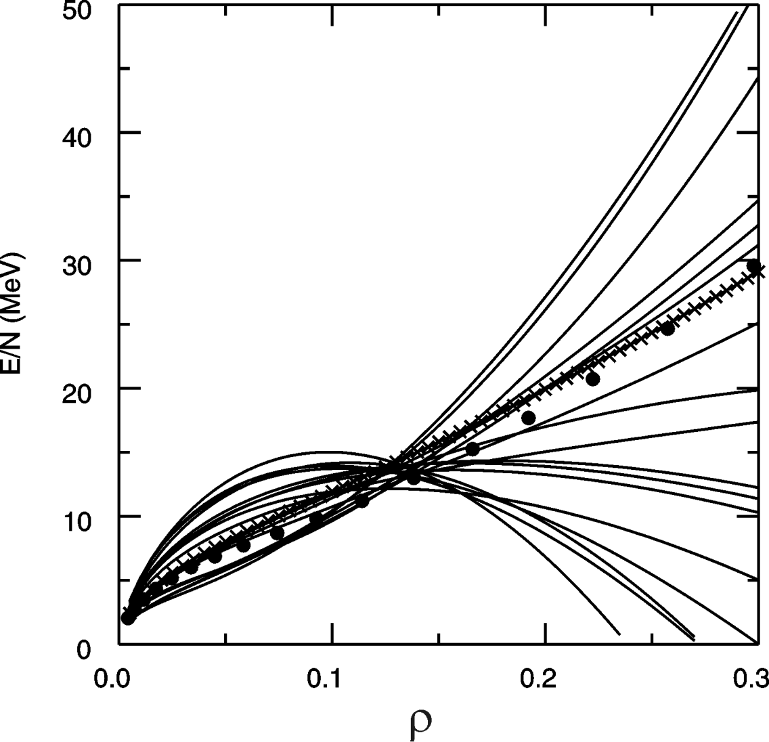
EOS: What are the questions?
B_{A,Z} = a_{v}[1-b₁((N-Z)/A)²]A - a_{s}[1-b₂((N-Z)/A)²]A^{2/3} - a_{c} Z²/A^{1/3} + δ_{A,Z}A^{-1/2} + C_{d}Z²/A,
δ=0
neutron matter
δ=1
ρ₀
Brown, Phys. Rev. Lett. 85, 5296 (2001)
O
E/A (ρ,δ) = E/A (ρ,0) + δ²⋅S(ρ)
δ = (ρ_{n}- ρ_{p})/ (ρ_{n}+ ρ_{p}) = (N-Z)/A
Nuclear effective interactions do not constrain neutron matter,
Main uncertainty is the density dependence of the symmetry energy
Notes:
Today we will be discussing the EOS and in particular its isospin dependence
If we express the EOS as an energy functional, we can isolate the isospin dependence of the EOS by decomposing it into symmetric matter EOS and a symmetry energy term that depends quandratically on the asymmetry.
The symmetric matter EoS describes how the bulk term of the liquid drop mass formulae depends on density.
The symmetry energy describes how the symmetry energy of the liquid drop mass formulae depends on density
The symmetric matter EOS has minimum at saturation density. The curvature about the minimum dictates the monopole resonance energy.
The symmetric matter EOS is a selection of different models for the density dependence..
The Symmetry energy are predictions using 2 and 3 body forces
The symmetry energy does not have a stable minimum that we know of, is increasing at saturation density
Both are uncertain away from saturation density, with the largest uncertainty at high density.
.

Slide 6
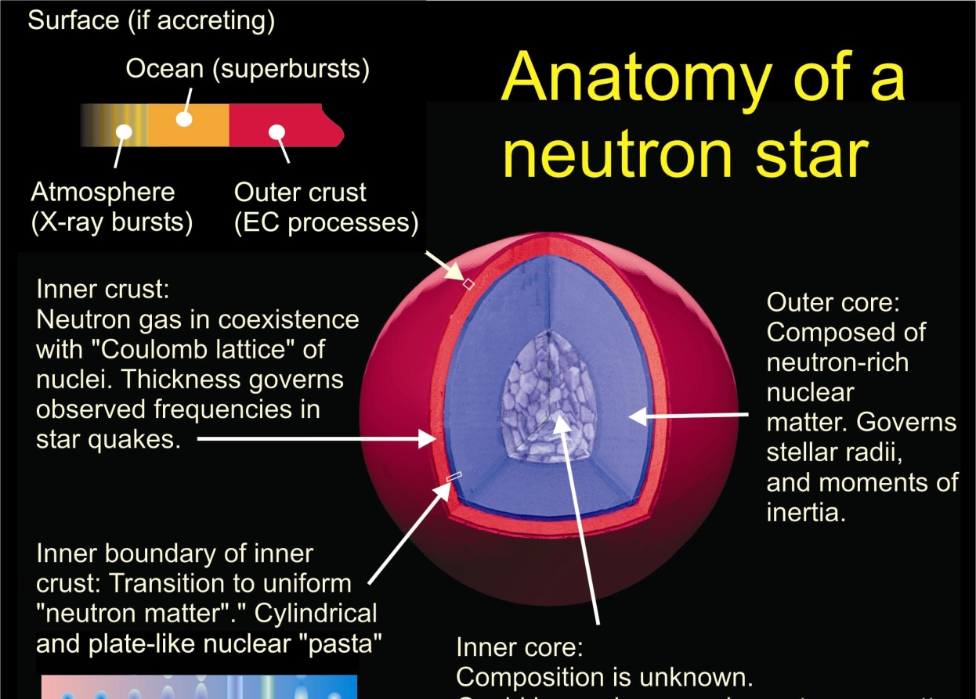
EOS, Symmetry Energy and Neutron Stars
Influences neutron Star stability against gravitational collapse
Stellar density profile
Internal structure: occurrence of various phases.
Observational consequences:
  Cooling rates of proto-neutron stars and
  Temperatures and luminosities of X-ray bursters .
  Stellar masses, radii and moments of inertia.
    Can be studied by X-ray observers.
O
Currently , scientists are working to constrain EoS with data on X-ray bursts and low mass X-ray binaries.
R vs. M relationship reflects EoS over a range of densities
It is important to obtain complementary laboratory constraints at specific densities.
Notes:
The EOS is an interesting interdisciplinary topic
There is a strong sensitivity of neutron star observables to the EOS and, in particular, to the symmetry energy. These are: read them.
Thus, it is important to constrain the symmetry energy if one desires to predict these observables. This issue has become much more interesting recently because of the data from X-ray observatories that have been put into Earth orbit. Observers like to turn the around and try to use the observations to constrain the EOS.
Mention Bob Rutledge at McGill, Ozel, Andrew Steiner,
Mention the ISO
Mention other short term approaches. and the need for laboratory measurements.

Slide 7
Comparisons of <r²>_{n}^{1/2} and <r²>_{p}^{1/2}
²⁰⁸Pb
softer
stiffer
Approximating the density profile by a Fermi function ρ(r)=ρ₀/(1+exp(r-R)/a), we show representative proton and neutron distributions for ²⁰⁸Pb.
Calculations predict that a stiff symmetry energy will result in a larger neutron skin.
Why?
  The symmetry pressure repels neutrons and attracts protons. The pressure is larger if S(ρ) is strongly density dependent.
Relation between skin thickness and EoS can be somewhat model dependent
Brown, Phys. Rev. Lett. 85, 5296 (2001)
P_{neut. matt.} (MeV/fm³)
(at ρ=0.1 fm⁻³ )

Slide 8
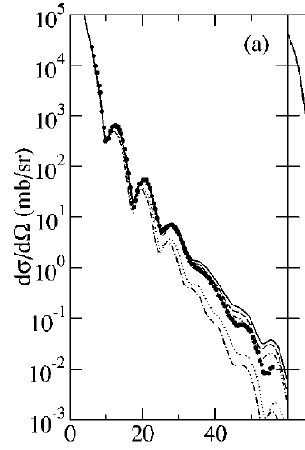
Measurements of radii
Parity violating electron scattering may provide strong constraints on <r_{n}²>^{1/2}- <r_{p}²>^{1/2} and on S(ρ) for ρ< ρ_{s}. Expected uncertainties were of order 0.06 fm. (see Horowitz et al., Phys. Rev. 63, 025501(2001).)
Nuclear charge and matter radii can be measured by diffractive scattering.
For example, <r_{p}²>^{1/2} has been measured stable nuclei, by electron scattering to about 0.02 fm accuracy.
  (see G. Fricke et al., At. Data Nucl. Data Tables 60, 177 (1995).)
Strong interaction shifts in the 4f→3d transition in pionic ²⁰⁸Pb also provide sensitivity to the rms neutron radius. (Garcia-Recio, NPA 547 (1992) 473)
  <r_{n}²>^{1/2} = 5.74±.07_{ran} ±.03_{sys} fm
  <r_{n}²>^{1/2}- <r_{p}²>^{1/2} = 0.22 ±.07_{ran} ±.03_{sys} fm
Proton elastic scattering is sensitive to the neutron density. (see the talk by T. Murakami.)
Karataglidis et al., PRC 65 044306 (2002)
²⁰⁸Pb(p,p)
E_{p} =200 MeV
<r_{n}²>^{1/2}=5.6 fm
<r_{n}²>^{1/2}=5.7 fm
O
θ_{cm} (deg)

Slide 9
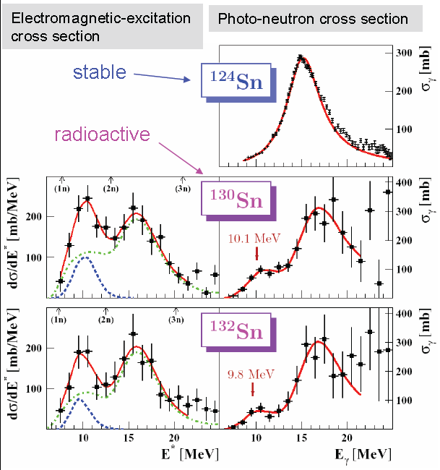
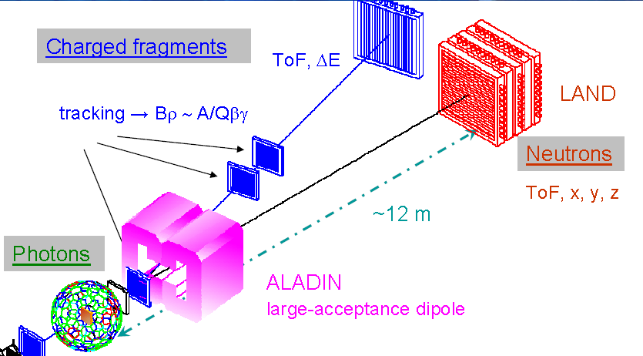
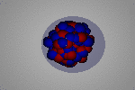
PDR: Electric dipole excitations of the neutron skin
P. Adrich et al., PRL 95 (2005) 132501
Coulomb excitation of very neutron rich ^{130,132}Sn isotopes reveals a peak at E*≈10 MeV.
  not present for stable isotopes
Consistent with low-lying electric dipole strength.
calculations suggest an oscillation of a neutron skin relative to the core.
Notes:
instead will discuss what happens when you have the neutron skin and it gets excited, but before I talk specifically about skin in the point now that you can excite a nucleus with a coulomb force because the coulomb force accelerates oh pounds but not the neutrons. In most nuclei when the coulomb excitation occurs quickly as in I velocity collision youth site the giant dipole resonance neutrons off against protons from the nucleus but when there isn’t skin bound weakly to the core you can ask late but at the differenti.e. lower frequency. you can see this happening in the extremely neutron rich tan isotopes. Where there is a second peek at low energies in addition to the giant dipole at higher energies. This is the measured and the probability of excitation term

Slide 10
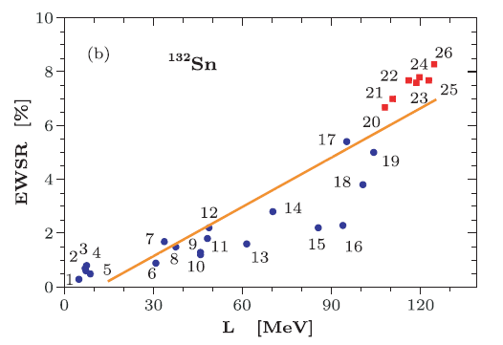
Relation to symmetry energy
A. Klimkiewicz, et al., PRC76, 051603(R) (2007)
A. Carbone,et al., PRC 81, 041301(R) (2010)
% TRK energy weighted sum rule
Data
Random phase approximation (RPA) calculations show a strong correlation between the neutron -proton radius difference and the fractional strength in the pygmy dipole resonance.
Random phase approximation (RPA) calculations show a strong correlation between the fractional strength and the symmetry pressure
Notes:
theoretically, the probability of excitation is for Portugal to the size of the neutron skin that shown on the left hand side probability of excitation on the one y-axis on the x-axis skin. You can quantify that probably the excitation by the fraction of the energy waited dipole some rule which is basically the energy weighting of the matrix element is the dipole operator consistent with the data dipole resonance is a matrix on the skin by the dipole operator from the cross-section to determine the matrix only for the dipole operator and you can do it each excitation energy and weight that with excitation energy somewhere between about one in 4/2% of the dipole strength in the energy waited some rule is coming from the pygmy dipole the surface of theoretically you can calculate how that depends on the density dependence of symmetry energy in the simplest and sequence is driven so you see that the this depends on the true the symmetry energy as a constrained. later in such relish this constraint compares with others

Slide 11
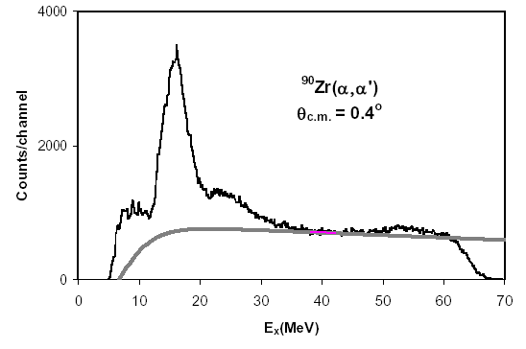
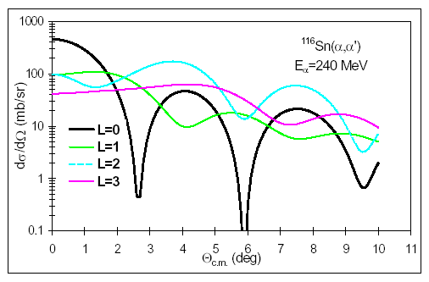
Giant resonances
Imagine a macroscopic, i.e. classical vibration of the matter in the nucleus.
  e.g. Isoscaler Giant Monopole (GMR) resonance
GMR and also ISGDR provide information about the curvature of ε(ρ,0,0) about minimum.
Inelastic α particle scattering e.g. ⁹⁰Zr(α,α′ )⁹⁰Zr* can excite the GMR. (see Youngblood et al., PRL 92, 691 (1999). )
  Peak is strongest at 0°
range of motion
ρ (fm⁻³)
Notes:
first we discuss small vareiations indensity.. Around rho0, the eos is quadratic. In the adiabatic limit the eos can be regarded as a pontential energy, the nucleonic motions are fast compared to the collective vibration. THE MONopole is less that a30 % density variation inmost nuclei. This collective vibration shows up at 17-18 MeV zr and at lower energies in heavier nuclei if you look at 0 degress.

Slide 12
Giant resonances 2
Of course, nuclei have surfaces, etc. This motivates a "leptodermous" expansion (see Harakeh and van der Woude, “Giant Resonances” Oxford Science...) :
  K_{sym} is a function of the first and second derivatives of the symmetry energy (G. Colo, et al., Phys. Rev. C70, 024307 (2004).)
  Measurements of GMR resonance energies over a range of isotopes can provide information the first and second derivatives of the symmetry energy as a function of density! (Actually, the first derivative is more important)
    Value of K_{sym}=500±100 MeV has been reported by T. Liet.al, PRC 81, 034309 (2010) from analysis of (α,α’) on stable Sn isotopes.
O
Notes:
but a nucleus has a surface and there is the coulomb interaction in the symmetry interaction so the monopole resonance energy is changed by that reflecting that you can do what is called sometimes let the Germans expansion matures contributing to the incompressibility coming from the surface coulomb symmetry the sixth terms probably the most interesting one of symmetry energy term and the Coelho has shown that the symmetry energy term is related to the first and second derivatives of the symmetry energy of the two first produced the most important

Slide 13
Constraints on the symmetric matter EoS from laboratory measurements
The symmetric matter EoS strongly limits what you probe with nuclei
  If the EoS is expanded in a Taylor series about ρ₀, the incompressibility, K_{nm} provides the term proportional to (ρ-ρ₀)². Higher order terms influence the EoS at sub-saturation and supra-saturation densities.
  The solid black, dashed brown and dashed blue EoS’s all have K_{nm}=300 MeV → the difference between these EoS'.
Nuclear properties are mainly sensitive to the EoS at 0.5ρ₀≤ ρ≤1/25ρ₀
To probe the EoS at 3ρ₀, you need to compress matter to 3ρ₀.

Slide 14
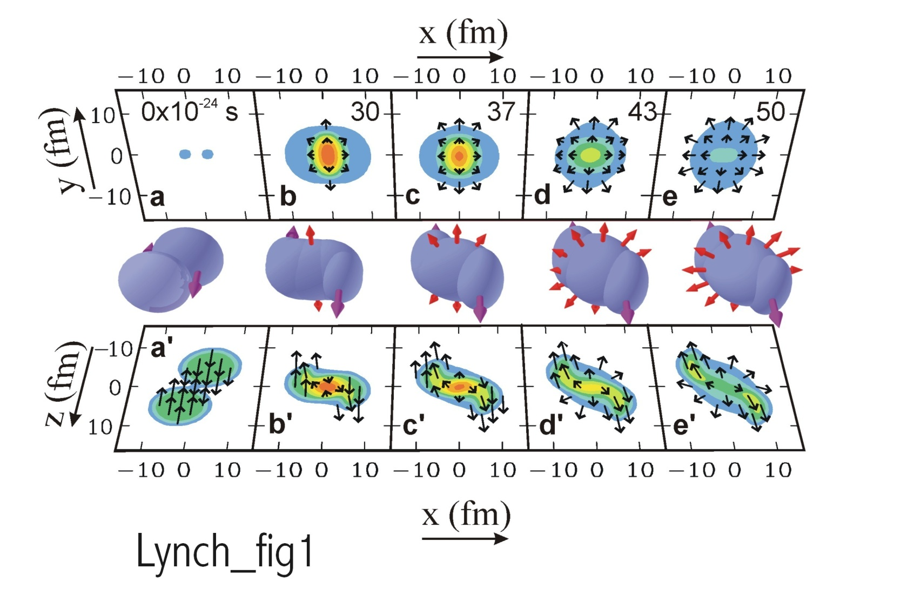
Constraining the EOS at high densities by laboratory collisions
Au+Au collisions E/A = 1 GeV)
pressure contours
density contours
Two observable consequences of the high pressures that are formed:
  Nucleons deflected sideways in the reaction plane.
  Nucleons are “squeezed out” above and below the reaction plane. .

Slide 15
Flow studies of the symmetric matter EOS
Theoretical tool: transport theory:
  Example Boltzmann-Uehling-Uhlenbeck eq. (Bertsch Phys. Rep. 160, 189 (1988).) has derivation from TDHF:
    f is the Wigner transform of the one-body density matrix
    semi-classically, = (number of nucleons/d³rd³p at ).
    BUU can describe nucleon flows, the nucleation of weakly bound light particles and the production of nucleon resonances.
  The most accurately predicted observables are those that can be calculated from i.e. flows and other average properties of the events.

Slide 16
Procedure to study EOS using transport theory
Measure collisions
Simulate collisions with BUU or other transport theory
Identify observables that are sensitive to EOS (see Danielewicz et al., Science 298,1592 (2002). for flow observables)
  Directed transverse flow (in-plane)
  “Elliptical flow” out of plane, e.g. “squeeze-out”
  Kaon production. (Schmah, PRC C 71, 064907 (2005))
  Isospin diffusion
  Neutron vs. proton emission and flow.
  Pion production.
Find the mean field(s) that describes the data. If more than one mean field describes the data, resolve the ambiguity with additional data.
Constrain the effective masses and in-medium cross sections by additional data.
Use the mean field potentials to calculate the EOS.
symmetric matter EOS
symmetry energy
quick
detailed

Slide 17
Constraining the EOS at high densities by laboratory collisions
Au+Au collisions E/A = 1 GeV)
pressure contours
density contours
quick
Two observable consequences of the high pressures that are formed:
  Nucleons deflected sideways in the reaction plane.
  Nucleons are “squeezed out” above and below the reaction plane. .

Slide 18
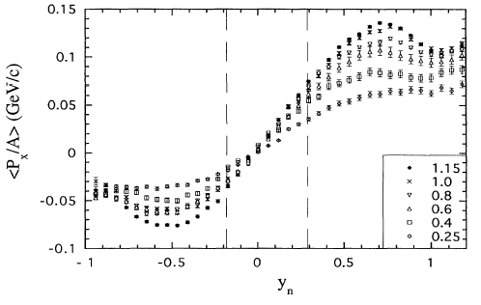
Directed transverse flow
Partlan, PRL 75, 2100 (1995).
target
Au+Au collisions
EOS TPC data
E_{beam}/A (GeV)
projectile
Event has “elliptical” shape in momentum space, with the long axis in the reaction plane ⊥
Analysis procedure:
  Select impact parameter.
  Find the reaction plane.
  Determine <p_{x}(y)> in this plane
  note:
y/y_{beam} (in C.M)
The data display the “s” shape characteristic of directed transverse flow.
  The TPC has in-efficiencies at y/y_{beam}< -0.2.
  Slope is determined at –0.2<y/y_{beam}<0.3

Slide 19
Determination of symmetric matter EOS from nucleus-nucleus collisions
Danielewicz et al., Science 298,1592 (2002).
  in plane
  out of plane
O
The curves labeled by K_{nm} represent calculations with parameterized Skyrme mean fields
  They are adjusted to find the pressure that replicates the observed transverse flow.
The boundaries represent the range of pressures obtained for the mean fields that reproduce the data.
They also reflect the uncertainties from the effective masses and in-medium cross sections.

Slide 20
Constraints from collective flow on EOS at ρ>2 ρ₀.
E/A (ρ, δ) = E/A (ρ,0) + δ²⋅S(ρ) δ = (ρ_{n}- ρ_{p})/ (ρ_{n}+ ρ_{p}) = (N-Z)/A≈1
Danielewicz et al.,
Science 298,1592 (2002).
Danielewicz et al.,
Science 298,1592 (2002).
O
Note: analysis required additional constraints on m* and σ_{NN}.
Flow confirms the softening of the EOS at high density.
Constraints from kaon production are consistent with the flow constraints and bridge gap to GMR constraints.
The symmetry energy dominates the uncertainty in the n-matter EOS.
Both laboratory and astronomical constraints on the density dependence of the symmetry energy are urgently needed.

Slide 21
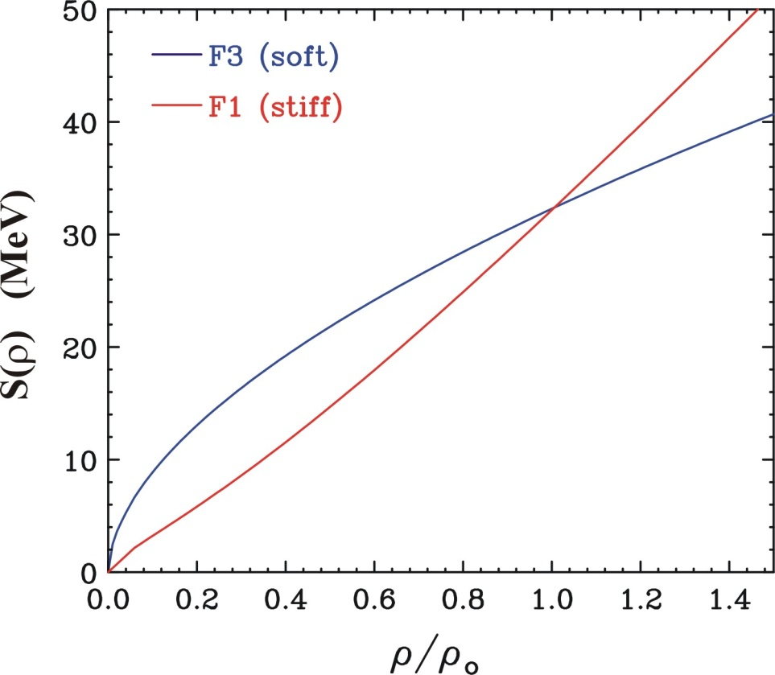
Probing the symmetry energy by nuclear collisions
E/A(ρ,δ) = E/A(ρ,0) + δ²⋅S(ρ) ; δ = (ρ_{n}- ρ_{p})/ (ρ_{n}+ ρ_{p}) = (N-Z)/A
To maximize sensitivity, reduce systematic errors:
  Vary isospin of detected particle
  Vary isospin asymmetry δ=(N-Z)/A of reaction.
Low densities (ρ<ρ₀):
  Neutron/proton spectra and flows
  Isospin diffusion
  Isotope yields
High densities (ρ≈2ρ₀) :
  Neutron/proton spectra and flows
  π⁺ vs. π⁻ production
symmetry energy

Slide 22
Probe: Isospin diffusion in peripheral collisions
{
Collide projectiles and targets of differing isospin asymmetry
Probe the asymmetry δ=(N-Z)/(N+Z) of the projectile spectator during the collision.
The use of the isospin transport ratio R_{i}(δ) isolates the diffusion effects:
Useful limits for R_{i} for ¹²⁴Sn+¹¹²Sn collisions:
  R_{i} =±1: no diffusion
  R_{i} ≈0: Isospin equilibrium
mixed ¹²⁴Sn+¹¹²Sn
n-rich ¹²⁴Sn+¹²⁴Sn
p-rich ¹¹²Sn+¹¹²Sn
Systems
Example:
measure asymmetry after collision
proton-rich target
P
δ
N
neutron-rich projectile

Slide 23
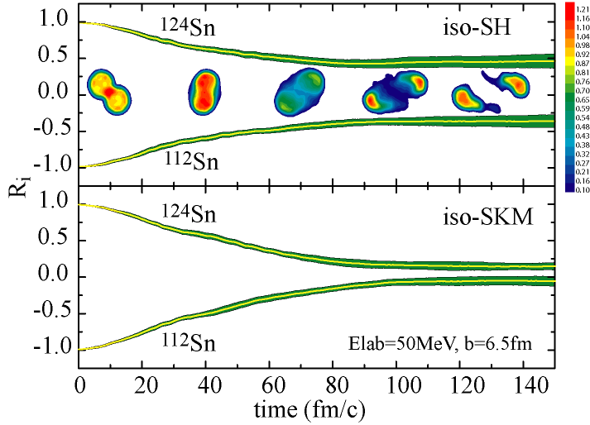
Sensitivity to symmetry energy
The asymmetry of the spectators can change due to diffusion, but it also can changed due to pre-equilibrium emission.
The use of the isospin transport ratio R_{i}(δ) isolates the diffusion effects:
Stronger density dependence
Sensitive to S(ρ) at ρ≈1/2ρ₀
Weaker density dependence
Lijun Shi, thesis (2003)
See also the talk of Dan Coupland
Tsang et al., PRL92(2004)

Slide 24
Experimental measurements of isospin diffusion
Experimental device:
Miniball with LASSA array
Experiment:
^{112,124}Sn+^{112,124}Sn, E/A =50 MeV
Projectile and target nucleons are largely “spectators” during these peripheral collisions.
  Projectile residue have somewhat less than beam velocity.
  Target residues have very small velocities.

Slide 25
Probing the asymmetry of the Spectators
The main effect of changing the asymmetry of the projectile spectator remnant is to shift the isotopic distributions of the products of its decay
This can be described by the isoscaling parameters α and β:
Liu et al.PRC 76, 034603 (2007).
Tsang et. al.,PRL 92, 062701 (2004)
no diffusion
α

Slide 26
Determining R_{i}(δ)
In statistical theory, certain observables depend linearly on δ=(ρ_{n}-ρ_{p})/ρ:
Calculations confirm this
We have experimentally confirmed this
In equilibrium statistical theory α=(μ_{n,2}-μ_{n,2})/t
These chemical potentials reflect the both the asymmetry and the symmetry energy in the system.
  This sensitivity has been explored by Yennello and collaborators to probe the symmetry energy.
  It has little or no impact on isospin diffusion, however.
Consider the ratio R_{i}(X), where X = α, X₇ or some other observable:
If X depends linearly on δ₂:
Then by direct substitution:

Slide 27
Probing the asymmetry of the Spectators
The main effect of changing the asymmetry of the projectile spectator remnant is to shift the isotopic distributions of the products of its decay
This can be described by the isoscaling parameters α and β:
Liu et al.PRC 76, 034603 (2007).
Tsang et. al.,PRL 92, 062701 (2004)
1.0
0.33
R_{i}(δ)
-0.33
-1.0

Slide 28
Quantitative values
Reactions:
  ¹²⁴Sn+¹¹²Sn: diffusion
  ¹²⁴Sn+¹²⁴Sn: neutron-rich limit
  ¹¹²Sn+¹¹²Sn: proton-rich limit
Exchanging the target and projectile allowed the full rapidity dependence to be measured.
Gates were set on the values for R_{i}(α) near beam rapidity.
  R_{i}(α) ≈ 0.47±0.05 for ¹²⁴Sn+¹¹²Sn
  R_{i}(α) ≈ -0.44 ±0.05 for ¹¹²Sn+¹²⁴Sn
Obtained similar values for R_{i}(ln(Y(⁷Li)/ Y(⁷Be))
  Allows exploration of dependence on rapidity and transverse momentum.
Liu et al., (2006)
Liu et al.PRC 76, 034603 (2007).
≈ v⏐⏐/v_{beam}

Slide 29
Comparison to QMD calculations
IQMD calculations were performed for γ_{i}=0.35-2.0, S_{int}=17.6 MeV.
Momentum dependent mean fields with m_{n}*/m_{n} =m_{p}*/m_{p} =0.7 were used. Symmetry energies: S(ρ) ≈ 12.3·(ρ/ρ₀)^{2/3} + 17.6· (ρ/ρ₀) ^{γi}
Tsang et al, PRL. 102, 122701 (2009)
Experiment samples a range of impact parameters
  b≈5.8-7.2 fm.
  larger b, smaller γ_{i}
  smaller b, larger γ_{i}
mirror nuclei
Go to constraints

Slide 30
Diffusion is sensitive to S(0.4ρ), which corresponds to a contour in the (S₀, L) plane.
Tsang et al., PRL 102, 122701 (2009).
GDR: Trippa,
PRC77, 061304
Danielewicz, Lee,
NPA 818, 36 (2009)
fits to IAS
masses
ImQMD
CONSTRAINTS
PDR: Carbone et al, PRC 81,
041301 (2010) ;
A. Klimkiewicz,
PRC 76, 051603 (2007).
Sn neutron skin thickness:
Chen et al., PRC C 82, 024321 (2010)
fits to
Expansion around ρ₀:
Symmetry slope L & curvature K_{sym}
Symmetry pressure P_{sym}
Notes:
Even though we do not have as full an understanding of the model dependencies of these observables as we would like, it is nevertheless interesting to see what the present data could imply about the symmetry energy and how such constraints might compare to those obtained from nuclear structure. It is important to understand something that I did not have time to show. We have explored the sensitivity of these observables to density and we know that they basically constrains the symmetry energy at about 0.4-0.5 saturation density. If we do taylor expansion about saturation density, we basically need two terms to get the S and L. So these data can constrain L, given S. The previous constraints assumed S-30 that is this verital line here. If you assume, S-31.= then you get the constraints from BUU published by Bao-an. If you let S free, you get the bounded region. If you contrain S to be consistent with PDR results, which is a reasonable range then you get the color region in S vs L or the bound region in the inset for S vs Rho. Discuss the other constraint. Giant monopole results can’t be easily plotted on this graph, but the constraints from that are compatible with these constraints.

Slide 31
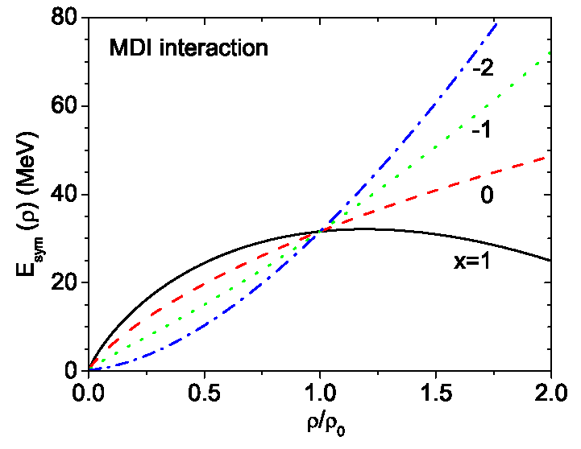
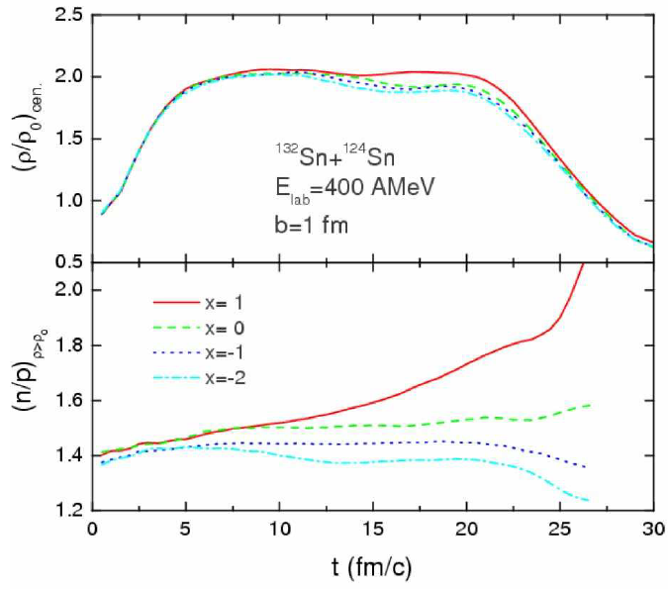
Asymmetry term studies at ρ≈2ρ₀
(Unique contribution from collisions investigations)
Densities of ρ≈2ρ₀ can be achieved at E/A ≈400 MeV.
  Provides information about direct URCA cooling in proto-neutron stars, stability and phase transitions of dense neutron star interior.
Densities of ρ≈2ρ₀ can be achieved at E/A ≈400 MeV.
  Provides information about neutron star radii, direct Urca cooling in proto-neutron stars, stability and phase transitions of dense neutron star interior.
S(ρ) influences diffusion of neutrons from dense overlap region at b=0.
  Diffusion is greater in neutron-rich dense region is formed for stiffer S(ρ).
Yong et al., Phys. Rev. C 73, 034603 (2006)

Slide 32
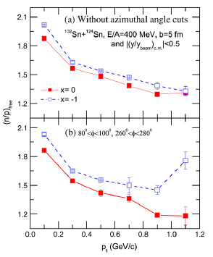
Comparisons of neutron and proton observables :
Most models predict the differences between neutron and proton flows and t and ³He flows to be sensitive to the symmetry energy and the n and p effective mass difference.
In this prediction, the ratio of neutron over proton spectra out of the reaction plane displays a significant sensitivity the symmetry energy.
Comparisons of elliptical flow of neutrons and protons have been recently published for Au+Au collisions at 400 MeV/u by P. Russotto et al., PLB 697 (2011) 471–476. See talk by Lemmon.
B.-A. Li et al., Phys. Rep. 464 (2008) 113.
soft
soft
Such measurements have been done recently at GSI:
  P. Russotto et al.
Notes:
Shifting gears, we turn to the discussion of the EOS.
Some progress has been made in obtaining constraints on the EOS for symmetric matter from measurements of collective flow at LBL and BNL and from kaon production at SIS. The bounded region shows the pressure density relationship for zero temperature matter predicted using mean field potentials whose density and momentum dependence has been constrained by these experiments. We can exclude some theoretical model such as NL3. At high density, the dependence is softer than quadratic dependence extracted from the monopole resonance.
The right side shows the pressure predict for neutron matter assume the left pane for symmetic matter and adding the pressure from the symmetry energy: pink for a stiff symmetry energy and cross hatched for a soft symmetry energy.
Such uncertainties in the neutron matter EOS have a strong effect on the mass radius relationship for neutron stars, the phases within the star and the proto-neutron star’s cooling rate after type II supernovae.

Slide 33
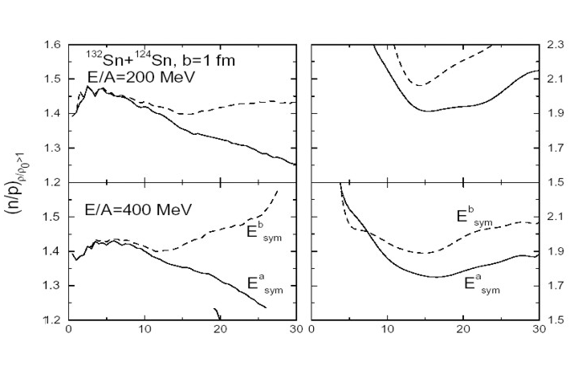
High density probe: pion production
Larger values for ρ_{n}/ ρ _{p} at high density for the soft asymmetry term (x=0) causes stronger emission of negative pions for the soft asymmetry term (x=0) than for the stiff one (x=-1).
π⁻ / π⁺ means Y( π⁻)/Y( π⁺)
  In delta resonance model, Y( π⁻)/Y( π⁺)≈(ρ_{n,}/ρ_{p})²
  In equilibrium,
  μ(π⁺)-μ(π⁻)=2( μ_{p}-μ_{n})
The density dependence of the asymmetry term changes ratio by about 10% for neutron rich system.
Li et al., arXiv:nucl-th/0312026 (2003).
soft
soft
stiff
stiff
π⁻ / π+
t (fm/c)
Investigations are planned with stable or rare isotope beams at the MSU and RIKEN.
  Sensitivity to S(ρ) occurs primarily near threshold in A+A

Slide 34
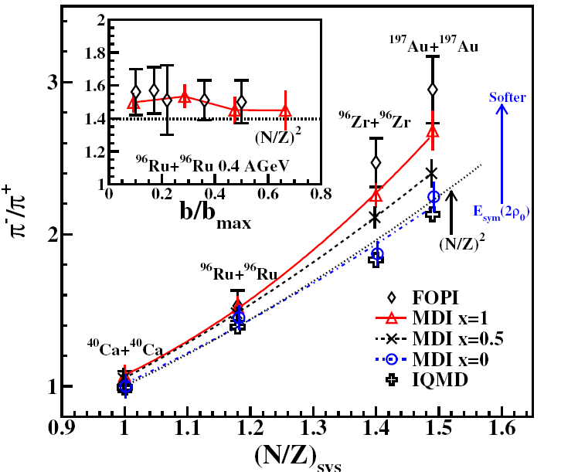
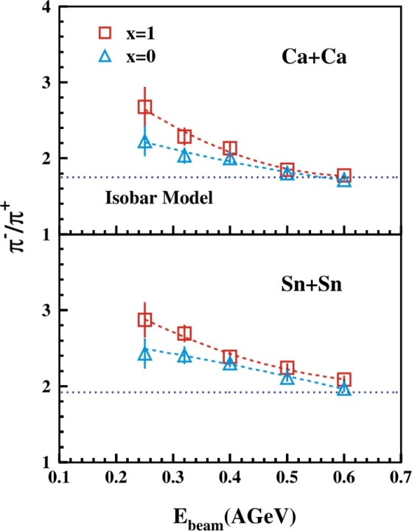
Choice of beams for pion ratios
Xiao, et al., arXiv:0808.0186 (2008)
Reisdorf, et al., NPA 781 (2007) 459.
Zhang et al., arXiv:0904.0447v2 (2009)
Sensitivity to symmetry energy is larger for neutron-rich beams
Sensitivity increases with decreasing incident energy.
Data have been measured for Au+Au collisions.
It would be interesting to measure with rare isotope beams such as ¹³²Sn and ¹⁰⁸Sn.
  Interesting comparison because the Coulomb interaction is the same for both to first order. Coulomb also strongly influences the pion ratios.
Notes:
Shifting gears, we turn to the discussion of the EOS.
Some progress has been made in obtaining constraints on the EOS for symmetric matter from measurements of collective flow at LBL and BNL and from kaon production at SIS. The bounded region shows the pressure density relationship for zero temperature matter predicted using mean field potentials whose density and momentum dependence has been constrained by these experiments. We can exclude some theoretical model such as NL3. At high density, the dependence is softer than quadratic dependence extracted from the monopole resonance.
The right side shows the pressure predict for neutron matter assume the left pane for symmetic matter and adding the pressure from the symmetry energy: pink for a stiff symmetry energy and cross hatched for a soft symmetry energy.
Such uncertainties in the neutron matter EOS have a strong effect on the mass radius relationship for neutron stars, the phases within the star and the proto-neutron star’s cooling rate after type II supernovae.

Slide 35
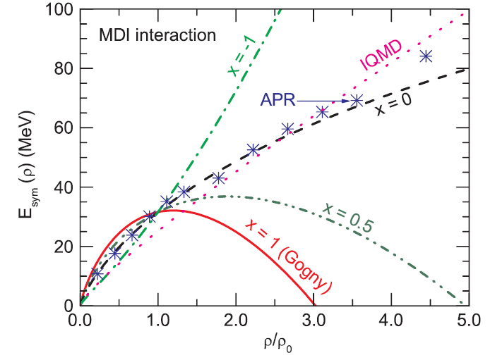
Analysis of Au+Au data at E/A=400 MeV suggest very weak density dependence at ρ>3ρ₀
Zhigang Xiao, et al, PRL, 102, 062502 (2009)
GSI
?
MSU
Isospin diffusion, n-p flow
Au+Au
Xiao, et al., arXiv:0808.0186 (2008)
Reisdorf, et al., NPA 781 (2007) 459.
Pion production

Slide 36
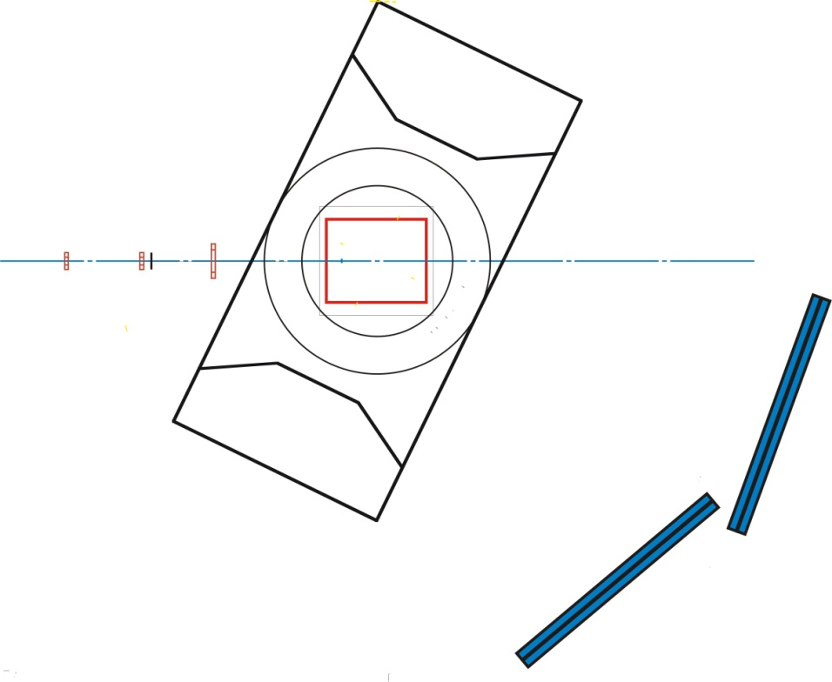
Device: SAMURAI TPC (U.S. Japan Collaboration)
T. Murakamiª, Jiro Murata^{b}, Kazuo Ieki^{b}, Hiroyoshi Sakurai^{c}, Shunji Nishimura^{c}, Atsushi Taketani^{c}, Yoichi Nakai^{c}, Betty Tsang^{d}, William Lynch^{d}, Abigail Bickley^{d}, Gary Westfall^{d}, Michael A. Famiano^{e}, Sherry Yennello^{g}, Roy Lemmon^{h}, Abdou Chbihi^{i}, John Frankland^{i}, Jean-Pierre Wieleczko^{i} , Giuseppe Verde^{j}, Angelo Pagano^{i}, Paulo Russotto^{i}, Z.Y. Sun^{k}, Wolfgang Trautmann^{l}
ªKyoto University, ^{b}Rikkyo University, ^{c}RIKEN, Japan, ^{d}NSCL Michigan State University, ^{e}Western Michigan University, ^{g}Texas A&M University, USA, ^{h}Daresbury Laboratory, ^{i}GANIL, France, UK, ^{j}LNS-INFN, Italy, ^{k}IMP, Lanzhou, China, ^{l}GSI, Germany
The SAMURAI TPC would be used to constrain the density dependence of the symmetry energy through measurements of:
  Pion production
  Flow, including neutron flow measurements with the nebula array.
The TPC also can serve as an active target both in the magnet or as a standalone device.
  Giant resonances.
  Asymmetry dependence of fission barriers, extrapolation to r-process.
TPC
SAMURAI dipole
Q
Nebula scintillators
Notes:
TO do these measurments we propo if you lost for larger editions of the symmetry energyse to put a TPC in the SAMURAI magnet
Read the slide, note the nebula detector

Slide 37
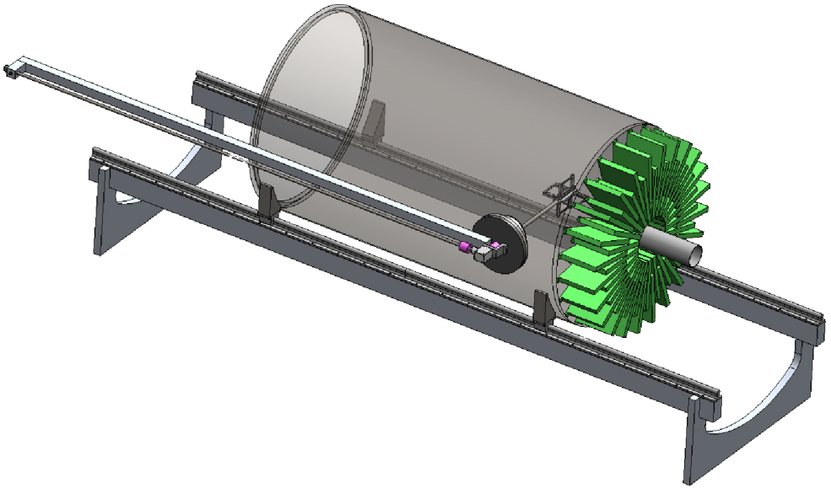
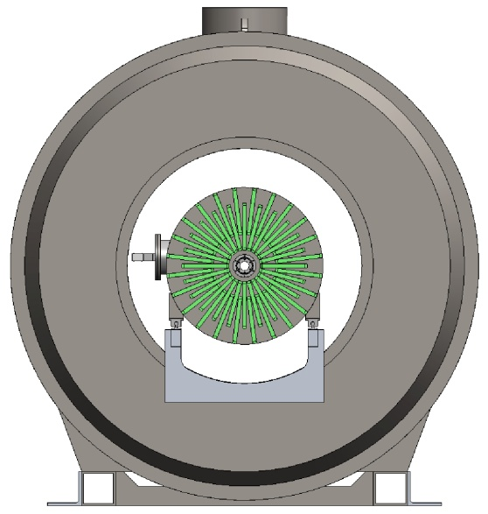
MSU:Active Target Time Projection Chamber
D Bazin, M. Famiano, U. Garg, M. Heffner, R. Kanungo, I. Y. Lee,
W.Lynch, W. Mittig, L. Phair, D Suzuki,G. Westfall
120 cm
Two alternate modes of operation
  Fixed Target Mode with target wheel inside chamber:
    4π tracking of charged particles allows full event characterization
    Scientific Program » Constrain Symmetry Energy at ρ>ρ₀
  Active Target Mode:
    Chamber gas acts as both detector and thick target (H₂, D₂, ³He, Ne, etc.) while retaining high resolution and efficiency
    Scientific Program » Transfer & Resonance measurements, Astrophysically relevant cross sections, Fusion, Fission Barriers, Giant Resonances
Notes:
we have also plans for doing measurements of pions at lower energies and you

Slide 38
Summary
The EOS describes the macroscopic response of nuclear matter and finite nuclei.
  Isoscalar giant resonances , kaon production and high energy flow measurements have placed constraints on the symmetric matter EOS, but the EOS at large isospin asymmetries is not well constrained.
The behavior at large isospin asymmetries is described by the symmetry energy.
  It influences many nuclear physics quantities:
    binding energies,
    neutron skin thicknesses, pigmy dipole , monopole and isovector giant resonances,
    isospin diffusion,
    proton vs. neutron emission and π⁻ vs. π⁺ emission
    neutron-proton correlations.
  Measurements of these quantities can constrain the symmetry energy.
Constraints on the symmetry energy and on the EOS will be improved by planned experiments. Some of the best ideas probably have not been discovered.
ε(ρ,0,δ) = ε(ρ,0,0) + δ²⋅S(ρ) ; δ = (ρ_{n}- ρ_{p})/ (ρ_{n}+ ρ_{p}) = (N-Z)/A

