Slide 1
Nuclear Symmetry Energy from QCD sum rules
Su Houng Lee
with Kie Sang Jeong
1. Few words on Nuclear Symmetry Energy
2. A QCD sum rule method
3. Preliminary results

Slide 2
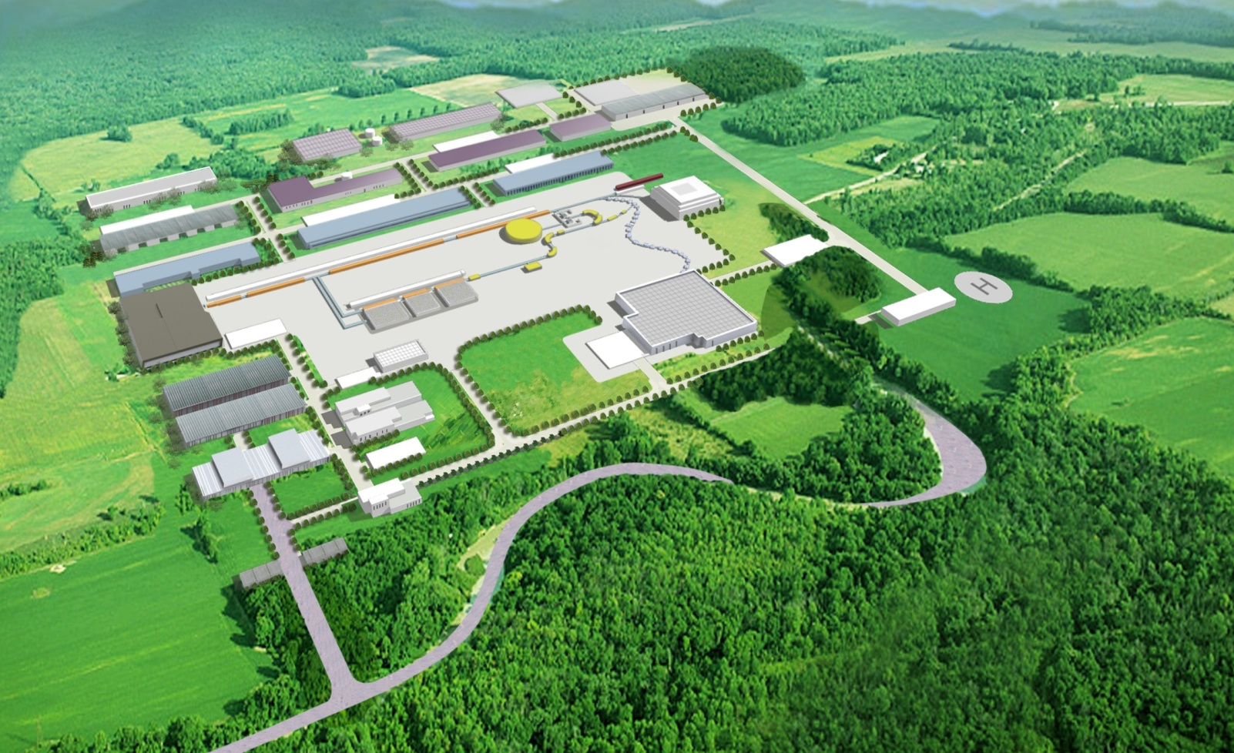
Korea Rare Isotope Accelerator (KoRIA) Talk by B. Hong

Slide 3
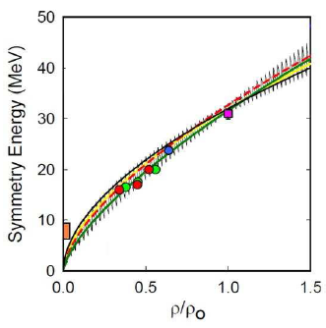
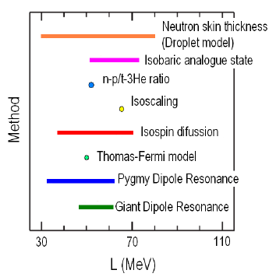
Nuclear Symmetry Energy
Shetty, Yennello, arXiv:1002.0313

Slide 4
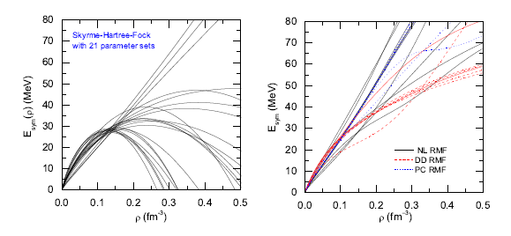
Nuclear Symmetry Energy
Li, Chen, Ko, Phys. Rep. 464, 113 (08)

Slide 5
1. Few words on symmetry energy

Slide 6
QCD Energy Momentum Tensor
Energy Density in asymmetric nuclear matter
Linear density approximation

Slide 7
Linear density approximation
E_{p}
E_{p}
p
n
nucleons in the vacuum
Nucleons in a background potential
E_{p}
E_{p}
p
n
nucleons in the asymmetric matter

Slide 8
Nucleon in Relativistic mean fields: (Di Toro et al)
Medium modification
Average potential
Symmetry Energy
Hadrons in nuclear medium from QCD
Nucleons in symmetric nuclear matter: Cohen, Griegel, Furnstahl (91) → consistent with a strong scalar attraction and vector repulsion
Vector meson in medium: Hatsuda and Lee (92) : 4 quark condensate are important

Slide 9
QCD sum rules for Nucleon
Large M²
Small M²
M²

Slide 10
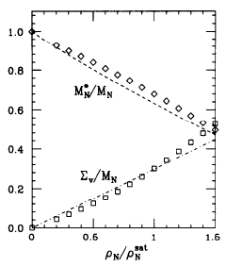
QCD sum rules for Nucleon in symmetric nuclear matter
Cohen, Griegel, Furnstahl 92

Slide 11
QCD sum rules for Nucleon asymmetric nuclear matter
K.S. Jeong, Lee 11

Slide 12
some detail
Expectation values

Slide 13
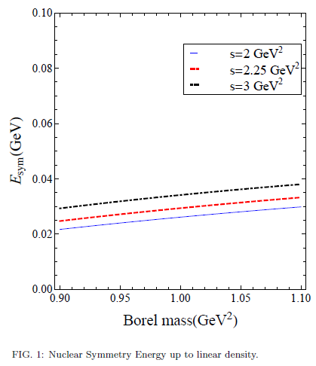
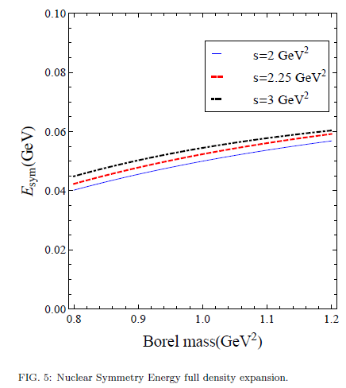
Results – Symmetry Energy

Slide 14
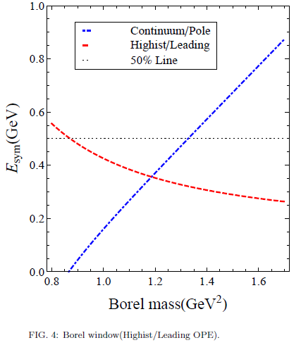
Results – Uncertainty

Slide 15
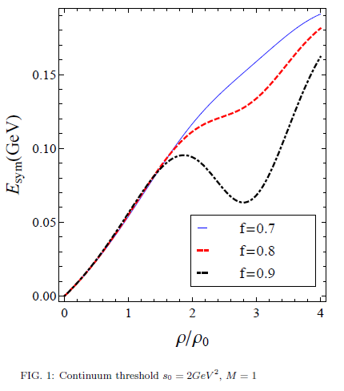
Results
Important operator

Slide 16
Operators in at finite density
Linear density approximation
Condensate at finite density

Slide 17
Summary
An attempt to get some insight of Symmetry energy from QCD
Vector densities are important
Higher dimensional operators are important at higher density

